Slide 1
HEALTHY CHILDREN HEALTHY COMMUNITIES
YMCA CHILDCARE RESOURCE SERVICE
Notes:
SAY: Welcome and thank you for being here this morning. Today’s workshop will focus on the changes to the Food Program which will nurture healthy children and healthy communities. Many of these changes are things you are already doing, like lowering sugar, increasing fruits and vegetables, and offering whole grains. Sometimes changes are overwhelming in part because we don’t know what’s going on, so I hope after we talk about the changes, you’ll find them easy for you to implement.
DO: Ask people to introduce themselves and how long they’ve been in child care business. Ask people to mix up groups according to experience and try to sit by people they don’t know well.

Slide 2
AGENDA
CHILD MEAL PATTERN
INFANT MEAL PATTERN
BEST PRACTICES
2
| PROFESSIONAL DEVELOMENT FOR HEALTHY EATING | ©2010 YMCA of the USA
Notes:
SAY: Today we’ll talk about three (3) things. [READ SLIDE] We’ll take a 10 minute break about an hour in.
If you haven’t signed in yet or picked up a binder, please do so (give location to sign in table). I hope you had a chance to grab breakfast or something to drink, if you haven’t please feel free to do so now. If you need to use the restroom, it’s (give location to restroom).
During your break or after the workshop, you can sign up for your first home visit at (give location to TA topic table).
DO: Point to TA topic table.
SAY: Please feel free to use the sticky notes, pens, and highlighters to highlight things you want to refer to after the workshop and please interrupt me if you have any questions.

Slide 3
OBJECTIVES
IDENTIFY THREE CHANGES TO THE UPDATED MEAL PATTERN.
CACFP Updates start October 1, 2017
IDENTIFY REIMBURSABLE FOODS FOR THE NEW MEAL PATTERN.
3
| PROFESSIONAL DEVELOMENT FOR HEALTHY EATING | ©2010 YMCA of the USA
Notes:
SAY: We have two learning objectives for today.
DO: Read slide.

Slide 4
OVERVIEW
4
| PROFESSIONAL DEVELOMENT FOR HEALTHY EATING | ©2010 YMCA of the USA
Notes:
SAY: We’ll start off by looking at the big picture.

Slide 5
OVERVIEW – WHY?
I LOVE YOU FROM MY HEAD
TO-MA-TOES
Notes:
SAY: Why is CACFP making these changes? There has been a shift in our diets. Now our diets are high in added sugars, saturated fat and sodium. 75% of Americans diets are low in vegetables, fruit and dairy. And 1 in 3 children are overweight or obese.
The Healthy Hunger Free Kids Act of 2010 instructed the USDA to better align the CACFP meal patterns with the Dietary Guidelines for Americans. This is the first major change since the program started in 1968! That’s almost 50 years ago!
We won’t get into the science behind the changes, but if you are interested in learning more, that will be a home visit option that you can request. Basically the changes came from science from the National Academy of Medicine and the Dietary Guidelines for Americans with consideration of cost and input from providers and sponsors. Ultimately though the changes are happening because we want the best for our children and our communities. We love love our children from my head to-ma-toes.

Slide 6
OVERVIEW – BIG PICTURE
Greater variety of vegetables and fruits
More whole grains
More protein options
Less added sugar and fat
Notes:
SAY: There are several changes, but the general idea is to offer a [review slide].

Slide 7
OVERVIEW
Notes:
SAY: Now we’ll go over the first page in your binder, the red one, which lists the changes made to the child meal patterns.
DO: Ask for volunteers to read first 3 sections.
SAY: I’ll go ahead and read the “Age Appropriate Meals” and “Less Added Sugar” section.
DO: Flip page over and encourage providers to review “previous” vs “updated columns.”
SAY: Under breakfast we see two changes. MMA may substitute the grains component up to 3 times per week and grains will be measured in ounce equivalents, but that won’t take effect until October 2019. Under lunch, supper, and snack we see there is now a separate f & v component.

Slide 8
GREATER VARIETY OF VEGETABLES & FRUIT
8
| PROFESSIONAL DEVELOMENT FOR HEALTHY EATING | ©2010 YMCA of the USA
Notes:
SAY: Now that we’ve seen an overview of the changes, lets look at the details, starting with f&v.

Slide 9
VEGETABLES & FRUIT – WHY?
Why the change?
Less than 10% of 4-8 year olds eat enough vegetables
3-5 year old lunch
Chicken Rice ¼ cup apples ¼ cup strawberries Milk | Chicken Rice ¼ cup apples ¼ cup peas Milk
Notes:
SAY: The majority of our kids are eating enough fruits and that’s great! Though as you see on the screen, less than 10% of 4 – 8 year olds are eating enough veggies. Let’s think about a “typical” day at childcare and the meals you serve.
ASK: Do you ever serve vegetables at breakfast? [Typically fruit is served.] Now think about lunch. Do you ever serve two vegetables at lunch? [It’s great to hear many of you do serve two vegetables! Sometimes some providers serve two fruits at lunch.]
SAY: Now think about snack. While some of you serve a fruit or vegetables at snack, it is more common that neither are served. If you serve a fruit at breakfast, two fruits at lunch and no fruit or vegetable at snack. A child can go the entire day and NEVER be served a vegetable! By separating vegetables and fruit component, at least one vegetable is now required at lunch/dinner.
(CLICK) Here is a example of what that might look like. The first column with 2 fruits will no longer be reimbursable. We can swap out strawberries for peas and now it’s a reimbursable meal! (CLICK)

Slide 10
VEGETABLES & FRUIT – MEALS
Can serve 2 different vegetables at lunch or dinner
3-5 Year Old Lunch
Chicken Rice ½ cup broccoli Milk | Chicken Rice ¼ cup broccoli ¼ cup carrots Milk
Notes:
SAY: Providers also have the option to serve two vegetables at lunch or dinner. When two vegetables are served at lunch or supper they must be two different vegetables. (CLICK)
In the first column we see that broccoli is served and counted as both vegetables. This is not a reimbursable meal, but in the second column broccoli AND carrots are served and this IS okay. (CLICK) Even if you were to serve roasted broccoli with steamed broccoli, it would still need to be two different types of veggies.

Slide 11
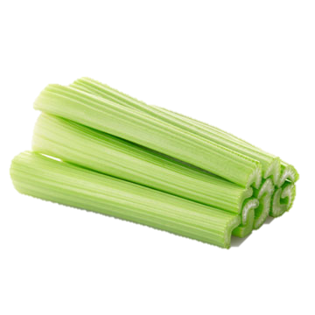
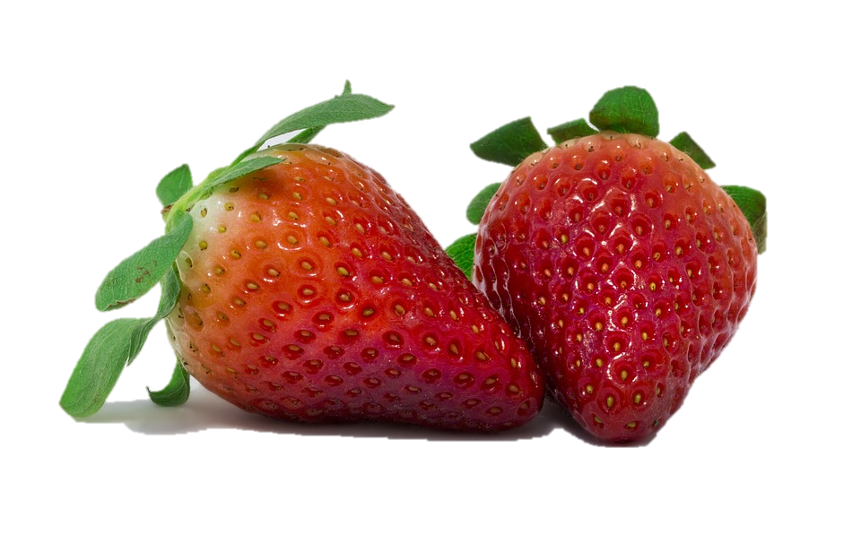
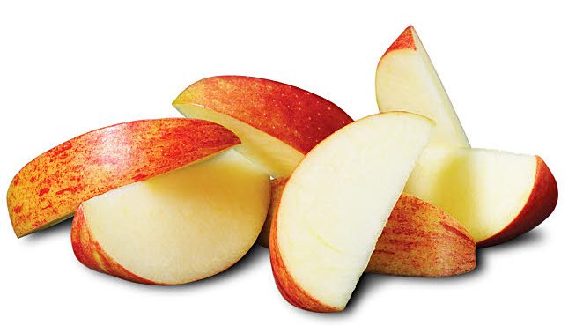
VEGETABLES & FRUIT – SNACKS
Can serve a fruit AND vegetable as snacks!
Super Snacks Starting October 1st
Notes:
SAY: An added benefit of separating the fruit and vegetable component is that Starting October 1 both a fruit and a vegetable can be a reimbursable snack! (CLICK) Here are some ideas for super snacks.

Slide 12
VEGETABLES & FRUITS
Oh thanks! I’ve turned over a new leaf.
You’re looking great.
Notes:
SAY: The eating habits that we are instilling in our children will stay with them for the rest of their lives. You might have a child who does not like veggies now, but after lots of exposure and lots of patience they might “turn over a new leaf.”
**Personal Anecdote (Insert personal anecdotes where appropriate): My husband grew up eating healthy and so he enjoys eating at home more than eating out. So if we eat out, it’s a downgrade from him.**

Slide 13
VEGETABLES & FRUIT – WHAT?
What counts as a vegetable?
Tomato
Avocado
Peppers
Choose
MyPlate.gov
Cucumber
Pumpkin
Butternut Squash
Notes:
ASK: We’ve been talking about increasing vegetables. What counts as a vegetable?
You can visit Choose myplate.gov for a complete list as to what is considered a vegetable or fruit.
SAY: Another way to consider this is to ask yourself, “Can I add it to a fruit salad?”
ASK: Would I add a tomato to a fruit salad?
SAY: Probably not so we will consider a tomato a vegetable.
ASK: How about adding an avocado to a fruit salad?
SAY: Again, traditionally not, so we will also consider this a vegetable. A fun fact is, all of the produce listed on this slide is actually a fruit, but counts as a vegetable.

Slide 14
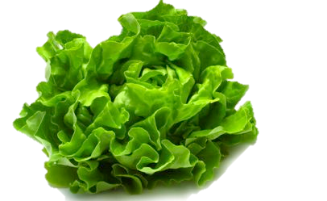
VEGETABLES & FRUIT – MEASUREMENTS
=
Leafy Greens
1 cup = ½ cup
Dried Fruit
¼ cup = ½ cup
Notes:
SAY: As a reminder ½ of a cup of fruit or vegetable counts as (CLICK) a ½ cup serving.
There are two changes. (CLICK) Now 1 cup of leafy greens counts as a ½ cup serving because of the space in between the leaves.
(CLICK) And ¼ cup of dried fruit counts as ½ cup serving of fruit. It’s unrealistic to ask a 1 year old to eat ½ a cup of raisins.

Slide 15
VEGETABLES & FRUIT – JUICE
Fruit or vegetable juice is limited to 1x per day
Juice must be:
100% fruit or vegetable juice
Full strength (not diluted)
Notes:
DO: Point to screen.
SAY: Fruit or vegetable juice is limited to 1x/day. 100% juice can be part of a healthy diet however it lacks dietary fiber that is found in whole fruit. Children 1 to 3 years old consume the highest amount of juice compared to whole fruits. The new meal patterns limit fruit or vegetable juice to one time per day for all children older than one year. Juice can only be served one time per day based on the meal served not on the children in attendance. For example, if juice is served at breakfast it cannot be also claimed at afternoon snack with a different set of kids.
(CLICK) When juice is served it must be 100% fruit or vegetable and full strength.

Slide 16
MORE WHOLE GRAINS
16
| PROFESSIONAL DEVELOMENT FOR HEALTHY EATING | ©2010 YMCA of the USA
Notes:
ASK: What questions do you have about the vegetable and fruit changes before we more on?
SAY: Now lets move on to the grains component.

Slide 17
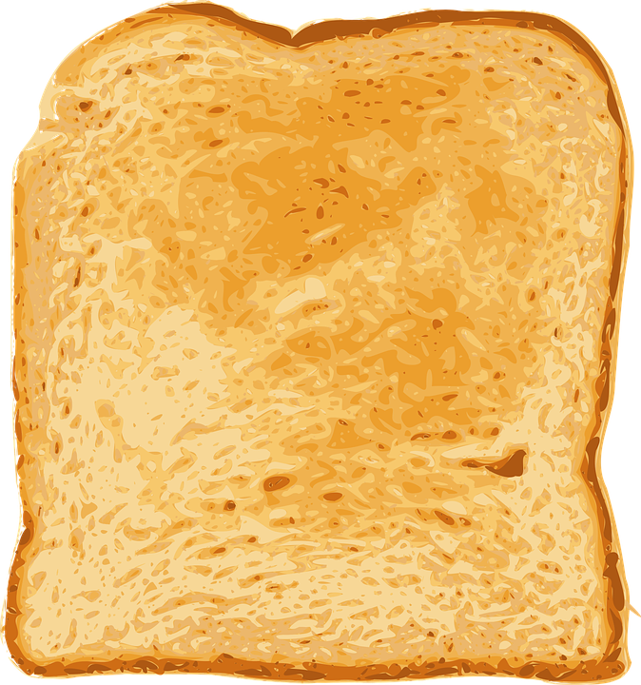
WHOLE GRAINS – WHY?
Recommended
whole grain intake =
Average
whole grain intake =
Average
refined grain intake =
Notes:
SAY: The Dietary Guidelines recommend that half of our total grains be whole grains. The recommended amount of whole grains for a child is 3 servings.
(CLICK) The average whole grain intake for a child though is ½ of a serving per day.
(CLICK) And the average refined grain intake for children is 5 servings.
Whole grains provide more vitamins, minerals, fiber, and makes us feel fuller longer. (CLICK)

Slide 18
WHOLE GRAINS
At least one serving of grains per day must be whole grain-rich.
Whole Grain Rich Definition:
50% of the grains must be whole grains and the remaining grains must be enriched.
Notes:
SAY: As a result, now at least one serving of grains per day must be whole grain-rich. With the CACFP updates, kids are now more likely to get at least one whole grain-rich serving per day.
SAY: So at least one grain a day has to be whole grain rich. What does that mean? (CLICK) The definition of a whole grain rich product is: 50% of the grains must be whole grains and the remaining grains must be enriched. When you’re documenting your meals, remember to specify “brown rice” or “whole wheat bread” to get credit for them.

Slide 19
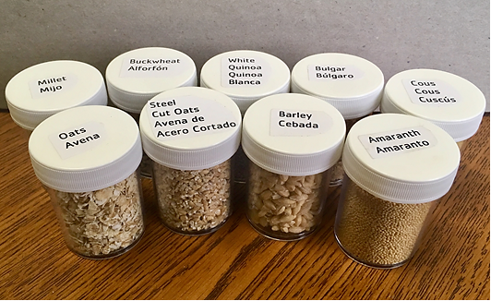
WHOLE GRAINS – SAMPLES!
Notes:
SAY: We have some whole grain samples up here if you'd like to look at them. These are products that are always considered whole grain rich, so you don’t have to look at the ingredients label. There’s a sheet next to them that tells you their taste, texture, price, protein content, and other notes. So be sure to check them out during your break or after the workshop.

Slide 20
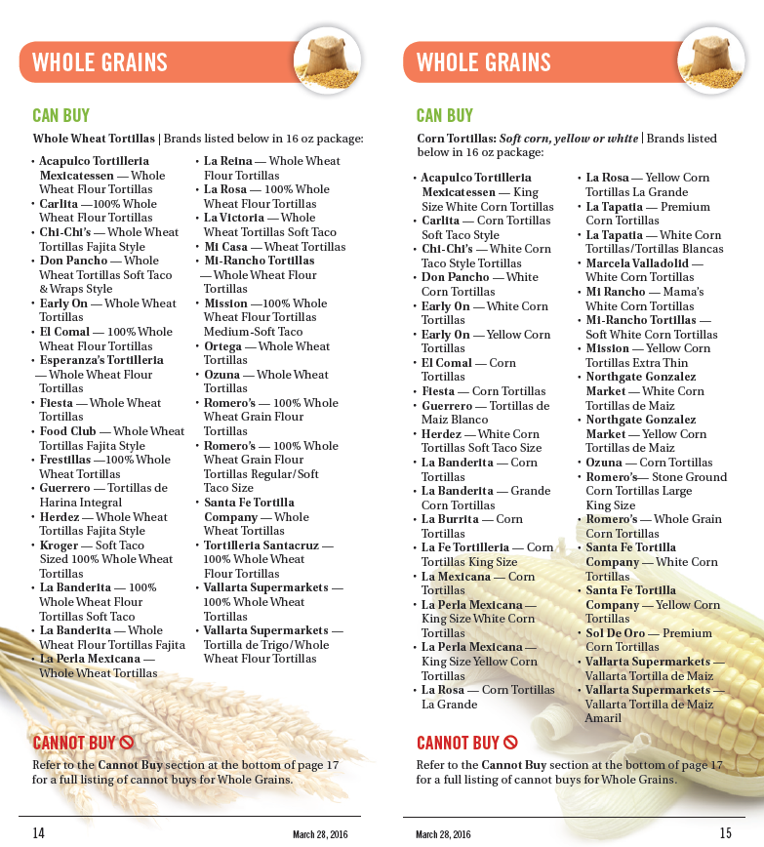
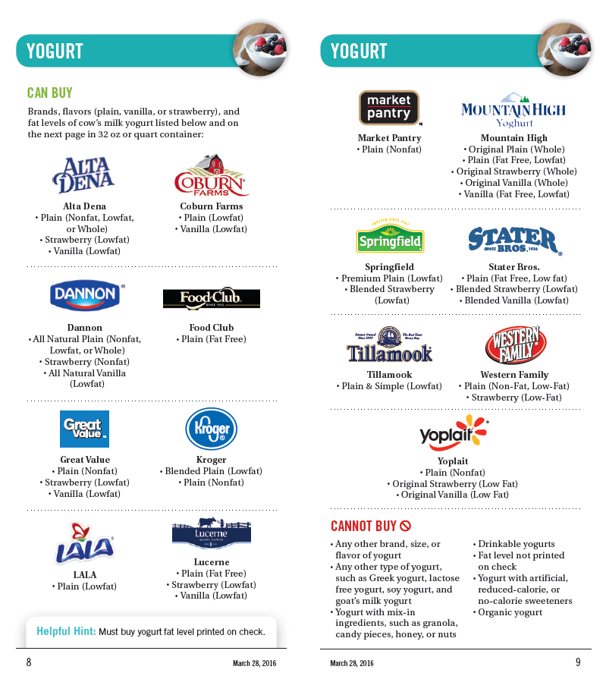
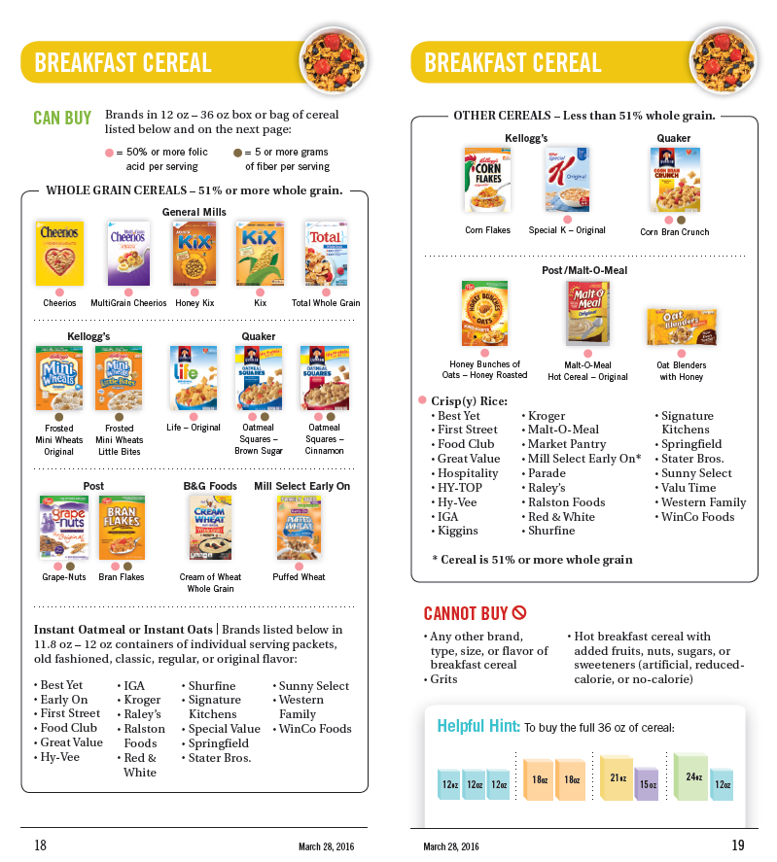
WHOLE GRAINS – WIC
Notes:
SAY: We will talk about two ways to figure out if a grain product is whole-grain rich. The first way is the easiest and my favorite.
DO: Hold up WIC shopping guide. Ask providers to pull it out of their binders. Model opening it to pages 13 – 17.
SAY: If it is a WIC approved grain, it is reimbursable and counts towards your whole-grain rich requirement. Many stores label their products with the WIC logo so it’s really nice! You don’t even have to pull out your shopping guide.
(CLICK) This is what the WIC logo looks like. Aside from using your WIC Shopping Guide to figure out if a grain product is whole grain-rich(CLICK), you can use it to identify reimbursable yogurts (CLICK) and cereals (CLICK).

Slide 21
WHOLE GRAINS – LABEL READING
Tips:
Any non-whole grain rich grains must include the word “enriched”
Ex: Enriched wheat flour
Ignore the word wheat gluten
It is not a grain, so we don’t have to look at it.
Ignore bran and germ
Unless one of these is the first ingredient, in which case the product is not a grain product
Ignore everything listed as less than 2% of the product
Notes:
SAY: Let’s look at the second way to identify a whole grain rich product—label reading. Here are a few tips. These tips are also located on your “Identifying Whole Grain Rich” handout. Go ahead and turn to that page because we’ll be using it in a moment.
DO: Hold up the handout. Once everyone has the sheet out, read slide.

Slide 22
WHOLE GRAINS – LABEL READING
Notes:
SAY: We’ll try label reading together. Using your handout, let’s see if this product is whole grain rich.
Find the ingredients list on the label. (CLICK)
Ignore anything after “Contains 2% or less” (CLICK)
Look at the first ingredient. (CLICK) In this case it is Whole wheat flour. When we look at our handout, we can see this is a whole grain ingredient.
(CLICK) Now we’ll review the remaining products which are water, sugar and yeast. Since none of these are grains, we can determine that this product is whole grain-rich.

Slide 23
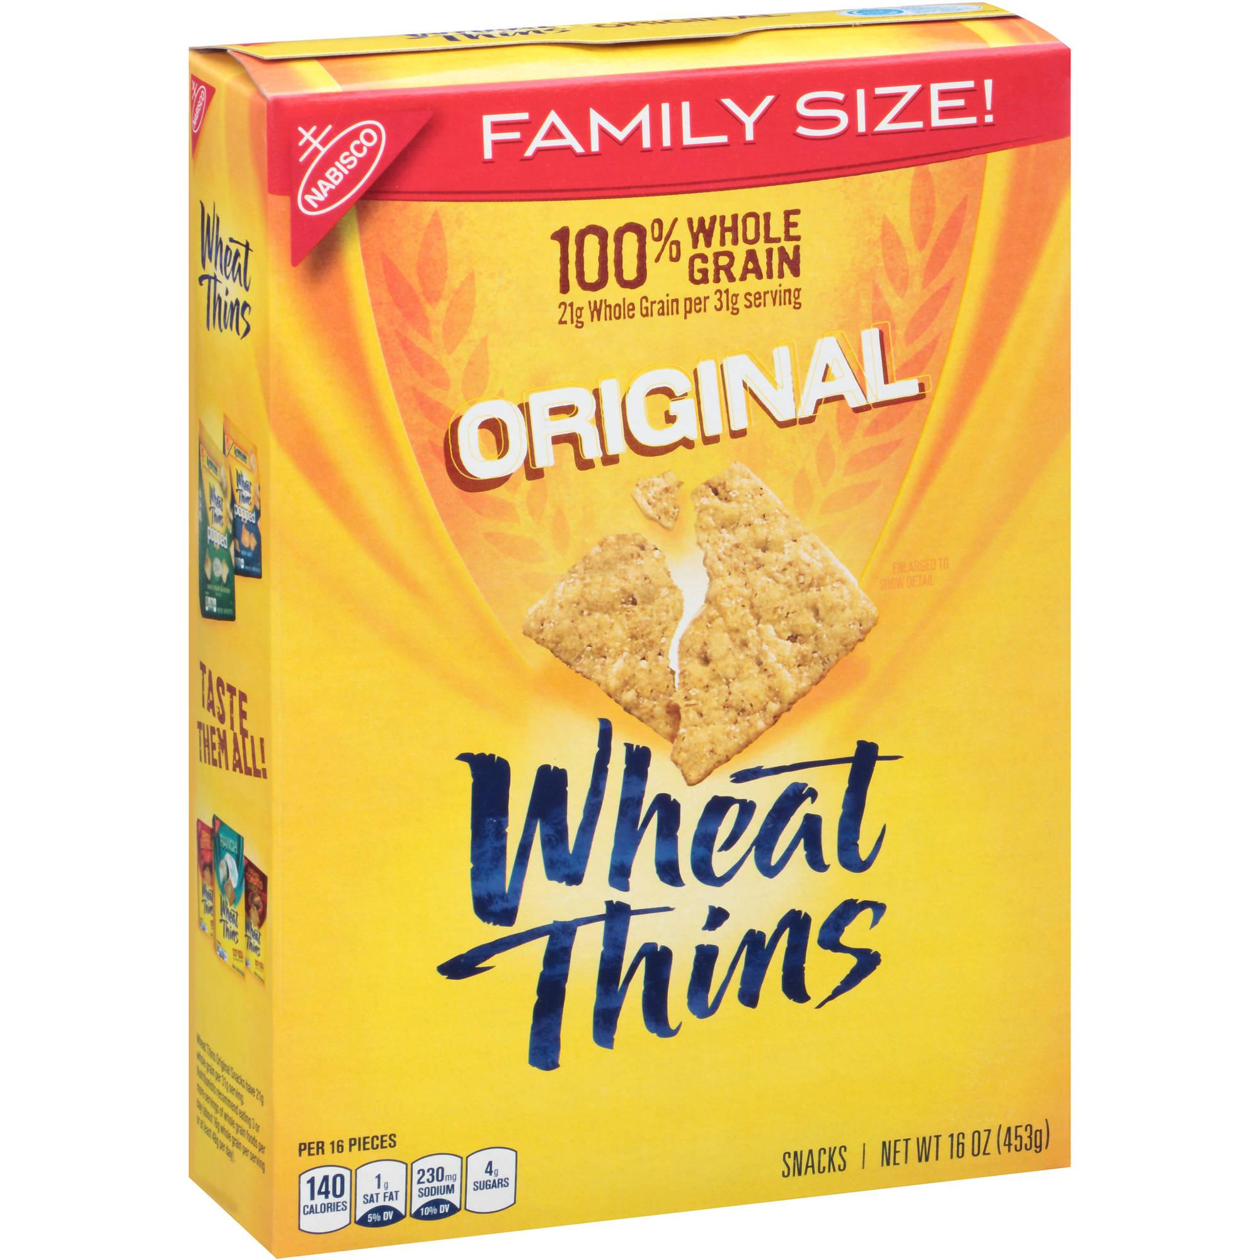
WHOLE GRAINS – PRACTICE
Ingredients:
Whole Grain Wheat Flour, Soybean Oil, Sugar, Cornstarch, Malt Syrup (from Corn and Barley), Salt, Invert Sugar, Leavening (Calcium Phosphate and/or Baking Soda), Vegetable Color (Annatto Extract, Turmeric Oleoresin). BHT added to packaging material to preserve freshness.
****Contains: Wheat.****
Notes:
SAY: Now we’ll practice identifying whole grain rich products with our table groups. Remember to refer back to your whole grains handout. We’ll take about 5 minutes to do this.
DO: Bring the group back together.
ASK: What did you get for the Wheat Thins? Is it whole-grain rich?
(ANSWER: YES)

Slide 24
WHOLE GRAINS – PRACTICE
Ritz Whole Wheat Crackers
Ingredients:
Unbleached Enriched Flour (Wheat Flour, Niacin, Reduced Iron, Thiamine Mononitrate [Vitamin B1], Riboflavin [Vitamin B2], Folic Acid), Whole Grain Wheat Flour, Soybean Oil, Sugar, Partially Hydrogenated Cottonseed Oil, Leavening (Calcium Phosphate and/or Baking Soda), Salt, High Fructose Corn Syrup, Soy Lecithin.
Notes:
ASK: How about the Whole Wheat Ritz Crackers?
DO: Collect responses.
(ANSWER: NO)
Even though these crackers aren’t whole grain rich, you can still serve them and they are still reimbursable on the Food Program. They just won’t count toward the requirement of at least one whole grain-rich product per day.

Slide 25
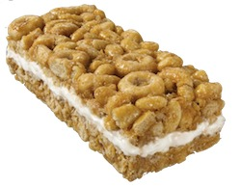
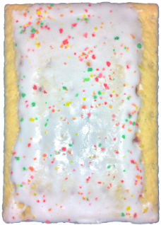
WHOLE GRAINS – DESSERTS
What is a grain-based dessert?
Cakes/ Cookies/ Pies/Fruit Turnovers/ Brownies
Doughnuts/ Sweet Rolls
Toaster Pastries/ Granola Bars/ Cereal Bars
Notes:
SAY: We talked about whole grain rich, now we're going to talk about grain based desserts. (CLICK) READ x 4.
What are all these high in? [Wait for response.] Sugar. Sugar stimulates the reward center in our brain. When we eat lots of sugar at a time and do it often, the brain becomes desensitized to the sugar. That makes us need more sugar (or stimulation) to have the same effect.
Added sugar consumption is extremely high in children. Recent research has found that high amounts of sugar affect our brain like drugs and can make us sugar addicts who experience tolerance and withdrawal.
The National Academy of Medicine and the Dietary Guidelines identified grain-based desserts as a source of added sugars and saturated fats. So…(CLICK)

Slide 26
WHOLE GRAINS – DESSERTS
Grain-based desserts are no longer reimbursable for
any meal or snack
Can they still be served?
Yes (Extra Only)
Notes:
SAY: Grain-based desserts are no longer reimbursable for any meals or snacks. Of course it’s unrealistic to completely avoid these foods and it is also important to teach children “balance” so….(CLICK) Can they still be served? (CLICK) Yes - as an extra only. If a provider chooses to serve any of these items for special occasions they will be considered an extra that is not reimbursable. The next handout in your binder is a list of grain based desserts that will no longer be reimbursable and on the back side a list of healthier reimbursable options you can substitute.
ADDITIONAL:
Muffins, quick breads, pancakes, French toast and waffles ARE still reimbursable.
However, keep in mind that the New Meal Pattern changes are designed with nutrition education in mind. We want children to be able to see and understand what they are eating.
What might a child perceive a muffin with frosting to be? (Cupcake) While a cupcake on occasion is a special treat, a muffin with frosting does not do a great job of helping to teach a child balanced nutrition.

Slide 27
MORE PROTEIN OPTIONS
27
| PROFESSIONAL DEVELOMENT FOR HEALTHY EATING | ©2010 YMCA of the USA
Notes:
SAY: What questions do you have about Whole Grains before we move on to Protein Options?

Slide 28
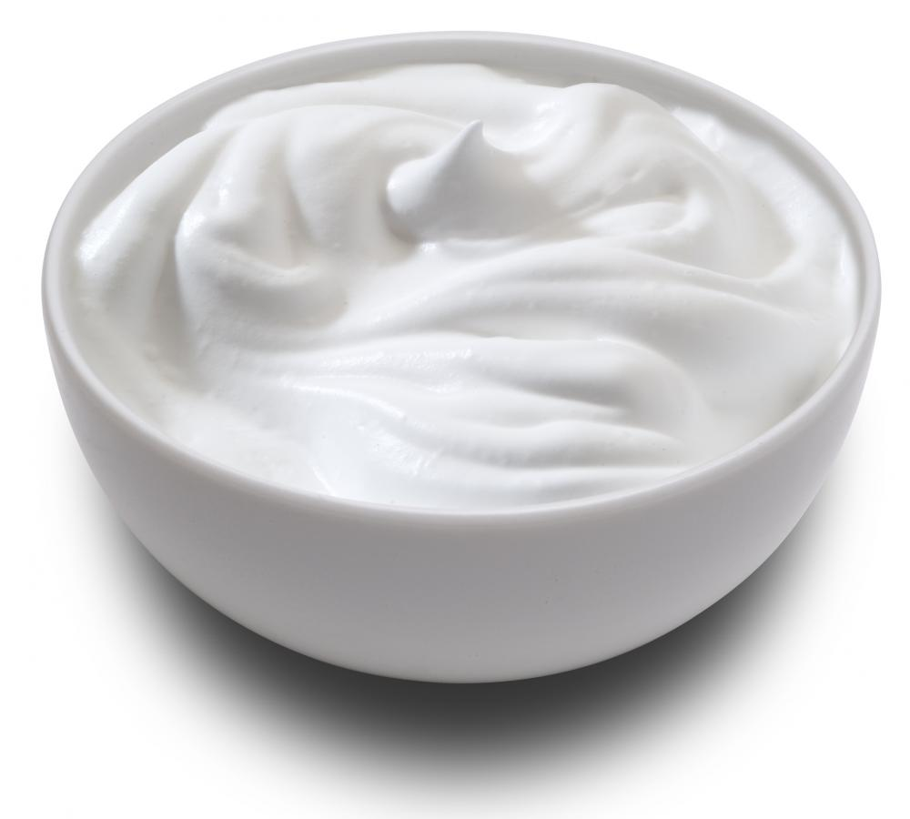
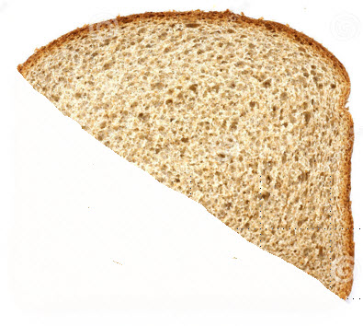
PROTEIN – BREAKFAST
Meat/meat alternate (MMA) can be served in place of grain at breakfast a up to 3 times per week
Example:
3-5 years: ½ serving grain swapped for 0.5 oz MMA
¼ cup
Notes:
SAY: Something new is that now a meat or a meat alternate can be served in place of a grain at breakfast up to three times per week.
For example: ½ slice of bread can be swapped for ¼ cup yogurt. (CLICK)

Slide 29
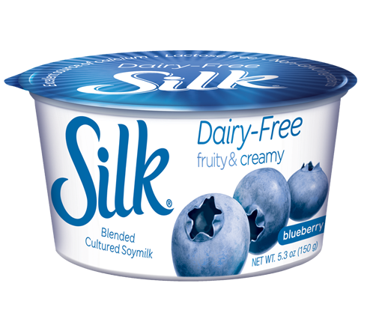
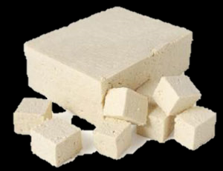
PROTEIN – TOFU
Tofu and soy yogurt are now reimbursable meat alternates
Identifiable Firm Tofu
Soy Yogurt
Notes:
SAY: Tofu and soy yogurt are now reimbursable meat alternates. Reimbursable tofu needs to be firm or extra firm and identifiable. Here identifiable means you or a child could identify the tofu in their food as a meat alternate. Examples of identifiable tofu are firm tofu in stir-fries, omelets, noodles, and soups. Non-reimbursable tofu is soft tofu incorporated in smoothies or dishes to add texture like tofu mixed in baked casseroles or used to thicken soups.
DO: Show providers the CACFP Tofu Informational Sheet handout.
SAY: As you can see on your Tofu handout, tofu must contain at least 5 grams of protein per 2.2 ounces (1/4 cup) to be reimbursed as 1.0 oz. MMA. Here a some reimbursable brands, but most firm and extra firm tofu's meet this requirement.

Slide 30
LESS ADDED SUGAR
30
| PROFESSIONAL DEVELOMENT FOR HEALTHY EATING | ©2010 YMCA of the USA
Notes:
SAY: What questions do you have about protein options before we move on to added sugars?

Slide 31
YOGURT – WHY?
Yogurt Sugar Limit
No more than 23 grams of sugar per 6 ounces of yogurt
Notes:
SAY: In an effort to reduce sugar intake in children, the new meal patterns include a yogurt sugar limit(CLICK) of no more than 23 grams of sugar per 6 oz.
SAY: We will talk about three ways to figure out if a yogurt is reimbursable. The first way is to check if it’s in your WIC Shopping Guide.
DO: Hold up Shopping Guide.

Slide 32
YOGURT – CHART
Notes:
SAY: The second way to identify a reimbursable yogurt is easy as well. Go ahead and pull out the blue “Choose Yogurts That Are Lower in Added Sugars” page. I like this tip sheet because it’s a fast way to figure out if a non-WIC yogurt is reimbursable instead of having to do the math.
DO: Walk through example on handout as group.

Slide 33
YOGURT – CALCULATIONS
Step 1: Find the total sugar on the Nutrition Facts Label (in grams)
Step 2: Find the yogurt serving size (ounce or grams)
Step 3: Divide the amount of sugar by the serving size
No more than 23 g of sugar per a 6 oz. serving of yogurt
Ounce calculations: 23 g of sugar/6 oz. of yogurt = 3.83
Less than or equal to 3.83 is reimbursable
Grams calculations: 23 g of sugar/170 g of yogurt= 0.135
Less than or equal to 0.135 is reimbursable
Notes:
SAY: The third way to identify a reimbursable yogurt is to do some calculations. There are three steps.
DO: Review slide.

Slide 34
YOGURT – CALCULATIONS
We’ll try a gram example together!
Here we see 19 g of sugar and 150 g of yogurt
19 g of sugar ÷ 150 g of yogurt = 0.1267
That is less than 0.135 so it is reimbursable.
Notes:
DO: Review slide
ASK: What questions do you have about yogurt before we move onto cereal?

Slide 35
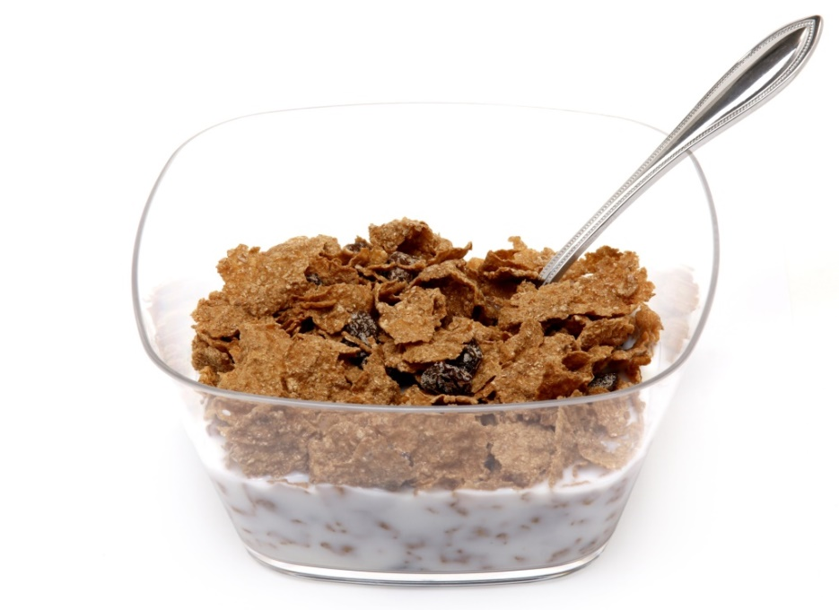
CEREAL
Breakfast cereal sugar limit
No more than 6 grams of sugar per dry ounce of cereal
Includes: ready-to-eat cereals & hot cereals, both instant/regular
Notes:
SAY: The breakfast cereal sugar limit is (CLICK) no more than 6 grams of sugar per dry ounce of cereal.
(CLICK) This includes ready-to-eat cereals and hot cereals, both instant and regular.
SAY: We will talk about three ways to figure out if a cereal is reimbursable. The first way again is checking to see if it’s in your WIC Shopping Guide.

Slide 36
CEREALS – CHART
Notes:
SAY: The second way to identify a reimbursable cereal similar to the yogurt is also a chart. Go ahead and pull out the goldenrod “Choose Breakfast Cereals That Are Lower in Added Sugars” page.
DO: Do example from handout together.

Slide 37
CEREAL – CALCULATIONS
Find the grams of sugars and the serving size in grams
Divide sugars by serving size (in grams)
If the answer is:
Equal to or less than 0.21 – Reimbursable
Greater than 0.21 – Not Reimbursable
Notes:
SAY: The third way to determine if a cereal is reimbursable is do some calculations. First…
Find the sugar and serving size in grams;
(CLICK) Then divide the sugars by the serving size;
(CLICK) and if the answer is equal to or less than 0.21 the cereal is reimbursable.
Now we’ll practice using the cereals on your tables. You can use your WIC shopping guide, the goldenrod chart, or the calculations on the screen. We’ll take a few minutes to do this with our table groups.

Slide 38
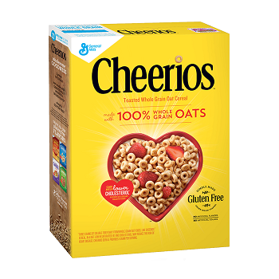
CEREAL – PRACTICE
Notes:
SAY: Who from the Cheerios table would like to share their answer?
ANSWER: Reimbursable.

Slide 39
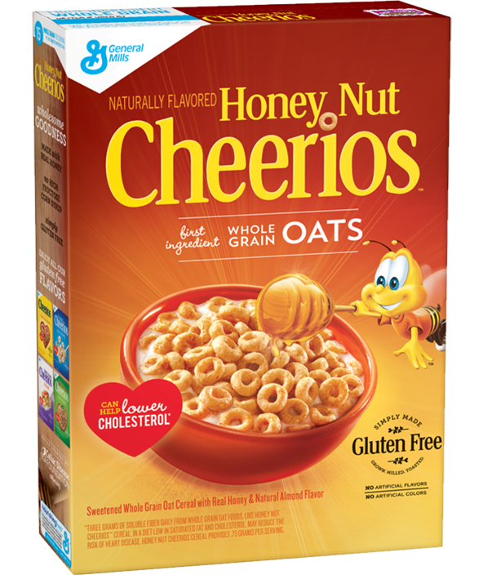
CEREAL – PRACTICE
Notes:
SAY: Who from the Honey Nut Cheerios table would like to share their answer?
ANSWER: Not reimbursable.

Slide 40
MAKING EVERY SIP COUNT
40
| PROFESSIONAL DEVELOMENT FOR HEALTHY EATING | ©2010 YMCA of the USA
Notes:
SAY: What questions do you have about identifying reimbursable cereals before we move on to milk?

Slide 41
MILK
1 year (12-23 months) | Unflavored whole (Vitamin D)
2-5 years | Unflavored skim (fat-free) Unflavored 1% (low-fat)
6-12 years | Unflavored skim (fat-free) Unflavored 1% (low-fat) Flavored skim (fat-free)*
Notes:
SAY: Figuring out which milk is reimbursable for each age can be confusing. Flip to the green sheet titled “Serving Milk in the CACFP” in your binder. I like it because it lists what milks are reimbursable for each age category. There’s also a summary chart on the slide.
DO: Ask for 2 volunteers to read;
Newborn to 23 months
2-18 years old
SAY: Flip over your sheet to the back. With the people at your table and the front of the sheet, answer the first 2 questions. We’ll regroup in 5 minutes.

Slide 42
MILK
Non-dairy beverages that are nutritionally equivalent to cow’s milk and meet the nutritional standards for fortification of calcium, protein, vitamin A and vitamin D are also allowed (some soy milks).
Notes:
ASK: Does anyone know why milk has its own component? [Allow for a few responses.]
SAY: With milk alternates becoming so popular, I think it’s important to know why milk is so important. Milk provides nutrients that are necessary for health and maintenance of our bodies. These nutrients include calcium, potassium, Vitamin D and protein. Most milk alternates aren’t nutritionally equivalent to cow’s milk, just a few soy milks.
(CLICK) [READ SLIDE] All the WIC approved soy milks are reimbursable. A doctor’s note is required for non-dairy beverages that are not nutritionally equivalent (such as almond milk) and you’ll need to contact your sponsor to get the request approved.
ADDITIONAL: Sometimes people ask why only 1 year olds (12-23 months) are served whole milk. 80% of brain growth and development happens before age 2 and the brain needs fat to grow and develop. Flavored milk will no longer be reimbursable for children under 6 years of age. That includes mixing in syrups or powders at home.

Slide 43
ADDITIONAL IMPROVEMENTS
43
| PROFESSIONAL DEVELOMENT FOR HEALTHY EATING | ©2010 YMCA of the USA
Notes:
ASK: What questions do you have about milk?
SAY: OK let’s move onto additional improvements.

Slide 44
ADDITIONAL
I’m fried.
Notes:
SAY: We’ve covered a lot of information this morning. I’m sure some of you might be feeling fried, so we’ll be going over one more slide before our 10 minute break.
**Personal Anecdote: I’d like to share a personal story. I’m a first generation Mexican American. My mom and dad grew up in poverty and started working at a young age, so they wanted to give me and my siblings the luxuries they wished they could have. So we got Doritos, Payasitos, Flaming Hot Cheetos, cup soups, and other junk. Since my metabolism was very fast, I was still so thin. I had people tell me, not ask me, that I was anorexic. So once I got to middle school, I joined sports clubs to gain weight, but I was hungrier, so with a Burger King next door and my dad working at a meat packing plant, I ate more fast food and meat—but it was okay since I was thin right? Well by age 17, I had high cholesterol. Even if someone is at a healthy weight, that doesn’t mean they don’t have to eat healthy and the habits we form as kids, are hard to break. I’ve heard many women tell me they used to be as thin as me and be able to eat a lot and not gain weight. When our metabolism inevitably slows down, that’s when we’ll gain weight because we can’t break our unhealthy eating habits. So the sooner the better to form healthy habits!**

Slide 45
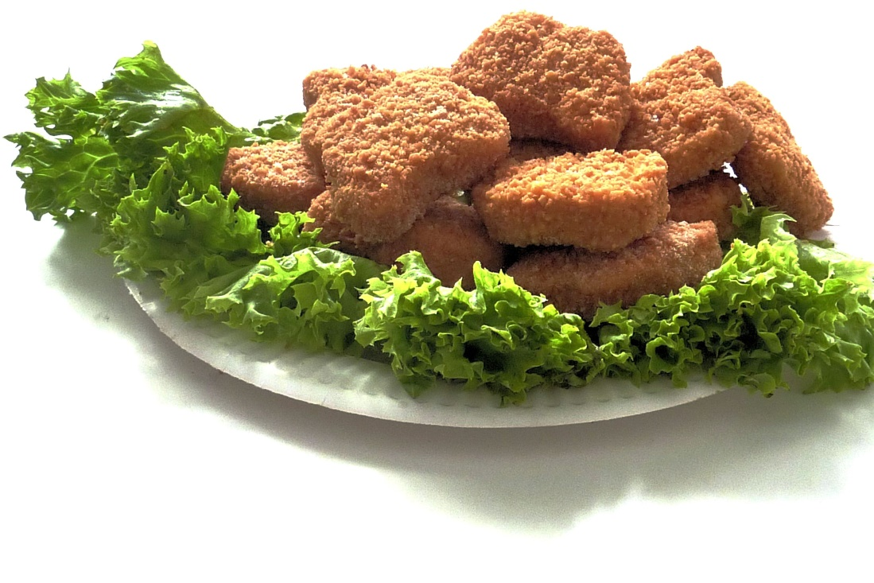
ADDITIONAL
No deep fat frying food
Water must be available AND offered to children throughout the day
Food cannot be used as a reward or punishment
Notes:
SAY: So to avoid forming unhealthy habits in our kids, deep fat frying is no longer allowed. Deep fat frying is defined as cooking by submerging food in hot oil or another fat. We can still sauté, pan-fry and stir-fry though.
Items that are purchased pre-fried (chicken nuggets, breaded fish, etc.) and reheated by oven, microwave, etc. are still reimbursable as long as they are not deep fat fried in your home.
(CLICK) Water must also be available AND offered to children throughout the day. Available means cups are next to the sink and water pitchers are out. Offer means we ask children if they would like water and provide visual cues to encourage drinking water.
(CLICK) And lastly, food cannot be used as a reward or punishment.

Slide 46
BREAK
46
| PROFESSIONAL DEVELOMENT FOR HEALTHY EATING | ©2010 YMCA of the USA
Notes:
SAY: Now we’ll take a 10 minute break.

Slide 47
INFANT MEAL PATTERN
47
| PROFESSIONAL DEVELOMENT FOR HEALTHY EATING | ©2010 YMCA of the USA
Notes:
SAY: For the second part of the workshop, we’ll be covering Infant Meal Patterns and Best Practices. We’ll start with the babies.

Slide 48
INFANT MEAL PATTERN
Notes:
SAY: Turn to the page titled “Updated Child and Adult Care Food Program Meal Patterns: Infant Meals.” It’s a blue paper like the one on the screen. You can refer to this later; we’ll be reviewing the changes shown on this paper in the PowerPoint.

Slide 49
ENCOURAGE & SUPPORT BREASTFEEDING
49
| PROFESSIONAL DEVELOMENT FOR HEALTHY EATING | ©2010 YMCA of the USA
Notes:
SAY: The first of the three parts of the infant updates are to encourage and support breastfeeding.

Slide 50
BREASTFEEDING
Breastfeeding is reimbursable on site
Expressed breastmilk is an acceptable fluid milk substitute for any age
Supplementing?
Only breastmilk or formula are served to babies 0-5 months
Notes:
SAY: Due to the many, many benefits of breastfeeding and the American Academy of Pediatrics' recommendation for breastmilk as the optimal source of nutrition through the first year of life, providers will now be reimbursed for meals when a mother breastfeeds her baby at your house from birth through any age. Many of you might know that every drop of breast milk counts. If a mom can provide part of an infant or child’s milk requirement, please encourage her to do so! Just remember that you will need to supplement with an approved milk so that the baby or child gets a full serving. The last breastfeeding change is that now only breastmilk or formula will be served to babies 0-5 months.
SIDE NOTE:
Providers already can be reimbursed when a parent/ guardian supplies expressed breastmilk and this will continue. Expressed breastmilk is an acceptable fluid milk substitute at any age (No note or form required!).

Slide 51
DEVELOPMENTALLY APPROPRIATE MEALS
51
| PROFESSIONAL DEVELOMENT FOR HEALTHY EATING | ©2010 YMCA of the USA
Notes:
SAY: The second of the three parts of the infant updates are to offer developmentally appropriate meals.

Slide 52
AGE GROUPS
Current Meal Pattern
0-3 months 4-7 months 8-11 months
*New* Meal Pattern
0-5 months 6-11 months
*Solid foods when developmentally ready
Sit in a high chair with good head control
Opens his/her mouth when food comes near his/her mouth
Can move food from a spoon into throat
Doubled birth weight and weighs about 13 pounds or more
Notes:
SAY: The new infant meal pattern goes from 3 age groups to 2. You can see the current meal patterns on the left side of the screen and the new on the right. The new age groups will be: 0-5 months; and 6- 11 months. The age groups were changed because the American Academy of Pediatrics recommends to exclusively breastfeed babies for the first 6 months of life and to start solid foods around 6 months of age. This will:
Make your record keeping easier;
Provide the best nutrition for our babies;
Delay the introduction of solid foods until around 6 months of age. Most babies aren’t ready to eat solid foods until about 6 months; and
Introducing solid foods too soon can increase a child’s risk of obesity.
(CLICK) Solid Foods should be started when a baby is developmentally ready as determined by a pediatrician.
ADDITIONAL:
As a best practice, the USDA recommends that a parent or guardian request in writing when solid foods should be started at child care.
SAY: A provider should be in constant communication with the parent regarding when and what solid foods should be introduced. Babies are ready for solids when they can (CLICK) READ SLIDE. In general, babies should be consuming solid foods from all food groups by 7 to 8 months of age.

Slide 53
SOLIDS
How do you communicate with parents about starting solids or offering new foods? What things do you say?
Notes:
ADDITIONAL (from previous slide): Once an baby is developmentally ready to eat solid foods, the child care is required to offer them to the infant. Solid foods are introduced gradually. New foods may be introduced one at a time over the course of a few days, and an infant’s eating patterns may change. For example, an infant may eat a cracker one week and not the next week. In addition, solid foods served to infants must be of a texture and consistency that is appropriate for the age and development of the infant being fed.
SAY: I think it’d be great to take advantage of all the knowledge we have in the room and learn from each other. Think about the question on the screen. “How do you communicate with parents about starting solids or offering new foods? What things do you say?” Do you have them write you a note? Do you have a form they need to fill out? I’ll give you about 3 minutes to share at your groups.
ASK: Who would like to share? [Take 2-3 large group responses.]

Slide 54
MORE NUTRITIOUS MEALS
54
| PROFESSIONAL DEVELOMENT FOR HEALTHY EATING | ©2010 YMCA of the USA
Notes:
SAY: The third change for infants is to offer more nutritious meals.

Slide 55
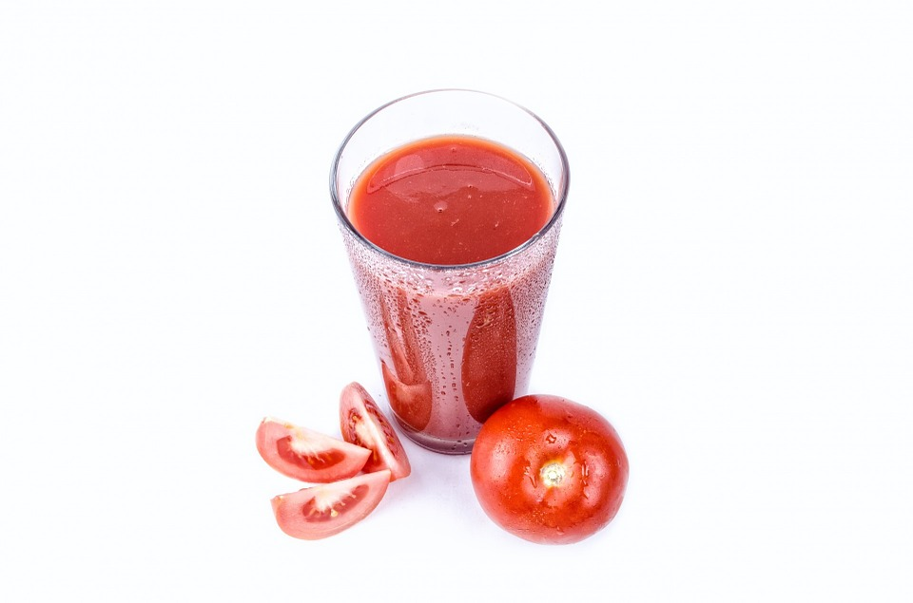
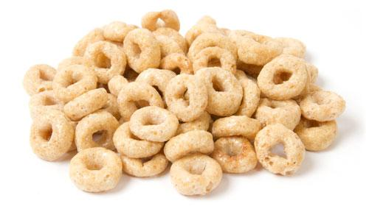
MEALS & SNACKS
Vegetable or fruit required at snack
No Juice
Ready-to-eat cereals* at snack
Notes:
SAY: Once a child is developmentally ready: A vegetable or fruit is required at snack.
ADDITIONAL: Recent studies have found that dietary habits are established by age two and that most infants do not consume any vegetables or fruits in a day. Offering a variety of different nutrient dense foods, including vegetables and fruits helps to promote good nutrition and healthy habits in infants.
(CLICK) - Juice is no longer reimbursable for infants. This supports research and recommendations of no fruit juice before age one due to the lower nutritional content of juice.
(CLICK) - Ready to eat cereals (such as cheerios) are allowed and reimbursable. Since ready-to-eat cereals are already being served they have been added to the infant meal pattern as a snack. Not all cereals may be appropriate for an infant so it is important that the cereal that is offered is a texture and consistency that is appropriate for the age and development of the baby. Ready-to-eat cereals served to infants must follow the same sugar limit (no more than 6 grams of sugar per dry ounce) as what is required in the child meal pattern.

Slide 56
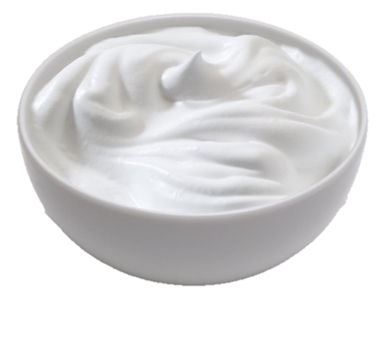
MEAT/MEAT ALTERNATE (MMA)
Allowed:
Cheese
Cottage cheese
Yogurt
Whole eggs
Not Allowed:
Cheese food or cheese spreads
Notes:
SAY: The meat/meat alternate component for infants now allows: cheese, cottage cheese, yogurt (same sugar limit as child meal pattern) and whole eggs. These are all good protein sources and are often served to infants as they are developmentally ready.
(CLICK) Because eating patterns are developed at a young age and cheese food and cheese spreads are typically higher in sodium, the new infant meal pattern does not allow cheese food and cheese spreads.
ADDITIONAL: Cow’s milk should not be served until age 1 but this does not extend to cow’s milk products. Infants should consume all foods from different food groups.
Around 6 months of age all allergen foods can be introduced. Research has found that later or delayed introduction of allergen foods may cause an increased risk of food allergies.
For example: Historically, egg whites have been thought to be a high allergen food for infants but due to the lack of evidence and research, after 6 months of age, once a child is developmentally ready, whole eggs may be offered.

Slide 57
MEALS & SNACKS
Meals
Breast milk/ Formula
Baby cereal and/or MMA
Vegetable and/or fruit
Snacks
Breast milk/ Formula
Vegetable and/or fruit
Grains
Notes:
SAY: The infant meal patterns can be found on the back of the blue sheet that reads “Infant Meals” at the top.
The required components at all meals—breakfast, lunch and supper are:
Breastmilk or iron fortified infant formula;
Iron fortified infant cereal AND/OR meat/meat alternate; and
A vegetable or fruit
The required THREE components for snacks at breastmilk/ iron fortified infant formula, a vegetable or fruit and a grain (cracker, bread or ready to eat cereal)
DO: Hold up blue infant summary. SAY: As you can see on the blue page, within the 6-11 month age category serving sizes range from 0-4 tbsp. of cereal or MMA. This is because no two babies are alike and even at 6 months not all children are going to be ready to start all foods.
ADDITIONAL: The “0” does not mean optional, once a baby is developmentally ready and tolerating that component, it is required.

Slide 58
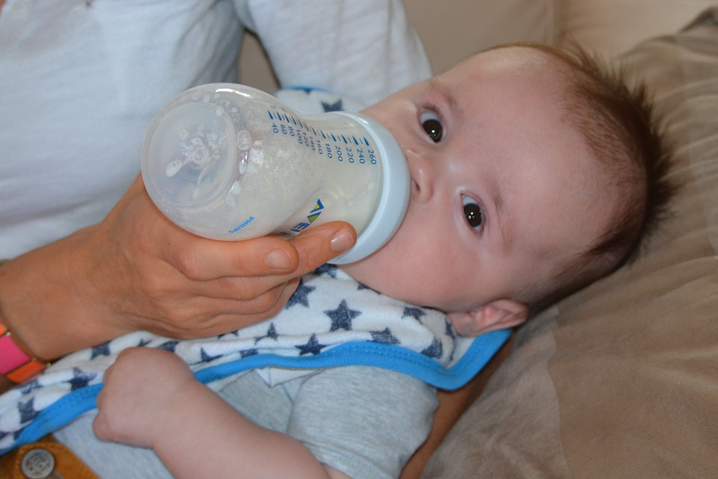
PARENTS/GUARDIANS
A parent may now only provide ONE component of the meal pattern
Notes:
SAY: The final change to the infant meal pattern is that before a parent could provide more than one component for their baby. Now a parent may only provide ONE component to the meal pattern.
If a parent provides breastmilk/formula this counts as the one component.

Slide 59
BEST PRACTICES
59
| PROFESSIONAL DEVELOMENT FOR HEALTHY EATING | ©2010 YMCA of the USA
Notes:
SAY: Our last topic is Best Practices. These are things that are optional. I know we have many providers who are over achievers here, so I figured you’d want to hear about these.

Slide 60
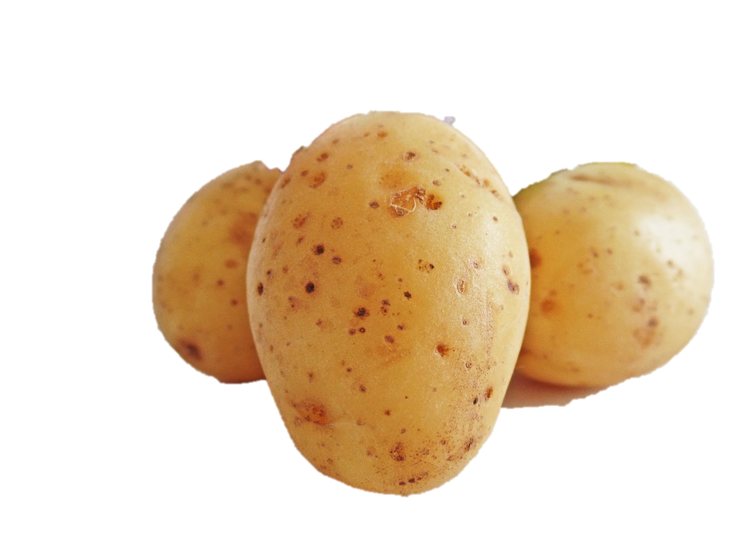
OPTIONAL BEST PRACTICES
Infants:
Support breastfeeding
Vegetables/Fruit:
Serve a vegetable or fruit for snack daily
Serve a variety of fruits and choose whole fruits
Provide at least one serving per week of:
Dark green vegetables Red/orange vegetables Beans and peas (legumes) Starchy vegetables Other
Notes:
SAY: Best Practices are listed on a green page in your binder after the last handout we looked at. (CLICK) For infants an optional best practice is to support mothers who breastfeed. You can do this by encouraging them to supply breastmilk for their babies while in your care, and offer a quiet, private area that is clean and comfy for moms who’d like to breastfeed at your home. Breast Feed San Diego is a great resource if you’d like more information on how to support breastfeeding. I can connect you to them.
Optional best practice for vegetables and fruit are to
(CLICK) make at least 1 of the 2 required components of a snack a fruit or veggie.
(CLICK) Serve a variety of fruits and choose whole fruits (fresh, canned, dried, or frozen) more often than juice.
(CLICK) Provide at least one serving each of dark green vegetables, red and orange vegetables, beans and peas (or another legume), starchy vegetables, and other vegetables once per week.
SAY: Since one of the Best Practices is to provide at least one serving each of dark green vegetables, red and orange vegetables, legumes, starchy vegetables, and other vegetables once per week, we have a vegetable activity. Please turn to the page titled “Vegetable Best Practices.” You’ll see five (5) columns of the types of vegetables listed. Take a minute to review this list and place an “X” next to the vegetables that you serve on a regular basis. Then, circle three (3) vegetables that you would like to add to your menu. As a best practice and a challenge, see if you can serve a vegetable each week from each column. Finally, work with your table group to, in the bottom boxes, make a list of child friendly ideas for serving vegetables in each category. We’ll take about 5 minutes to do this.
ASK: Who would like to share an idea they came up with? [Collect a few responses and thank them for sharing.]

Slide 61
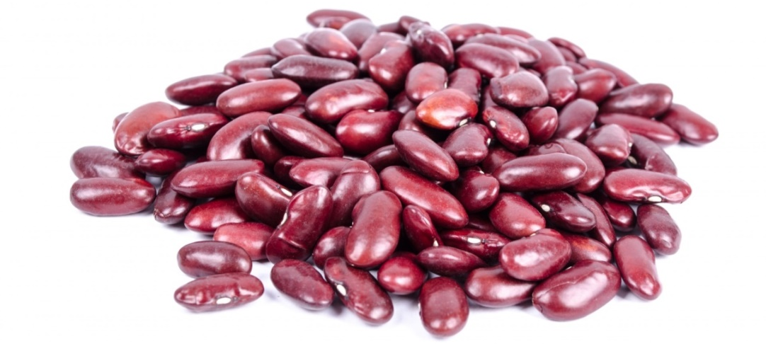
OPTIONAL BEST PRACTICES
Grains:
Serve whole grains twice per day
Meat/ Meat Alternate:
Serve only lean meats, nuts, & legumes
Limit processed meats to once/week
Serve only natural, low-fat/ reduced fat cheeses
Milk
Unflavored milk for all!
Notes:
SAY: (CLICK) Provide at least two servings of whole grains per day.
(CLICK) A best practice for MMA is to serve only lean meats (CLICK), nuts (CLICK), and legumes (CLICK). Limit serving processed meats to no more than one serving per week. Serve only natural cheeses and choose low-fat or reduced fat-cheeses.
(CLICK) And serve unflavored milk everyone.
ADDITIONAL: If flavored milk is served to children 6 years old or older, use the Nutrition Label to see if it contains no more than 22 grams of sugar per 8 fluid ounces. If that’s not available, then just the one with the lowest amount of sugar.

Slide 62
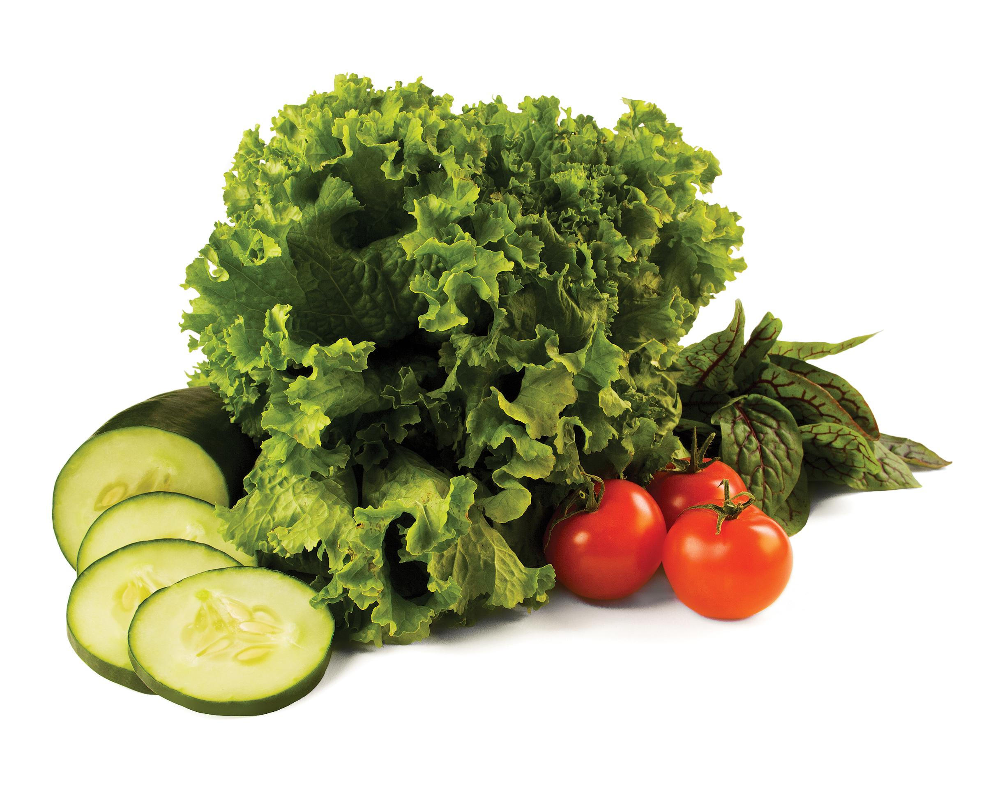
OPTIONAL BEST PRACTICES
Seasonal and local produce
Limit pre-fried food to once/week
Avoid non-reimbursable foods that are sources of added sugars
Notes:
SAY: Some more best practices are to (CLICK) purchase seasonal and local produce.
(CLICK) Limit serving purchased pre-fried foods to no more than one serving per week.
And to (CLICK) avoid serving non-reimbursable foods that are sources of added sugars, such as sweet toppings, jam or syrup for example, mix-in ingredients sold with yogurt (like honey, candy, or cookie pieces), and sugar sweetened beverages (such as fruit drinks or sodas).

Slide 63
WHY?
Notes:
SAY: I think it's important that we come back to the "why" behind the changes to the meal patterns. Ultimately, the changes all come down to wanting to do the best we can for the children that we care for and to give them the best possible start in life. So as you reflect on the changes that we talked about today, I want you to think about what the goal of these changes are.
ASK: Why do you personally feel that they are important? [Take a few responses.]
SAY: Those are all great reasons! It's obvious that you’re always looking out for their best interests. Many of you are already replacing grain based dessert items with healthier choices, limiting juice and trying to incorporate more whole grains. Now the meal patterns will make it possible for children all over the country to benefit.
**Personal Anecdote: I’d like to share another personal story. I was a teen mom. My daughter is now 8 years old. In my daughter’s preschool years, I didn’t think about nutrition and my daughter was obese. The person who got me to change the way I viewed food and how I fed my daughter was Melinda, my daughter’s family childcare provider, someone just like you. And now my daughter is at a healthy weight and I pursued a career in nutrition.** You have built relationships with your families and you have earned their respect. This is information you can share with them as well. The children are the ones to benefit from these New Meal Patterns and it's all thanks to you. So, thank you so much for everything you do!

Slide 64
QUESTIONS & EVALUATIONS
64
| PROFESSIONAL DEVELOMENT FOR HEALTHY EATING | ©2010 YMCA of the USA
Notes:
ASK: We covered all the information. What questions do you have?
SAY: In your binder are evaluations and a post assessment for today’s workshop. Your feedback is very important! My feelings won’t get hurt if you make suggestions for changes, in fact that would help me and I would love that! After you complete both the survey and the assessment please turn it into me and I’ll give you your family style dining kits. I’ll call you next week to schedule your first home visit.
DO: Point to and encourage providers to look through additional resources table.

Slide 65
THANK YOU
Cecilia Morley Health Educator Field Services Department 619-521-3055 ext. 2530 cmorley@ymca.org www.ymca.org/CRS facebook.com/ymca.crs
The YMCA of San Diego County is dedicated to improving the quality of human life and to helping all people realize their fullest potential as children of God through the development of the spirit, mind and body.
Notes:
SAY: Thank you so much for taking time out of your Saturday morning to join me today. Here is my contact information. Have an excellent day!

