Slide 2
New USDA Meal Pattern Guidelines
Implementation
October 1, 2017

Slide 3
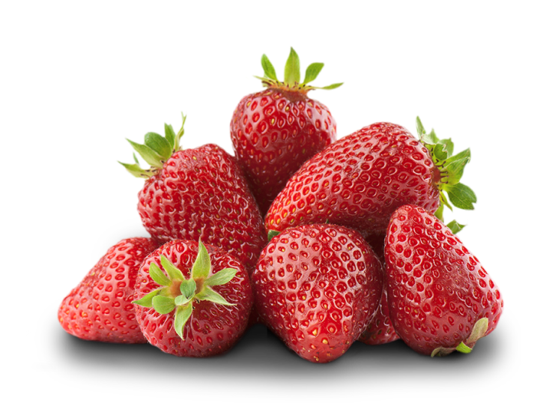
Vegetables and Fruits
Allows two vegetables or one vegetable and one fruit for lunch or supper.
Two fruits is NOT allowed.
Juice is limited to once per day.

Slide 4

Grains
At least one grain per day must be whole grain-rich.
Whole grain-rich is defined as foods that contain at least 50% whole grains. FNS is will issue further guidance in the near future. Criteria will be the same as the NSLP.

Slide 5
Grains
Grain based desserts are disallowed.
This means cookies, cakes, sweet pie crusts, fruit turnovers, doughnuts, granola bars, toaster pastries, sweet rolls and brownies are no longer reimbursable.
Breakfast cereals must contain no more than 6 grams of sugar per dry ounce.

Slide 6
Grains
Uses ounces equivalents to determine serving sizes for grains
(Starts October 1, 2019)
One oz. equivalents equals 16 grams of creditable grains.

Slide 7
Meat and Meat Alternative
May substitute the ENTIRE grains component at breakfast a maximum of three times per week.
Yogurt must contain no more than 23 grams of sugar.
Allow tofu.

Slide 8

Fluid Milk
Yogurt may be served in place of milk once per day for adults. As a best practice, water should be served as a beverage in its place.

Slide 9
Food Preparation
Deep-fat frying (cooking by submerging in hot oil or other fat) on site is prohibited.
Centers may still saute, pan-fry, and stir-fry foods.
Purchasing pre-fried foods still allowed.

Slide 10
Additional Provisions
Using food and beverages as a reward or punishment is not allowed.
Allows parents/guardians, an adult participant, or a person behalf of an adult participant to provide one meal component for adults with non-disability medical or special dietary needs.

