Slide 1
Proposed Rule to Update Meal Patterns in the Child and Adult Care Food Program
USDA Food & Nutrition Service
Child and Nutrition Division

Slide 2
Proposed Rule Resources
CACFP Meal Pattern webpage:
http://www.fns.usda.gov/cacfp/meals-and-snacks
Proposed rule
One-page summaries
CACFP Meal Pattern Proposed Rule Webinar
Notes:
The CACFP meal patterns webpage is a great one-stop shop for all the proposed rule resources. It includes a link to the press release, the proposed rule in the Federal Register, the one-page summaries of the infant meal patterns and child and adult meal patterns, a copy of the CACFP Meal Pattern Proposed Rule webinar, and instructions on how to provide public comment.

Slide 3
Proposed Rule
Title: Child and Adult Care Food Program: Meal Pattern Revisions Related to the Healthy, Hunger-Free Kids Act of 2010
Publication Date: January 15, 2015
Docket #: FNS-2011-0029
Review and comment at http://www.regulations.gov/#!documentDetail;D=FNS-2011-0029-0001
90-day comment period: April 15, 2015
Notes:
Here is some general information about the proposed rule.
The proposed rule is titled Child and Adult Care Food Program: Meal Pattern Revision Related to the Healthy, Hunger-Free Kids Act of 2010.
The rule was published in the Federal Register today with the Federal Register number FNS-2011-0029. The best way to find the proposed rule is to search using this number. You can also use find the link provided on the slide to access the proposed rule on the Federal Register.
The proposed rule will be open for public comment for 90 days which will be until April 15th, 2015. We’ll provide instructions on how to comment at the end of the webinar.

Slide 4
Webinar Overview
Background
Proposed infant meal pattern
Proposed child and adult meal pattern
Best practices
Additional proposed revisions
Proposed changes to other Child Nutrition Programs
Public comments
Notes:
During today’s webinar we’ll review:
The background of the proposed rule and how it was developed,
The proposed meal pattern for infants, children and adults,
The proposed best practices,
Additional proposed revisions,
Corresponding changes in the meal pattern that would impact other Child Nutrition Programs, and
How to provide public comment.

Slide 5
Background

Slide 6
Background
Healthy, Hunger-Free Kids Act (HHFKA) requires USDA to:
Update the CACFP meal patterns
Align the meal patterns with:
The most recent version of the Dietary Guidelines for Americans
Most recent and relevant nutrition science
Recommendations from an authorized scientific agency or organization
Notes:
The Healthy, Hunger-Free Kids Act of 2010 expanded the purpose of CACFP to ensure the program provides nutritious foods that contribute to the wellness, healthy growth and development of young children and the health and wellness of older adults.
With this goal in mind, the Healthy, Hunger-Free Kids Act requires USDA to update and align the CACFP meal patterns and make them more consistent with
The most recent version of the Dietary Guidelines for Americans (DGAs),
Most recent and relevant nutrition science, and
Recommendations from an authorized scientific authority
This is the first major revision of the CACFP meal patterns since the Program’s inception in 1968. Since then nutritional science has evolved tremendously and it’s important that the meal patterns reflect this new knowledge. Additionally, nutrition related health concerns have shifted from malnutrition to the overconsumption of calories, saturated fat, added fats, added sugars, and under consumption of fiber and other essential nutrients. This proposed meal pattern revision aims to addresses these concerns and to help safeguard the health of children early in their lives and improve the wellness of adults.

Slide 7
Background
IOM recommendations
Released Child and Adult Care Food Program: Aligning Dietary Guidance For All report in November 2010
Report can be accessed at: www.iom.edu/Reports/2010/Child-and-Adult-Care-Food-Program-Aligning-Dietary-Guidance-for-All.aspx
2010 Dietary Guidelines for Americans
Stakeholder input
Notes:
As a first step in updating the CACFP meal patterns, USDA commissioned the Institute of Medicine (IOM) to review the current CACFP meal patterns and provide recommendations that are practical and would improve the nutritional quality of meals and align them with the 2005 Dietary Guidelines, which was the most current version at the time.
The IOM released their report in November 2010. It is titled “Child and Adult Care Food Program: Aligning Dietary Guidance for All” and can be accessed through the link provided on the slide.
Along with the IOM recommendations, USDA took into consideration the 2010 Dietary Guidelines and engaged in extensive stakeholder consultation prior to drafting the proposed rule.
State agencies, sponsors, providers, and nutrition advocates provided input on the greatest areas of need and opportunity for improvement, issues of practicality, and resources needed for successful implementation.
Recognizing that CACFP operates in diverse types of facilities, that there are varying degrees of resources, and that no additional reimbursement was provided for CACFP meals, USDA designed meal patterns that are achievable and do not raise costs for providers.

Slide 8
Child Nutrition Programs
Child and Adult Food Care Program
National School Lunch Program
School Breakfast Program
Special Milk Program
Notes:
Several of the proposed changes for CACFP extend to the National School Lunch Program, the School Breakfast Program, and the Special Milk Program.
This was done to help increase consistency across all Child Nutrition Programs.
We’ll discuss these changes in more detail later in the webinar.

Slide 9
Regulation Process
Proposed Rule published 1/15/15
90 day comment period ends 4/15/15
Final Rule published
Implementation
Notes:
Before discussing the proposed changes, here is an illustration of how the regulation process works and what happens next with the proposed meal patterns.
The proposed rule was published on today and is now open for public comment for 90 days. This means any one is welcome and encouraged to submit their feedback on the changes we have proposed until April 15, 2015. USDA will then take all those comments into consideration when drafting a final rule. The rule will not be in effect until after the final rule is published.

Slide 10
Proposed Infant Meal Pattern
Notes:
Now we’re going to discuss the proposed meal patterns, starting with the Infant Meal Pattern.

Slide 11
Proposed Infant Meal Pattern
New age groups:
0 through 5 months, 6 through 11 months
Delays introduction of solid foods until 6 months
Allows reimbursement when a mother breastfeeds her child onsite
Requires fruit or vegetable at snack for 6 -11 month age group
Prohibits fruit juice, cheese/cheese products
Allows ready-to-eat cereal to count towards grain component at snack
Notes:
The changes in the proposed infant meal pattern support breastfeeding and increase the amount of fruits and vegetables infants will be served.
First, the proposed rule consolidates the infant age groups. Currently there are 3 infant age groups: 0 through 3 months, 4 through 7 months, and 8 through 11 months. Under the proposed rule there would be 2 infant age groups: 0 through 5 months and 6 through 11 months.
This was done because the American Academy of Pediatrics (AAP) advises delaying the introduction of solid foods until after 6 months of age. And in their report the IOM found that almost 30 percent of infants were fed solid foods before the age of 4 months.
To accommodate these concerns we are proposing to consolidate the infant age groups so that infants under 6 months of age would only receive breastmilk or infant formula. The gradual introduction of solid foods would be allowed starting at 6 months of age. Currently the meal pattern allows for the introduction of solid foods as early as 4 months, as developmentally appropriate.
These new age groups are also consistent with the infant age groups in the Special Supplemental Nutrition Program for Women, Infants, and Children (WIC).
Second, in response to the IOM’s recommendation to develop additional incentives to support breastfeeding, USDA is proposing to allow any child care facility to receive reimbursement for meals when the mother breastfeeds her child on site. This would apply even if breast milk is the only component served to the infant.
Currently the meal patterns allow parents or guardians to provide their own breast milk and for the center or day care home to be reimbursed. Additionally, the current meal patterns allow day care home providers who breastfeed their own infants to claim reimbursement for the meal, if the provider is eligible to claim her own children’s meal at the time of the feeding.
Third, we are proposing to require a fruit or vegetable be served at snack for the 6 through 11 month age group and proposing to eliminate fruit juice from being served to infants in all age groups. This ensures infants are provided more access to fruits and vegetables without consuming added sugars and the low-nutrient dense calories that fruit juice provides. It also brings the CACFP meal pattern into alignment with the food packages for infants in WIC.
Fourth, we are also proposing to prohibit cheese and cheese products in the infant meal pattern.
Currently the infant meal pattern allows infants to be served cheese, cottage cheese, or a cheese food or spread beginning at 8 months. However, the IOM recommended no cow’s milk or cow’s milk by products be introduced to infants until 12 months of age. So, the proposed rule would eliminate the option of serving all cheese and cheese products, as well as yogurt.
Finally, we are proposing to allow ready-to-eat cereal to count towards the grain component at snack.
CACFP stakeholders and providers requested that additional grain options be allowed for infant snacks. Ready-to-eat cereals are often served but do not currently count towards the grain requirement. To better meet the needs of child care providers and because allowing additional grain options would not increase costs, the proposed rule allows ready-to-eat cereal to count as a grain for older infants.

Slide 12
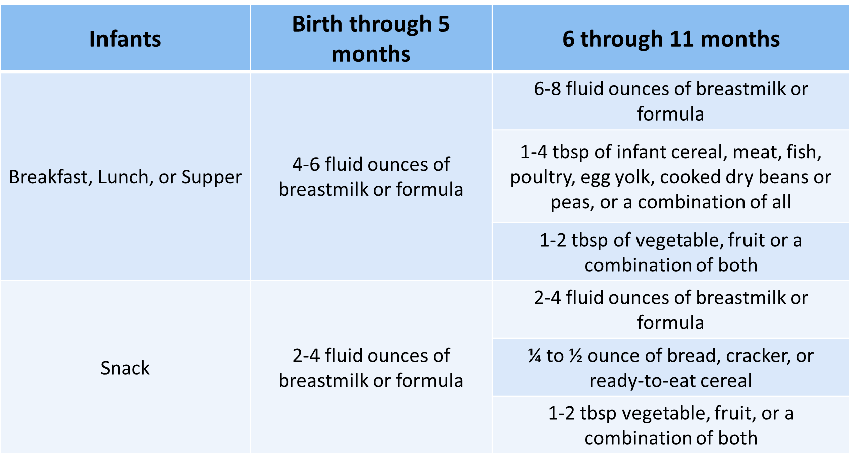
Proposed Infant Meal Pattern
Notes:
Here is a table with the proposed infant meal pattern

Slide 13
Proposed Child and Adult Meal Patterns
Notes:
Now we’ll discuss the proposed meal patterns for children and adults. We’ll start by going through the proposed new age group and then the proposed changes for each of the meal pattern components.

Slide 14
Age Groups
Establishes a fourth age group for children:
1 through 2 years
3 through 5 years
6 through 12 years
13 through 18 years (new)
Notes:
The proposed rule creates a fourth age group for children: 13 through 18 year olds. This was done to better reflect the characteristics of the population served by CACFP.
The meal pattern for the 13 through 18 year age group would be the same as the meal pattern for 6 through 12 year age group. We are not proposing to increase the serving size requirements for the 13 through 18 year age group at this time because it would increase operating costs.
It’s important to keep in mind, though, that the meal patterns outline minimum serving sizes so providers may choose to serve larger portions to older children if it is nutritionally appropriate.
We recognize that the nutritional needs of this older age group may vary so we will recommend accommodations in future guidance.

Slide 15
Fruits and Vegetables
Fruits and vegetables are 2 separate components for lunch, supper and snack
Allows fruit or vegetable juice to comprise entire fruit or vegetable component
Does not allow fruit and vegetable juice to be served at the same meal
Allows only one beverage to be served at snack
Notes:
The proposed rule adopts an IOM recommendation to separate the currently combined fruit and vegetable component into a separate fruit component and a separate vegetable component at lunch, supper, and snack. This change would increase the variety of fruits and vegetables that children and adults would be served.
However, to maintain consistency with the School Breakfast Program, the fruit and vegetable component at breakfast would not be separated. Additionally, the total amount of fruits and vegetables required at each meal would remain the same to keep the meal pattern low-cost.
Under the proposed rule providers would be required to serve one fruit component and one vegetable component at lunch and supper. This will eliminate the need to serve two different types of vegetables or fruits as currently required.
Because the fruit and vegetable component will be split into two, the proposed rule would allow fruit and vegetable juice to make up the entire fruit or vegetable component at all meals. However, it would not allow fruit and vegetable juice to be served at the same meal and would allow only one beverage (milk or juice) to be served at snack.

Slide 16
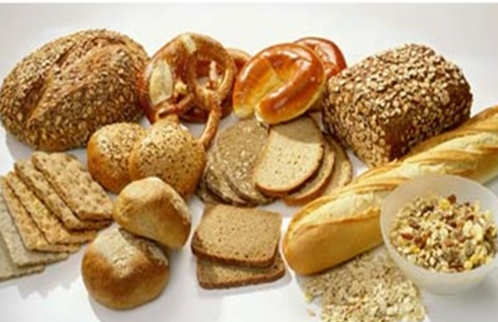
Grains
At least one serving per day must be whole grain or whole grain-rich
Breakfast cereal must meet WIC requirements
Disallows grain-based desserts
Notes:
USDA is proposing to require at least one serving of grains per day be whole grain or whole-grain rich. This was done to better align with the DGAs recommendation to make half of all grains whole grains.
The definition of whole grain would be the same as the one used in the National School Lunch Program. And whole grain-rich foods would be foods that are not 100% whole grain but generally contain at least 50 percent whole grains and the remaining grains are enriched.
USDA will provide additional guidance to providers to help identify whole grain products.
To help reduce the amount of sugar consumed, the IOM recommended prohibiting breakfast cereals with more than 6 grams of sugar per dry ounce. WIC has similar requirements for breakfast cereals and WIC State agencies maintain State-specific lists of breakfast cereals that meet these requirements. Therefore, USDA is proposing to require that breakfast cereals meet the WIC requirements.
Lastly, USDA is proposing to disallow grain-based desserts. The IOM identified grain-based desserts as a source of solid fats and added sugars. In order to reduce the consumption of solid fats and added sugars the proposed rule would no longer allow grain-based desserts to count towards the grain component. USDA will provide guidance explaining what is considered a grain-based dessert.

Slide 17
Meat and Meat Alternates
Allows a meat/meat alternate to be served in place of up to ½ of the grain component at breakfast
Tofu is allowed as a meat alternate
Notes:
In the meat/meat alternate component, we are proposing to allow a meat or meat alternate to be served in place of no more than half of the grain component at breakfast.
This was added because we recognize that meat and meat alternates are good sources of a host of vitamins and minerals, including B vitamins, vitamin E, zinc, magnesium, and iron. This option also gives providers greater flexibility, especially to those providing care for older adults who may have to limit the amount of carbohydrates they eat due to medical reasons, such as diabetes.
Additionally, we are proposing to allow tofu as a meat alternate. It would be allowed to meet all or part of the meat or meat alternate component.

Slide 18
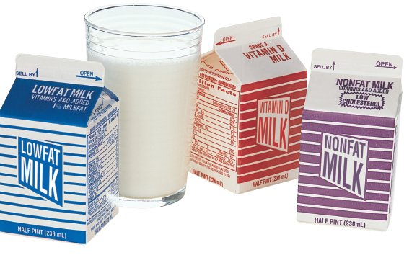
Fluid Milk
Allows only low-fat or fat-free milk to children 2 years of age and older and adults
Allows only unflavored whole milk for children 1 year of age
Requires flavored milk to be fat-free only
Notes:
The Healthy, Hunger-Free Kids Act requires that all milk served in Child Nutrition Programs be consistent with the most recent version of the DGAs, which recommends children 2 years and older and adults drink low-fat or fat-free milk. In September 2011, CACFP issued a memorandum implementing this policy. The proposed rule adds this current requirement into our regulations so it is not new.
CACFP 21-2011 Revised, “Child Nutrition Reauthorization 2010: Nutrition Requirements for Fluid Milk and Fluid Milk Substitutions in the Child and Adult Care Food Program, Questions and Answers”
We are also proposing to only allow:
Unflavored whole milk to be served to children 1 year of age based on a recommendation by the IOM, and
Any flavored milk served to children and adults must be fat-free; this is consistent with the National School Lunch Program.

Slide 19
Fluid Milk
Allows non-dairy substitutes that are nutritionally equivalent to cow’s milk for participants with medical or special dietary needs
Yogurt may serve as a fluid milk alternate once per day for adults only
Notes:
The milk memo issued in September 2011 that I just mentioned also addressed non-dairy substitutes for children or adults who cannot consume fluid milk due to non-disability medical or other special dietary needs.
The proposed rule reflects that policy. It also allows non-dairy beverages that are nutritionally equivalent to milk to be served in lieu of fluid milk for participants with medical or special dietary needs.
Additionally, USDA is proposing to allow yogurt to be used to meet the fluid milk requirement for adults, no more than once per day. This was recommended by the IOM. At this time, USDA is not allowing yogurt to count towards the fluid milk requirement for children because milk provides a wealth of nutrients growing children need such as vitamin A and D. Comparable quantities of these nutrients are not currently found in commercially available yogurt.

Slide 20
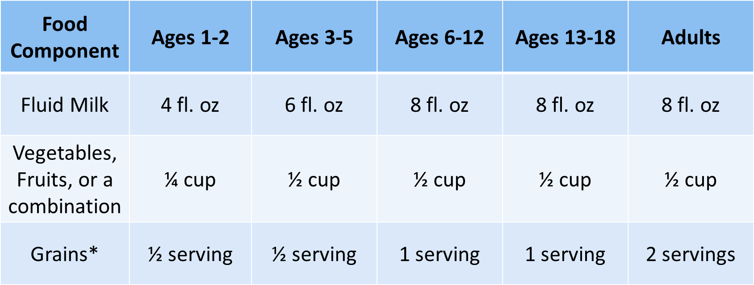
Proposed Child and Adults: Breakfast
*A meat/meat alternate may be used to meet 50% of the grains requirement.
Notes:
This table outlines the proposed breakfast meal pattern for children and adults

Slide 21
Proposed Child and Adults: Lunch and Supper
Notes:
Here is a table with the proposed lunch and supper meal pattern for children and adults.
As you can see in the table, fruit and vegetable are listed as separate components. Under the proposed meal patterns, a lunch containing two different fruits, such as an apple and orange would not be reimbursable. One of the fruits would need to be replaced with a vegetable, such as a lunch with an apple and carrots.

Slide 22
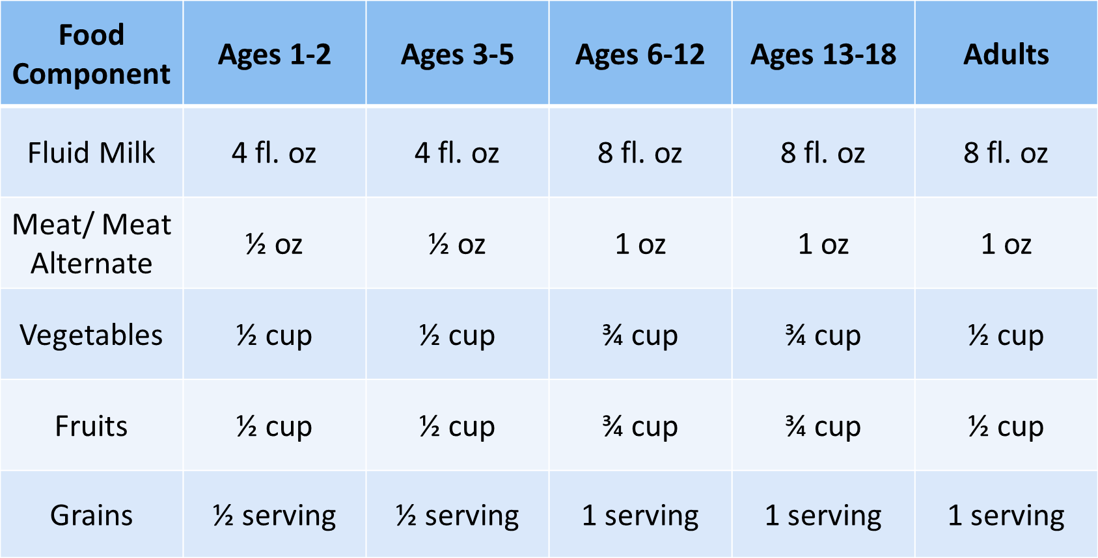
Proposed Child and Adults: Snacks (serve 2 of the 5 components)
Notes:
This table reflects the proposed snack meal pattern for children and adults. At snack, there is still a choice to serve 2 of the 5 components.

Slide 23
Additional Proposed Revisions
Notes:
Now we’ll go through the additional proposed revisions that address meal service requirements.

Slide 24
Additional Proposed Revisions
Prohibits frying as a method of onsite preparation
Water must be available to drink when requested
Parent/guardian may provide 1 component for medical or special dietary needs
Family style meals practices
Extends offer versus serve to at-risk afterschool sites
Notes:
First, we are proposing to prohibit frying as a way of preparing food on site to reduce the amount of fat served in a meal.
To keep this standard flexible and prevent increasing costs, USDA would allow all purchased foods that are pre-fried, flash-fried, and par-fried to be served. However, they must be reheated using a method other than frying, such as baking or microwaving.
USDA will develop guidance to help explain what is considered “frying”, and is seeking input from stakeholders on this proposed standard and encourage people to provide comments on what they consider “frying.”
The Healthy, Hunger-Free Kids Act requires that drinking water be available to children throughout the day.
In May 2011, USDA issued a memo implementing this requirement. The memo requires that CACFP centers and day care homes make drinking water available to children, as nutritionally appropriate, throughout the day, including at meal times. It requires that water be available when a child requests it but water does not have to be available for a child to self-serve.
“Child Nutrition Reauthorization 2010: Water Availability in the Child and Adult Care Food Program”
While not specifically required for adults, adult day care centers are encouraged to ensure adult participants also have access to drinking water.
The proposed rule reflects this policy that is already being implemented.
The proposed rule would allow parents or guardians to provide one food component for children who cannot eat the regular meal because of non-disability medical or special dietary needs.
The proposed rule reflects the current family style meal service best practices that a center or day care home must follow when serving meals family style. This includes placing enough food on each table and actively engaging children to serve themselves the full required portion of each meal component. Similar to offering water, this is already being implemented and is not new.
The proposed rule extends the option of OVS to children receiving meals in at-risk after-school care centers. Currently, CACFP only allows offer versus serve (OVS) in adult care centers.

Slide 25
Additional Proposed Revisions
Flavored milk served to children 2 through 4 years of age
A1: Prohibit the service of flavored milk OR
A2: Require flavored milk to contain no more than 22 grams of sugar per 8 fluid ounce serving
Notes:
In the proposed rule, USDA is presenting several options related to flavored milk and yogurt.
In their report the IOM identified flavored milk as a source of added sugars. To limit added sugars the IOM recommended that flavored milk be limited and served only to adults and children 5 years of age and older. The IOM also recommended limiting the amount of sugar in flavored milk.
USDA acknowledges that foods high in sugar such as flavored milk can contribute excess calories to a child’s diet and agrees that the sugar limits recommended for flavored milk and yogurt seem reasonable based on products currently available in the marketplace.
In the proposed rule, USDA is presenting two options for flavored milk served to children 2 through 4 years of age
A1: Prohibit the service of flavored milk OR
A2: Require flavored milk to contain no more than 22 grams of sugar per 8 fluid ounce serving
USDA is seeking public input on these options.

Slide 26
Additional Proposed Revisions
Flavored milk served to children 5 years and older
B1: Flavored milk must contain no more than 22 grams of sugar per 8 fluid ounce serving OR
B2: Sugar limit is a best practice
Yogurt (all age groups)
C1: Yogurt served must contain no more than 30 grams of sugar per 6 ounce serving OR
C2: Sugar limit is a best practice
Notes:
USDA is also presenting two options for a sugar limit on flavored milk served to children 5 years of age and older and adults. The two options are:
B1: flavored milk must contain no more than 22 grams of sugar per 8 fluid ounce serving OR
B2: the sugar limit is a best practice that centers and day care homes may choose to adopt at their own discretion
On top of recommending a limit on the amount of sugar in flavored milk, the IOM also recommended limiting the amount of sugar in yogurt.
USDA is presenting two options for a sugar limit on yogurt served to participants of all ages:
C1: yogurt served must contain no more than 30 grams of sugar per 6 ounces OR
C2: the sugar limit is a best practice
We are seeking public input on these options.

Slide 27
Best Practices
Notes:
USDA is including best practices in the proposed rule that CACFP providers may choose to follow.
The best practices outlined in the proposed rule reflect important recommendations from the IOM and American Academy of Pediatrics that USDA chose not to require at this time to allow for an incremental approach and to ensure the meal patterns are cost-neutral and easy to implement.
Program operators can use the best practices as a guide when choosing to improve their menus and to ensure that children and adults are getting the optimal benefit from the meals they receive.
While the best practices would be part of the regulatory text, they are optional.

Slide 28
Best Practices: Breastfeeding
Support and encourage breastfeeding by:
Providing materials and other educational opportunities to breastfeeding mothers
Encouraging mother to supply breastmilk to their infants while in care
Providing mothers with a quiet, private area to breastfeed
Notes:
Under the best practices, providers should support and encourage breastfeeding.
This can be done by:
Providing mothers access to breastfeeding materials and educational opportunities,
Encouraging mothers to supply breastmilk for their infant while in day care, and by
Providing mothers who come to the day care facility with a quiet, private area to breastfeed.

Slide 29
Best Practices: Fruits & Vegetables
Limit consumption of fruit juice to no more than 1 serving per day
Make at least 1 of the 2 required components of every snack a fruit or vegetable
Provide at least 1 serving each of dark green vegetables, red/orange vegetables and legumes per week
Notes:
To limit the intake of added sugars, USDA is encouraging providers to limit the consumption of fruit juice to no more than once per day for children.
This is based on the IOM’s report that pointed out that some fruit and vegetable products and preparation methods can be a source of added sugars, such as juices.
USDA is encouraging providers to offer at least one serving each of dark green vegetables, red or orange vegetables, and legumes once per week, and to make at least one of the two required components of every snack a fruit or vegetable.
Fruits and vegetables provide a variety of vitamins and minerals needed for growth and health maintenance. Exposing children to a variety of fruits and vegetables throughout the week is not only good for them but may help children develop healthy habits for life.

Slide 30
Best Practices: Grains
Provide at least 2 servings of whole grain-rich grains per day
Serve breakfast cereals that contain no more than 6 g of sugar per serving
Notes:
We are recommending that providers serve at least two servings of whole grain-rich grains each day to meet the IOM that at least half of all grains served be whole grain-rich.
Additionally, USDA is encouraging providers to serve breakfast cereals that contain no more than 6 grams of sugar per serving which is stricter than the WIC cereal standards. One dry ounce (WIC standard) is equivalent to 1/8 cup. Most breakfast cereals’ serving sizes are ½-3/4 cup which is about 4-6 dry ounces

Slide 31
Best Practices: Fluid Milk
Serve only unflavored milk to all participants regardless of age
Notes:
In response to the IOM’s identifying flavored milk as a source of added sugar, USDA recommends that providers serve only unflavored milk to all children and adults, regardless of age.

Slide 32
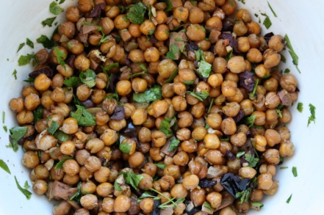
Best Practices: Meat and Meat Alternates
Serve only lean meat, nuts and legumes
Avoid or limit serving processed meats to no more than once per week
Serve only natural cheese
Notes:
USDA encourages providers to serving only lean meats, legumes and nuts; limiting processed meat to no more than once per week; and serving only natural cheese.
The Food Buying Guide provides some information on what is a natural cheese and USDA will provide additional guidance to help providers identify natural cheeses.
This best practice is based on DGA and IOM recommendations

Slide 33
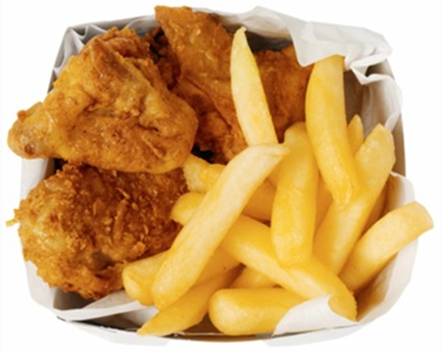
Best Practices: Preparation
Avoid or limit serving fried or pre-fried foods to no more than once per week
Notes:
USDA is also recommending that providers limit serving fried or pre-fried foods to no more than once per week to help reduce the consumption of fat.
This best practice is an extension of the proposed rule’s provision to prohibit frying a way of preparing food onsite. It recommends that purchased pre-fried, par-fried food items not be served, such as chicken nuggets.

Slide 34
Proposed Changes to Other Child Nutrition Programs
Notes:
Now we’ll talk about the corresponding changes to other Child Nutrition Programs that would occur with this proposed rule.

Slide 35
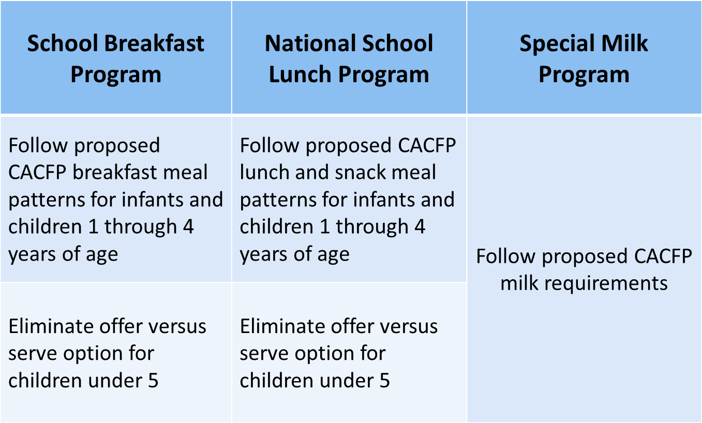
Other Child Nutrition Programs
Notes:
To maintain consistency among the meal pattern requirements for preschoolers, the meal pattern requirements for infants and children 1 through 4 years of age in School Breakfast and National School Lunch Programs would be revised to reflect the proposed CACFP breakfast, snack, and lunch meal patterns for those age groups. Meals served to children ages 5 years and older would continue to follow the School Breakfast and National School Lunch Programs’ meal patterns.
Additionally, the proposed rule would eliminate the offer versus serve option for children under 5.
Additionally, this proposed rule would require schools and institutions participating in the Special Milk Program (SMP) to follow the proposed CACFP milk requirements which includes serving:
Only unflavored whole milk to children 1 year of age
Low-fat or fat-free milk to children 2 years of age and older, and
Non-dairy milk substitutes that are nutritionally equivalent to cow’s milk participants with medical or special dietary needs

Slide 36
Public Comments
Notes:
That ends the summary of the proposed revisions.
USDA strongly encourages stakeholders to provide comments on the proposed rule. We cannot emphasize enough how important public comments are!
We invite your comments on how to make the proposed rule easier to understand, as well as comments and information that could help us make the program effective and practical. And, we want to emphasize the importance of unique, individual comments. We value group submissions but want to remind everyone that group submissions count as 1 comment. We look at each individual comment that is submitted and take it into consideration when writing the final rule. Please take the time to tell us what you think!

Slide 37
How to Submit Comments
Online (preferred method)
Visit the Federal eRulemaking Portal at www.regulations.gov
http://www.regulations.gov/#!documentDetail;D=FNS-2011-0029-0001
Mail
Tina Namian
Branch Chief, Policy and Program Development Division, Child Nutrition Programs, Food and Nutrition Service, Department of Agriculture
P.O. Box 66874
St. Louis, MO 63166
Emails will not be accepted
Notes:
All comments must be submitted in writing. Verbal comments will not be recorded. Written comments may be submitted two ways:
First, you may submit your comment online by visiting www.regulations.gov. The link for the proposed rule on regulations.gov is provided on the slide. Submitting comments through regulations.gov is the preferred method.
Second, you may submit comments via mail to the address presented on the slide.
Comments submitted via email or through any other medium will not be accepted.

Slide 38
Public Comments
Comment period open for 90 days: April 15, 2015
Written comments should:
Be specific and confined to issues pertinent to the proposed rule
Explain the reasons and/or provide supporting information for any recommended changes or provisions you oppose
Reference the section or paragraph of the proposal you’re addressing, when possible
Notes:
The comment period will be open for 90 days, which ends April 15, 2015
Comments should be specific, confined to issues pertinent to the proposed rule and should explain the reason(s) and/or provide supporting information for any change you recommend or proposal(s) you oppose. And when possible, please reference the specific section or paragraph of the proposal you are addressing.
And, please remember, anyone can comment!

