Slide 1
Staff Wellness for Early Care & Education Professionals
Notes:
In addition to the CDC and Nemours logos you are welcome to add your own state logo(s) and unique project name to these slides.

Slide 2
Acknowledgements
A special thank you to:
Centers for Disease Control and Prevention (CDC)
For generous funding support and expertise
Nemours
For their expertise, materials, support, and time spent on the project’s implementation
Gretchen Swanson Center for Nutrition
For the evaluation component of this national effort
Notes:
Enter acknowledgements for your state partners.
The ECELC is a project funded by the Centers for Disease Control and Prevention (CDC) to support early care and education (ECE) providers to promote best practices in healthy nutrition, physical activity, breastfeeding support, and screen time.
Nemours is supporting this project monthly through their expertise, materials, and time throughout the implementation process.
Gretchen Swanson Center for Nutrition is administering the evaluation component of this project.

Slide 3
Overview
Nutrition & Meal Planning
Physical Activity
Stress
Numbers for your Health
Notes:
Today we are here to talk about talking care of you. As ECE professionals, you spend your work time supporting young children in all of these areas and so many others. Our session today will focus on simple steps you can take to support your personal health. We will look at these topics from the perspective of working adults-what your needs are and how you can improve your overall wellness.

Slide 4
Notes:
When we fly, flight attendants give passengers a safety briefing. They instruct passengers that in the event of an emergency oxygen bags will drop from the ceiling above, adults should place the bag on themselves before they assist children in putting their bag on. Why is this?
Quick Large Group Discussion.

Slide 5
Group Discussion
As a caregiver, what are some of the consequences of not taking care of yourself?
Notes:
Group discussion
Burn out
Fatique
Poor health outcomes etc.

Slide 6
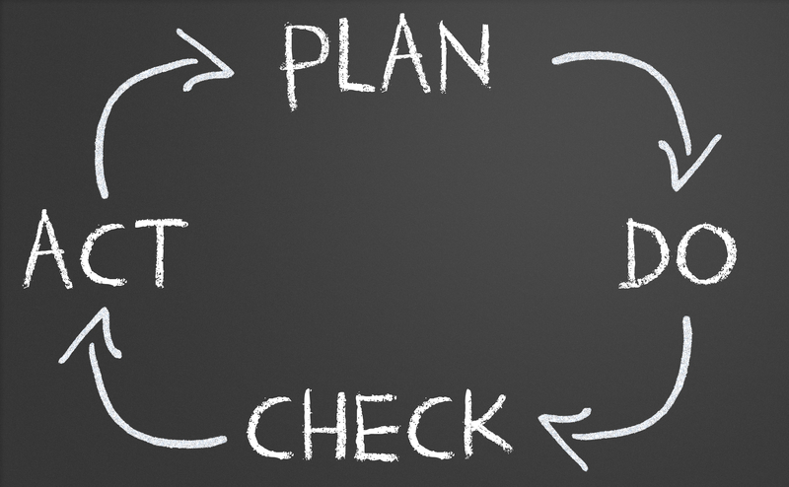
Training Outcome
Create a Personal Wellness Plan
Notes:
On the back page of your handout you will find a personal wellness plan. As we saw with our long term action plans, it is important to set goals, have target dates and list out the steps.
Today we are challenging you to create an action plan for your personal wellness and health. Not everything we talk about today will be something that interests you or is relevant to you at this moment. Maybe you already exercise regularly and don’t need to add more PA into your day. Perhaps you have a new baby at home and getting adequate sleep is a really big challenge. We all have our unique situations. Our hope is that you take this time to think about your own health and health behaviors and consider a few next steps.
Lets take a few minutes to review the action plan on the last page of your handout. Read through the bullets on the page. As we go through our sections today, feel free to flip back to this page and note things that are of interest to you and you would like to put in your personal plan.

Slide 7
“Take care of your body. It’s the only place you have to live.”
– Jim Rohn, author and motivational speaker

Slide 8
Nutrition and Meal Planning

Slide 9
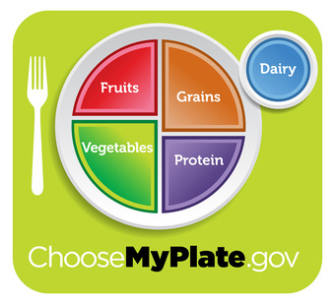
Notes:
Choose MyPlate is the United States Department of Agriculture (USDA) Food Guidance System for Americans. This image was developed using the 2010 Dietary Guidelines for Americans and was released in June 2011. It serves as a visual guide to healthy eating. Americans may be familiar with the former visuals of MyPyramid and the Food Guide Pyramid.
Food gives us nutrients like vitamins, minerals and dietary fiber which our bodies use to stay healthy. When keeping track of energy balance/calories it is important to ensure you are getting nutrients necessary for good health. It is important to eat a balanced diet with a variety of foods.
We have talked about this for children but it is just as important that you have nutrient rich foods.
Healthier options within food group
Example: whole grains vs. refined grains; low-fat dairy vs. full-fat dairy
Variety within food group
Example: rotate protein source with beans, fish, poultry, red meat, etc.
How much (portion size)
How often (over the course of a week)
How it is prepared
Example: baked vs. fried

Slide 10
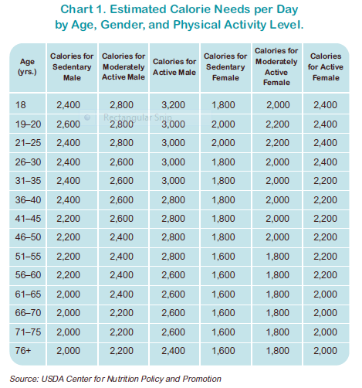
Notes:
While it is important to consume all nutrients following my plate it is also useful to become aware of the caloric values of food and our daily caloric needs. Take a look at your estimated calorie needs per day based on your activity level. Each of us is going to have individual variances based on how active we are daily.
One of the challenges we face is how many calories are in the food we consume. In learning session 2 we did an activity with food labels that helped us understand how to look at food labels and portion sizes to understand the calories in the food we eat. Information on food labels can be found in Best Practices for Healthy eating. The recent addition of calories at many restaurants menus also supports understanding caloric values.

Slide 11
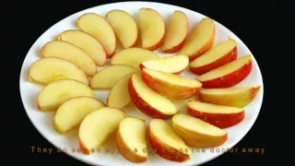
What does 200 calories look like?
https://www.youtube.com/watch?v=TMQDPXDtLh8
Notes:
https://www.youtube.com/watch?v=TMQDPXDtLh8

Slide 12
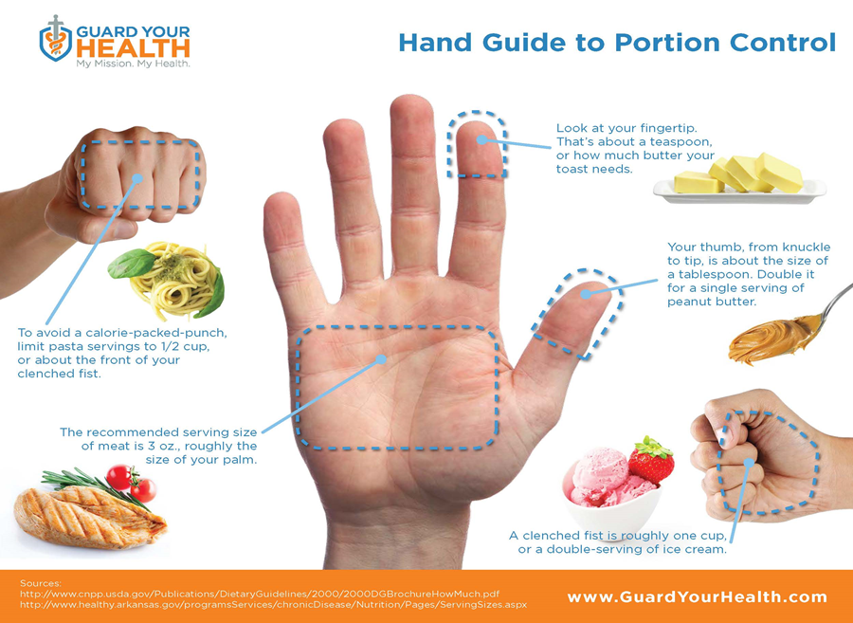
Notes:
Portion sizes also support us in controlling caloric intake. Refer to handout. Walk through portion sizes. Relay that this is useful for children and adults to use their hands to guide their serving size. As our hand grows, our serving size increases slightly.
Activity- with participants holding their hand, looking at their handout, identify and touch the parts of their hand that correspond to serving sizes.

Slide 13
USDA SuperTracker
Notes:
SuperTracker, is a website that allows individuals to set nutrition and physical activity goals. SuperTracker provides opportunities to develop personalized nutrition and physical activity plans using a food and physical activity tracker. It also offers resources and tips to help guide individuals to make healthier choices and plan ahead.
For more information direct participants to www.choosemyplate.gov/supertracker. Encourage participants to share this website with their program staff and families.
Other useful apps/websites on handout include my fitness pal, spark people and lose it!

Slide 14
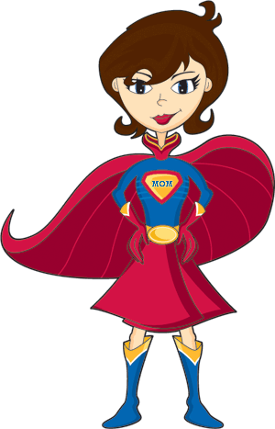
Planning
Notes:
The struggle we all face is how to eat healthy with limited time and a budget! Sometimes we need super powers to accomplish this!
The key to having a eating healthy consistently, is planning ahead. You need to have a plan of what foods you will eat, what workouts you will do, etc. By prepping your meals ahead of time, you get rid of all temptation to snack on food while cooking your actual meal, or just choosing the most convenient snack bar at hand. This way you have your meals ready at hand, all measured out and hunger will not dictate what goes into your body. Sometimes meal prepping can seem like an extremely daunting task. How are you supposed to cook all your food for 7 days, in one afternoon?
Simple steps like planning and bringing your snack can help you control last minute decisions.

Slide 16
Meal Planning 101
Benefits
Lower cost
Healthier food options
Can use your break time to relax instead of going out to a drive through
Involve children and family in the prep
Role model for and support coworkers
Strategies
Plan/Make Shopping lists
Shop in season for produce
Prep veggies and fruits a the beginning of your week to grab and go through your week
Prep proteins and starches at the beginning of your week for lunches and quick meal prep after work
Don’t shop hungry

Slide 17
Notes:
"If you can't pronounce it, you shouldn't eat it."
Jamie Oliver's Foundation works to bring food education to schools, youth programs, and communities. www.jamieoliverfoodfoundation.org--great resources
TED video on the Jamie Oliver food foundation website

Slide 18
Notes:
What do you notice about the food pictured here?
All fresh--not processed
Colorful
Large variety--change the choices each week
Easy to grab and go-- Increases the chances that you will grab a healthy choice for lunch and dinner if you plan ahead

Slide 19
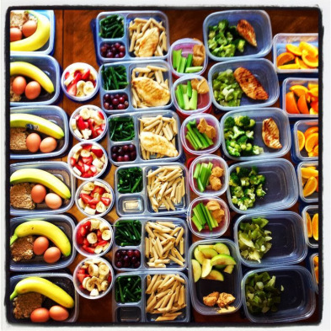
Notes:
Discuss different options
Protein options
– Chicken Breasts Boneless, Skinless
– Chicken thighs are okay for specific recipes
– Ground Beef – 85% lean or higher
– Ground Turkey – 93% lean or higher
– Fish – Salmon, Tilapia, Shrimp*
– Eggs (hard boil a bunch for the week!)
– Vegetarian or Vegan?
Try plant based proteins:
beans (black beans, garbanzo beans, kidney beans, etc.) edamame, tofu, tempeh
– Starch options: opt for whole grain, complex carbohydrates as your fuel!
– Quinoa— you can add whatever flavors/spices of dish to quinoa to boost flavor
– Sweet potato
– Brown rice
– Pasta
– Potato
– Rice Varities: Jasmine*, Basmati*, Wild Grain*, Etc.
– Buckwheat
– Amaranth
(there are other options as well, this is a ‘basic’ list)
– Vegetable options: leafy greens are your best bet here! I have put a * next to my favorites!
– Spinach
– Green Beans
– Mushrooms
– Asparagus
– Brocoli
– Cucumber
– Red, Yellow, Orange Peppers
– Zucchini
– Kale
– Bok Choy
– Spaghetti Squash
– Carrots
– Tomatoes
– Sugar Snap Peas

Slide 20
Notes:
The mason jar salad is here to solve all your lunchtime problems. It’s portable, healthy, easy to make and offers room for plenty of variety. It’s the perfect solution, and it’s about to be your new best friend this summer. You can layer so many vegetables and grains in the jar, and mix and match so many different ingredients that you’ll never get bored.
Packing your salad in a jar is also an amazing way to solve the classic soggy salad problem. If you pack a pre-dressed salad for lunch, the greens will be limp and soggy by the time you’re ready to eat it. And who has a separate salad container to bring in addition to the salad itself? The mason jar salad keeps your greens from getting dressed until you’re ready to mix it up. All you have to do is put the salad dressing in first and layer in ingredients one by one, leaving the salad greens on top. You should start with the heaviest, most non-absorbent ingredients first.
http://www.huffingtonpost.com/2014/06/06/mason-jar-salads_n_5452313.html

Slide 21
Notes:
Oatmeal packet ideas to make your own instant oatmeal…you know and control the ingredients. Much more cost effective than buying the already packaged.
There are many other ideas like this one to help us eat healthier while saving money.

Slide 22
Notes:
Water helps maintain balance of body fluids, helps control calorie intake, energizes muscles, hydrates skin, increases kidney and bowel functions.
Recommend amount 8-8 oz glasses which equals 2 liters per day
Infused Water ideas
Mint and Cucumber
Lemon, Lime or Orange or a citrus blend
Raspberry
Basil and Strawberry
Watermelon

Slide 23
Small Changes
Choose this: Instead of this:
Corn Tortilla White Tortilla
Brown Rice White Rice
Sweet Potato Fries French Fries
Fruit Water Soda or Juice
Cucumber Chips Potato Chips
Fruit Chocolate
Notes:
Ideas for healthier substitutes for frequently used foods. Remember as we have said many times – small changes can make a big difference.
Group discussion on small changes they have made

Slide 24
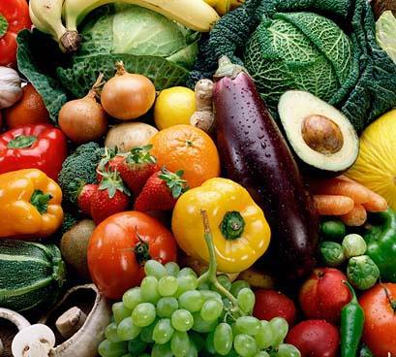
If you keep only good food in your fridge,
you will eat good food.
Notes:
Create an environment where healthy eating is the easy or only choice!

Slide 25
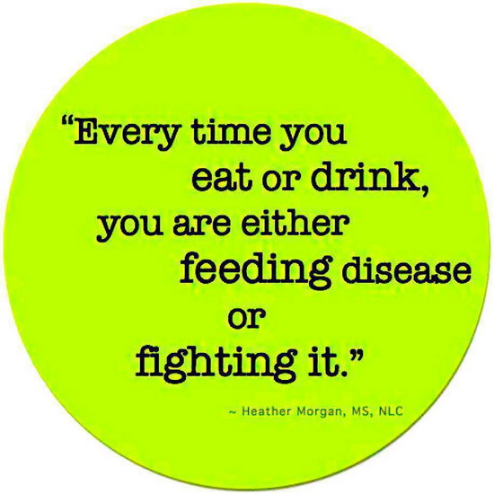
Notes:
Remember the saying "An apple a day keeps the doctor away". Does this hold merit? There are researched correlations between food additives/preservatives and diseases--Sodium nitrates, high fructose corn syrup, trans fats, OTHERS??

Slide 26
Notes:
Refer to handout for review.
Encourage the group to take a few minutes and think about nutrition and meal planning on their action plans. Is there anything that fits in their short or long term goals relating to nutrition?

Slide 27
Physical Activity
Notes:
Movement of the body that requires energy

Slide 28
Adults need at least:
2 hours and 30 minutes (150 minutes) of moderate-intensity aerobic (i.e., brisk walking) every week and muscle-strengthening activities on 2 or more days a week that work all major muscle groups (legs, hips, back, abdomen, chest, shoulders, and arms).
or
1 hour and 15 minutes (75 minutes) of vigorous-intensity aerobic activity (i.e., jogging or running) every week and muscle-strengthening activities on 2 or more days a week that work all major muscle groups
Notes:
http://
www.cdc.gov/physicalactivity/basics/adults/index.htm
Examples of Moderate intensity aerobic activity-brisk walking, water aerobics, yoga, playing with children
Muscle strengthening activity examples-lunges, crunches, push-ups, pull-ups,

Slide 29
Stretching
https://www.youtube.com/watch?v=tdNEzxhPhpo
Notes:
Stretching is important! It warms up your muscles, reduces tension, and increases range of motion. It helps to prevent strains and soreness It also raises your body temperature and increases circulations in order to prepare your body to move!

Slide 30
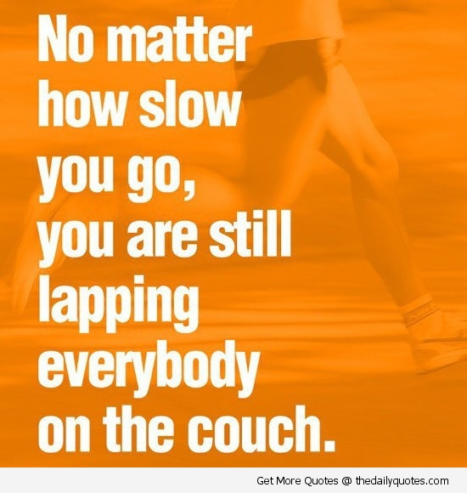
Notes:
Establishing a new habit or healthy behavior. Set realistic expectations!

Slide 31
Why PA
Regular physical activity is one of the most important things you can do for your health. It can help:
•Control your weight
•Reduce your risk of cardiovascular disease
•Reduce your risk for type 2 diabetes and metabolic syndrome
•Reduce your risk of some cancers
•Strengthen your bones and muscles
•Improve your mental health and mood
•Improve your ability to do daily activities
•Increase your chances of living longer
Notes:
Source: http://www.cdc.gov/physicalactivity/basics/pa-health/index.htm
http://www.huffingtonpost.com/2013/09/04/body-on-exercise-what-happens-infographic_n_3838293.html

Slide 32
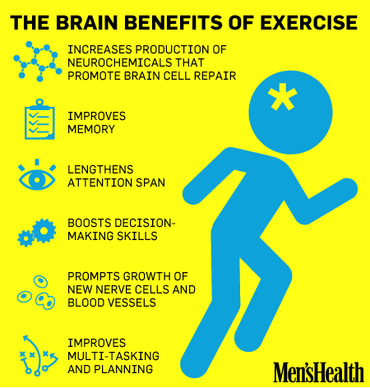
Notes:
Exercise is a "total body" workout!

Slide 33
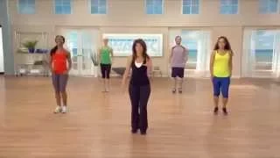
Easy Light Walk
https://www.youtube.com/watch?v=LQMpBlJ-sTA
Notes:
What are small steps you can take? Refer participants to the fit Facts on p 4 of their handout. Spend a few minutes discussion small ways to increase physical activity. Is physical activity something you want to add to your personal wellness plan. Flip back to the action plan and spend a few minutes annotating your plans.

Slide 34
STRESS
Notes:
Group Discussion- What stresses you out?
Participants will give lots of answers!

Slide 35
What are your stressors?
Notes:
Group Discussion
Example of stressors:
Emotional-fear, anger
Chemical-caffeine, nicotine, sugar
Physical-obesity, sickness
Environmental-noise pollution
Social-age, income, social status, cultural background, previous experience, lifestyle, attitude

Slide 36
Emotional
Chemical
Physical
Environ-mental
Social
Notes:
Sources of stress
Emotional-Fear, Anger, Frustration
Chemical-Caffeine, Nicotine, Sugar
Physical-Illness, Obesity
Environmental- Noises, Scents, Equipment
Social-Income, Culture, Experience, Lifestyles, Attitude

Slide 37
Triggers
Involuntary
B/P
Voluntary
Yelling
Road Rage
Heart Rate
Notes:
Involuntary- blood pressure rises; heart rate increases (act out, whine)
Voluntary-can be controlled (yell, argue)

Slide 38
2 types of Stress
Eustress
Distress
Notes:
Eustress- positive stress (getting excited about a ballgame)
Distress- negative stress
•acute stress-comes immediately after a change in routine. Short lived. Acute stress is the
type of stress many people feel when they have trouble at work or their children have
problems in school. Once the situation is resolved, the stress diminishes.
•chronic stress- occurs with constant change of routine. Long term. (financial stress,
relationship stress)

Slide 39
5-minute Stress Test
Notes:
Take the quiz

Slide 40
100 ways to reduce stress
Notes:
Source: http://www.counseling.org/resources/library/vistas/2011-v-online/Article_27.pdf
Refer to handout
Discussion on some of their favorite ways to control or reduce their stress. Is this something to add to your wellness plan?

Slide 41
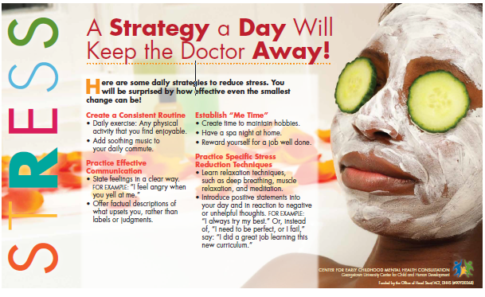
Notes:
These posters are free to download and can be a nice addition to your staff or parent areas.

Slide 42
Know Your Numbers

Slide 43
Sleep
Notes:
Before we talk about numbers let’s spend a few minutes talking about sleep. Sleep is a basic human need, as important for good health as diet and exercise. When we sleep, our bodies rest but our brains are active. Sleep lays the groundwork for a productive day ahead. Although most people need seven to nine hours of sleep each night to function well the next day, the National Sleep Foundation (NSF) 1998 Women and Sleep Poll found that the average woman aged 30-60 sleeps only six hours and forty-one minutes during the workweek.
A more recent 2005 NSF Sleep in America poll of all adults revealed that women are more likely than men to have difficulty falling and staying asleep and to experience more daytime sleepiness at least a few nights/days a week. Research has shown that too little sleep results in daytime sleepiness, increased accidents, problems concentrating, poor performance on the job and in school, and possibly, increased sickness and weight gain.
Getting the right amount of sleep is vital, but just as important is the quality of your sleep. Biological conditions unique to women, like the menstrual cycle, pregnancy and menopause, can affect how well a woman sleeps. This is because the changing levels of hormones that a woman experiences throughout the month and over her lifetime, like estrogen and progesterone, have an impact on sleep. Understanding the effects of these hormones, environmental factors and lifestyle habits can help women enjoy a good night’s sleep.

Slide 44
Notes:
Royal blue is recommended amounts of sleep
Turquoise is may be appropriate
Yellow areas are not is not recommended
https://sleepfoundation.org/sites/default/files/STREPchanges_1.png

Slide 45
Notes:
27 % of adults in Kentucky smoke
http://kentuckyhealthfacts.org/data/topic/show.aspx?ind=6
In a gallop poll conducted in 2013 Kentucky had the highest rate of all 50 states
http://www.gallup.com/poll/167771/smoking-rate-lowest-utah-highest-kentucky.aspx

Slide 46
Know your numbers
BMI
Blood Pressure
Cholesterol
Blood Sugar
Notes:
Some health factors impact the way you feel everyday. You are better able to be a caregiver when we are as healthy as we can be. Work with your health care provider for advice on your personal health including your blood pressure, cholesterol, blood sugar and BMI. Today we are going to share some information about these numbers and why they are so important to your health.
Many of the these indicators are measured in a biometric screenings. Some employers offer biometric screenings through their health insurance programs.
Knowing these numbers can help you track your health over time.

Slide 47
Blood Pressure
Notes:
Your blood pressure rises with each heartbeat and falls when your heart relaxes between beats. While BP can change from minute to minute with changes in posture, exercise, stress or sleep, it should normally be less than 120/80 mm Hg (less than 120 systolic AND less than 80 diastolic) for an adult age 20 or over. About one in three U.S. adults has high blood pressure.
If your blood pressure reading is higher than normal, your doctor may take several readings over time and/or have you monitor your blood pressure at home before diagnosing you with high blood pressure.
A single high reading does not necessarily mean that you have high blood pressure. However, if readings stay at 140/90 mm Hg or above (systolic 140 or above OR diastolic 90 or above) over time, your doctor will likely want you to begin a treatment program. Such a program almost always includes lifestyle changes and often prescription medication for those with readings of 140/90 or higher.
If, while monitoring your blood pressure, you get a systolic reading of 180 mm Hg or higher OR a diastolic reading of 110 mm HG or higher, wait a couple of minutes and take it again. If the reading is still at or above that level, you should seek immediate emergency medical treatment for a hypertensive crisis. If you can't access the emergency medical services (EMS), have someone drive you to the hospital right away.
Even if your blood pressure is normal, you should consider making lifestyle modifications to prevent the development of HBP and improve your heart health.
Which number is more important, top (systolic) or bottom (diastolic)?
Typically more attention is given to the top number (the systolic blood pressure) as a major risk factor for cardiovascular disease for people over 50 years old. In most people, systolic blood pressure rises steadily with age due to increasing stiffness of large arteries, long-term build-up of plaque, and increased incidence of cardiac and vascular disease.

Slide 48
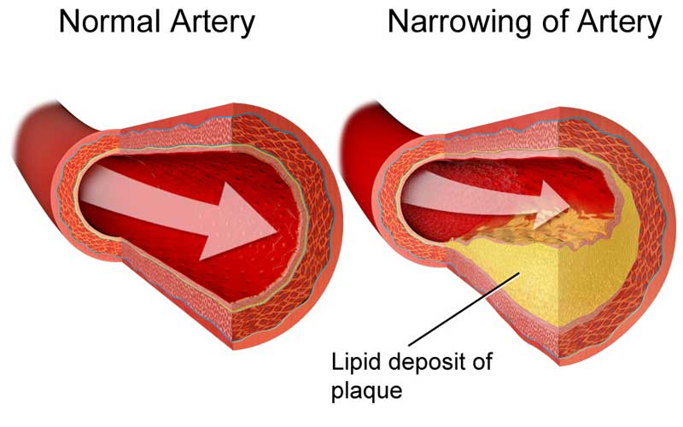
Cholesterol
Notes:
Keeping your cholesterol levels healthy is a great way to keep your heart healthy – and lower your chances of getting heart disease or having a stroke. But first, you have to know your cholesterol numbers.
The American Heart Association recommends all adults age 20 or older have their cholesterol, and other traditional risk factors, checked every four to six years.
Your test report will show your cholesterol levels in milligrams per deciliter of blood (mg/dL). Your total cholesterol and HDL (good) cholesterol are among numerous factors your doctor can use to predict your lifetime or 10-year risk for a heart attack or stroke. To determine how your cholesterol levels affect your risk of heart disease, your doctor will also take into account other risk factors such as age, family history, smoking and high blood pressure.
A complete fasting lipoprotein profile will show the following for:
Total blood (or serum) cholesterol
Your total cholesterol score is calculated using the following equation: HDL + LDL + 20 percent of your triglyceride level.
HDL (good) cholesterol
With HDL cholesterol, higher levels are better. Low HDL cholesterol puts you at higher risk for heart disease. People with high blood triglycerides usually also have lower HDL cholesterol. Genetic factors, type 2 diabetes, smoking, being overweight and being sedentary can all result in lower HDL cholesterol.
LDL (bad) cholesterol
A low LDL cholesterol level is considered good for your heart health. However, your LDL number should no longer be the main factor in guiding treatment to prevent heart attack and stroke, according to new guidelines from the American Heart Association. For patients taking statins, the guidelines say they no longer need to get LDL cholesterol levels down to a specific target number. A diet high in saturated and trans fats raises LDL cholesterol.
Triglycerides
Triglyceride is the most common type of fat in the body. Normal triglyceride levels vary by age and sex. A high triglyceride level combined with low HDL cholesterol or high LDL cholesterol is associated with atherosclerosis, the buildup of fatty deposits in artery walls that increases the risk for heart attack and stroke

Slide 49
Blood Glucose
Notes:
A blood glucose test measures the amount of a sugar called glucose in a sample of your blood. Glucose is a major source of energy for most cells of the body, including brain cells. Carbohydrates are found in fruit, cereal, bread, pasta, and rice. They are quickly turned into glucose in your body. This raises your blood glucose level.
The goal for fasting blood glucose is 70-100 mg/dL.
In incidences of prediabetes, there may be no symptoms. People may not be aware that they have type 1 or type 2 diabetes because they have no symptoms or because the symptoms are so mild that they go unnoticed for quite some time. Not everyone has the same symptoms
Possible symptoms:
Increased or extreme thirst, Increased appetite, Fatigue, Increased urination, Weight loss, Blurred vision, Fruity odor or breath, Sores that do not heal
100 to 125 mg/dL Prediabetes (also called Impaired Fasting Glucose) Blood glucose levels are higher than normal but not high enough to be diagnosed as diabetes. This condition puts you at increased risk for developing type 2 diabetes, heart disease, and stroke.
126 mg/dL or more Diabetes mellitus (type 2 diabetes) Type 2 diabetes develops when your body doesn't make enough insulin or develops "insulin resistance" and can't make efficient use of the insulin it makes. It greatly increases your risk of heart disease and stroke.

Slide 50
Body Mass Index
Notes:
Distribute BMI tables, invite participants to determine if they are at a healthy weight. Knowing information better enables to make decisions.
The benefits of maintaining a healthy weight go far beyond improved energy and smaller clothing sizes. By losing weight or maintaining a healthy weight, you are also likely to enjoy these quality-of-life factors too.
•Fewer joint and muscle pains
•More energy and greater ability to join in desired activities
•Better regulation of bodily fluids and blood pressure
•Reduced burden on your heart and circulatory system
•Better sleep patterns
•Reductions in blood triglycerides, blood glucose, and risk of developing type 2 diabetes
•Reduced risk for heart disease and certain cancers
BMI is an indicator of the amount of body fat for most people. It is used as a screening tool to identify whether an adult is at a healthy weight.
Excess weight increases the heart's work. It also raises blood pressure and blood cholesterol and triglyceride levels and lowers HDL (good) cholesterol levels. It can make diabetes more likely to develop, too. Lifestyle changes that help you maintain a 3-5% weight loss are likely to result in clinically meaningful improvements in blood glucose, triglycerides, and risk of developing type 2 diabetes. Greater weight loss can even help reduce BP and improve blood cholesterol.

Slide 51
Notes:
Our final numbers for today are numbers we have focused on throughout the ECELC. While our ECELC focused on children, it is important for all to eat 5 a day, limit screen time, engage in physical activity and reduce/eliminate sugary beverages. These healthy behaviors lay a foundation of health for children and continue supporting optimal health as we grow and age.

Slide 52
What light bulb information stood out for you?
Notes:
Small group or large group discussion

Slide 53
Wellness Plan
Notes:
Time to spend some time working on the last page of your handout. Not all of the information presented today will be relevant to you at this moment but your personal health is important-whatever place you are in in your life today. The first step is to make the decision to take charge of your health and wellness. While this may seem overwhelming and complicated, identifying small steps that are important to you can break it down into manageable pieces. What are some healthy habits you want to establish? Small changes can has a big impact on how you feel and on your health.
Spend 5-10 minutes completing the plan. Review the PDCA cycle. If time permits, ask someone to share a piece of their plan.

Slide 55
The End

