Slide 1

support infant feeding
Notes:
Notes for trainer:
This slide set offers child care and early education providers an in-depth look at LMCC Goal 5: Support Infant Feeding.
You can use these slides to train providers. Hold a training on LMCC or integrate LMCC content into existing or new trainings, including in-person and online trainings.
Please feel free to adapt the slides for specific needs and audiences, including adding slides from other LMCC slide sets. For example, use the slides from the ‘Introduction to Let’s Move! Child Care’ slide set to show providers how to participate in LMCC.
We have included some interactive activities in this module to keep providers engaged and promote learning. Consider including more!
Consider adding additional slides that give information on local resources, training opportunities, and contacts for technical assistance.
For questions, please email LMCCHelp@cdc.gov.

Slide 2
Learning Objectives
Understand Let’s Move! Child Care Goal and best practices for infant feeding
Know the benefits of supporting breastfeeding moms and babies
Get strategies and ideas to create a private room for mothers to breastfeed or pump
Learn about the resources and tips available on the Let’s Move! Child Care website: www.HealthyKidsHealthyFuture.org

Slide 3
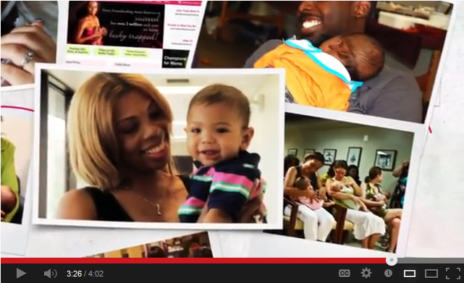
Growing a First Food Movement –
Coming Together in Support of Breastfeeding
Notes:
Suggested talking points:
To start, let’s watch a short video on breastfeeding.
Notes for trainer:
Play this video during your training session. The video is ~4 min.
NOTE: The image on the slide is ONLY an image, not a video.
If you will have internet during your training session, click on the title to show the video.
If you will not have internet during your training session, try embedding the video in your presentation. You can find the video on YouTube at: www.youtube.com/watch?v=Zhx-R6p1xAQ

Slide 4
Knowledge Check
For how many months should a baby be exclusively breastfed?
3 months
4 months
5 months
6 months

Slide 5
Knowledge Check
For how many months should a baby be exclusively breastfed?
3 months
4 months
5 months
6 months
  An “exclusively breastfed” baby is given only breast milk (no formula, cereal, juice, water, or baby food).
  The American Academy of Pediatrics (AAP) recommends:
  “Exclusive breastfeeding” for the first 6 months
  Continued breastfeeding for at least 12 months
    There is no ‘age limit’ – after 12 months, AAP recommends breastfeeding continue for as long as mother and baby desire

Slide 6


Mother’s milk is best for babies
Protects her baby from infections and illnesses with customized immune factors that no infant formula will ever be able to match
Provides her baby exactly what is needed to grow and thrive, and changes over time to keep up with baby’s changing needs
  Even when a mother’s own diet is poor, her milk is still perfect for her baby.
Programs her baby for healthy habits, diet, and nutrition that keep going long after breastfeeding ends
Notes:
Suggested talking points:
Mother’s milk is designed to meet the needs of her infant.

Slide 7

Take A Look
Notes:
Suggested talking points:
This shows a drop of formula and a drop of breast milk. Which one do you think is the human milk?
Notes for trainer:
Have providers choose which one they think is the human milk. Then, go to the next slide to give them the answer.

Slide 8
Take A Look
Drop of formula vs. Drop of breast milk
White blood cells protect against infection.
Fat globules help eyes and brain grow faster.

Slide 9
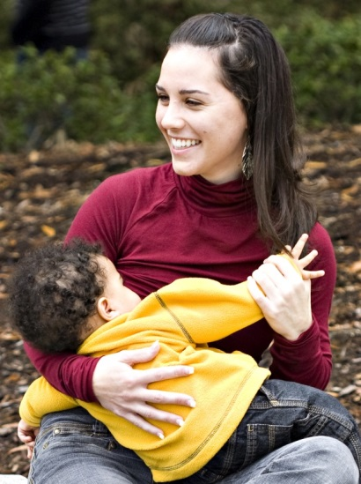
Breastfeeding Protects Babies
Helps make babies less likely to grow up to be obese or suffer from things like diabetes and asthma
Helps keep babies from getting sick with things like diarrhea and ear infections
  Helps keep babies who do get sick from becoming severely ill and needing to go to the hospital
Helps protect babies against Sudden Infant Death Syndrome (SIDS)
Notes:
Notes for trainer:
For more information, visit: www.womenshealth.gov/Breastfeeding/why-breastfeeding-is-important/

Slide 10

Breastfeeding Benefits Mothers
Helps protect moms against things like breast and ovarian cancers and type 2 diabetes
Helps moms fend off and deal with postpartum depression
Makes bonding easier and helps mothers stay closely bonded to their babies after going back to work
Helps mothers be able to be at work instead of taking time off to care for a sick baby
Saves mothers money – at least ~$1500/year
Notes:
Suggested talking points:
Mothers benefit from breastfeeding too!
Breastfeeding can feel great – Physical contact is important to newborns. It can help them feel more secure, warm, and comforted. Mothers can benefit from this closeness, as well. Breastfeeding requires a mother to take some quiet relaxed time to bond.
Breastfeeding can be good for the mother’s health, too – Breastfeeding is linked to a lower risk of these health problems in women:
Breast cancer
Ovarian cancer
Type 2 diabetes
Postpartum depression
Breastfeeding can save money – Formula and feeding supplies can cost well over $1,500 each year, depending on how much a baby eats. Breastfed babies are also sick less often, which can lower health care costs.
Life can be easier for mothers when they breastfeed – Breastfeeding may take a little more effort than formula feeding at first. But it can make life easier once mothers and their babies settle into a good routine. Plus, when you breastfeed, there are no bottles and nipples to sterilize. You do not have to buy, measure, and mix formula. And there are no bottles to warm in the middle of the night! You can satisfy your baby’s hunger right away when breastfeeding.
Mothers miss less work – Breastfeeding mothers miss fewer days from work because their infants are sick less often.
Notes for trainer:
This information is from: www.womenshealth.gov/Breastfeeding/why-breastfeeding-is-important/

Slide 11
Expressed Milk = Food Brought From Home
Follow existing procedures for handling and storing other foods brought from home (such as infant formula and baby foods) when handling and storing expressed milk
  Be sure not to waste expressed milk – wasting milk does not support moms who work very hard to collect and provide their milk
  No procedures exist for foods brought from home? Follow existing procedures for medications brought from home
Notes:
Suggested Talking Points
Freshly expressed milk can sit safely and hygienically at room temperature for up to 8 hours after expression.
Expressed milk, infant formula, and baby food should never be heated in a microwave oven, instead they should be heated in their containers with warm or hot tap water running over them in a sink.

Slide 12
Appropriate Procedures for Storing, Handling, and Feeding Expressed Milk
Storage:
Label all containers (child’s name, date)
Organize containers (group by child, newest milk in back)
Handling and Feeding:
Follow food safety guidelines (expressed milk is FOOD, not hazardous body fluid)
  Gloves? Only if required for food handling
  Microwave heating? Never microwave any infant foods
  Reheating? Never reheat any infant foods
Notes:
Suggested Talking Points
Freshly expressed milk can sit safely and hygienically at room temperature for up to 8 hours after expression.
Expressed milk, infant formula, and baby food should never be heated in a microwave oven, instead they should be heated in their containers with warm or hot tap water running over them in a sink.

Slide 13
Knowledge Check
Expressed milk is a hazardous body fluid that requires extra precautions for storage and handling to prevent infection.
TRUE
FALSE
Notes:
KATHLEEN

Slide 14
Knowledge Check
Expressed milk is a hazardous body fluid that requires extra precautions for storage and handling to prevent infection.
TRUE
FALSE
  The answer is FALSE.
  Expressed milk is not a hazardous substance, it is a food.
  “Universal precautions” do not apply to expressed milk.
  Expressed milk should be stored in refrigerators and freezers appropriate for food storage.
  Expressed milk may be stored along with any other foods and beverages.
Notes:
KATHLEEN

Slide 15

Feeding Expressed Milk Benefits YOU as a Care Provider
Expressed milk is reimbursable!
  When fed by a care provider, expressed milk is reimbursable for infants as part of the Child and Adult Care Food Program (CACFP) meal pattern
Expressed milk is free!
  Mothers provide their milk to you. Nothing for you to buy; more money in your pocket.
Notes:
Suggested talking points:
Note: Not reimbursable if mom breastfeeds or feeds baby herself.

Slide 16
How to Know a Mom is Breastfeeding
You can’t tell if she’s breastfeeding just by how she looks – all kinds of moms breastfeed!
  Every race/ethnicity
  Single, married, divorced, poor, rich, young, old, hippie, conservative, gay, straight
  From/in big cities, the middle of nowhere, the Deep South, far Out West, way Up North, Back East, and every country in the world
  Never finished school, in school, hated school, loved school, have no degree, have multiple degrees
  Work in cars, restaurants, schools, fields, hospitals, jails, banks, airplanes, ships, governments, offices

Slide 17
Why Do Moms Need Your Support?
81% of moms desire to breastfeed
60% of moms do not meet their breastfeeding goals
Returning to work is the primary reason for ending breastfeeding
Shorter duration if baby is in an early care and education environment

Slide 18
Why Do Moms Need Your Support?
Most moms want to breastfeed – you might be the only champion around.
  Some families don’t support moms who want to breastfeed.
  Some hospitals do things when the baby is born that make breastfeeding harder than it needs to be.
  Some employers don’t want moms to breastfeed/express milk.
  Some jobs make it hard to keep breastfeeding.
Most moms worry about breastfeeding – you might be the only reassuring voice.
  Most worry whether there’s enough milk and many struggle to express enough milk for you.
  All who aren’t able to provide enough milk will be sad.

Slide 19

Supporting Parental Choice
Some mothers will choose not to breastfeed, and that’s okay! Support their decision.
For moms whose babies don’t get expressed milk, infant formula is the only safe alternative.

Slide 20
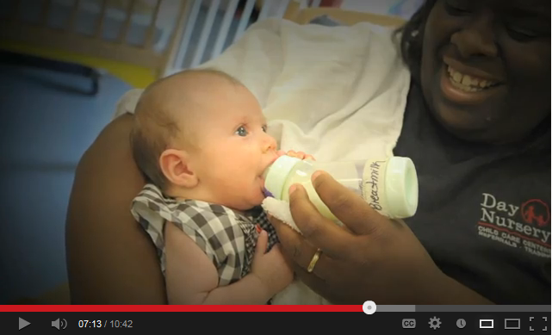
How To Support a Breastfeeding Mother
Notes:
Suggested talking points:
This video is from the Breastfeeding Coalition of Oregon and the Indiana Perinatal Network.
Notes for trainer:
Play this video during your training session. The video is ~11 min.
NOTE: The image on the slide is ONLY an image, not a video.
If you will have internet during your training session, click on the title to show the video.
If you will not have internet during your training session, try embedding the video in your presentation. You can find the video on YouTube at: www.youtube.com/watch?v=IpDDxnbin7c

Slide 21


LMCC Goal 5: Infant Feeding
Have a private room for moms to breastfeed or pump
other than a bathroom
appropriate seating and privacy
Have the space available for mothers who want privacy.
Notes:
Suggested talking points:
As you heard in the video, there are many ways that programs can support breastfeeding mothers. Today, we’re going to focus on the Let’s Move! Child Care best practice.
Breast milk is like any other food and should not be present in a bathroom.
It’s ideal to both welcome moms who wish to breastfeed in the classroom, and to provide a private space for those who wish to use it.

Slide 22
Creating a Space
A privacy barrier could be a door, curtain, room divider, or furniture.
Appropriate seating could be a relaxing chair, sofa, or loveseat.
Other things you will need:
  an electrical outlet (for electric breast pumps)
  a small table for pump and bottle supplies

Slide 23
What are the challenges you face?
Not enough space
Cost
Resources
Time
Notes:
Notes for trainer:
Ask providers to think about the challenges to creating a private space for mothers. Ask for volunteers to share some of their challenges with the group. Then, throughout the remainder of the presentation, you can refer back to the challenges they mentioned and give providers tips for overcoming those challenges and point out resources that can help them.

Slide 24
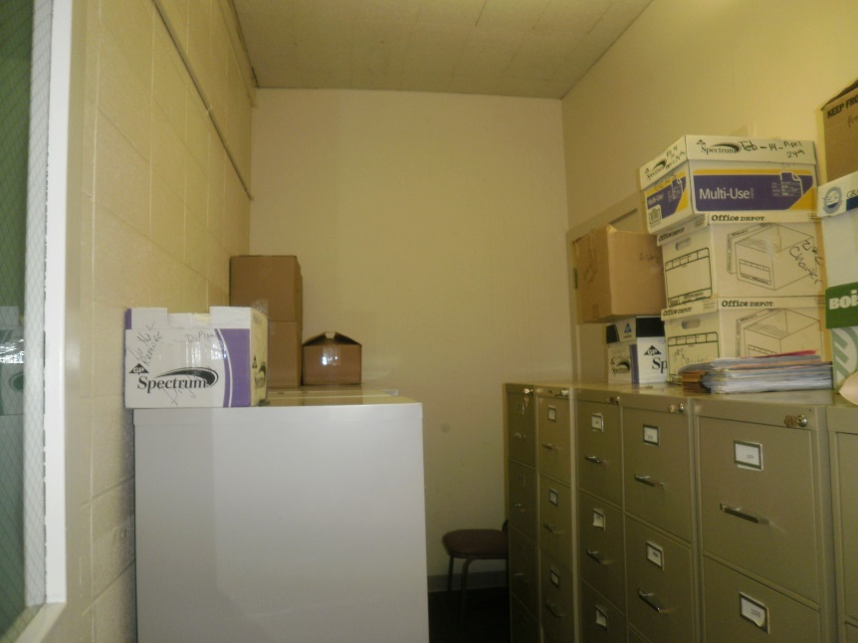
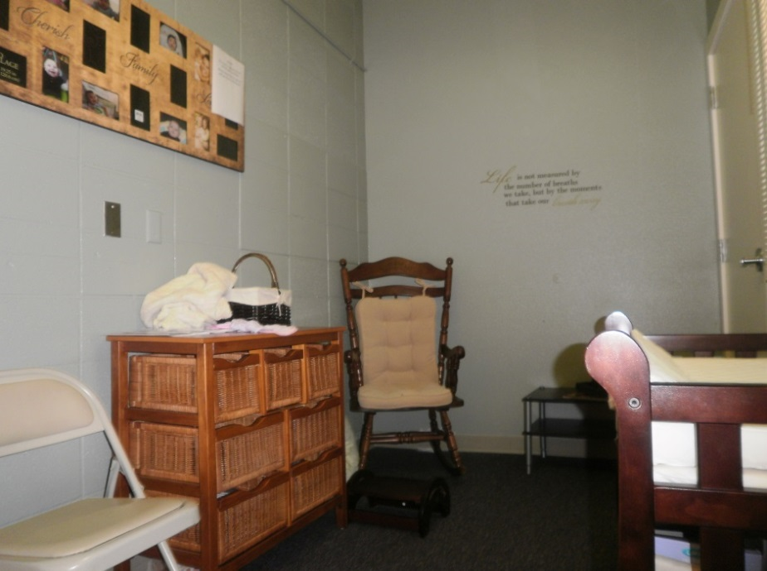
Early College High School Child Care Center
Turned a closet into a private room
Before
After
Notes:
Notes for trainers:
Share this story as an example of how you can create a private space.
Here’s what the Early College High School Child Care Center told us about their efforts:
Early College High School (ECHS) Child Care Center in Oregon serves infants of teen moms while they attend classes. The center also
serves the children of Salem-Keizer Public Schools district staff.
We received funds to create a private breastfeeding space.
We decided to turn a large closet into a private room. Here are the before and after photos.

Slide 25
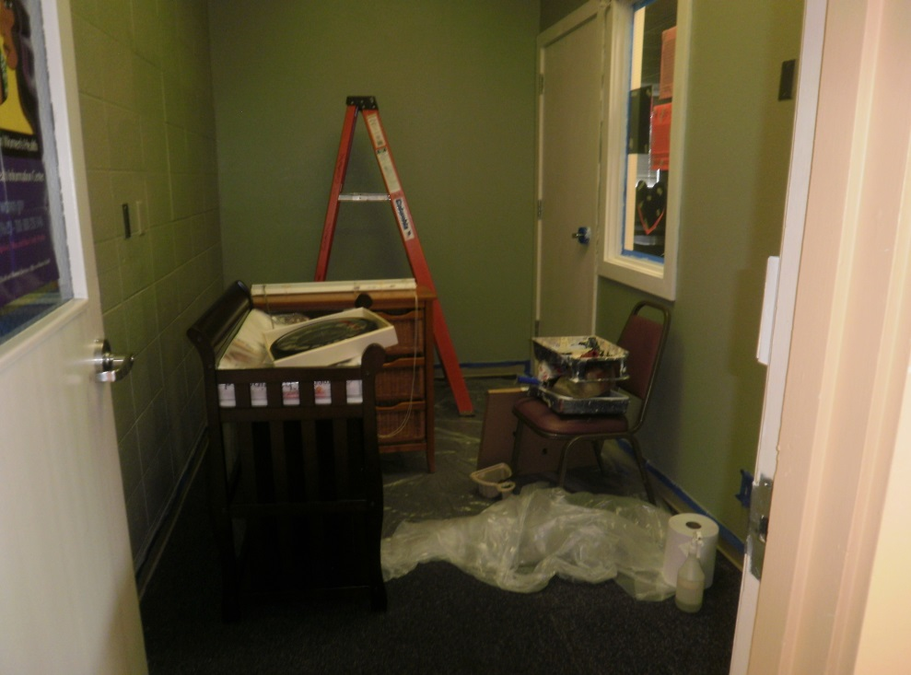
What did the program do?
Moved files to the hallway
Cleaned room
Painted
Purchased items and put together new furniture
Notes:
Notes for trainers:
More details from ECHS:
We evaluated the building space and decided that there was a perfect location that was storing student records and a jumble of discarded items.
It only took 1 day to move all the student records down the hall to new file cabinets and to begin the task of cleaning, painting, and purchasing and putting together all the furniture to create the warm and inviting space!

Slide 26
Items Purchased
Artwork
Boppies and Washable Covers (2)
CD Player with soothing sounds CDs
Changing Table
Clothes Hamper
Rocking Chair
Waste Basket
Mini Blinds and Curtains
Mirror
Nursing Pads (disposable)
Nursing Stool
Paint
Receiving Blankets
Small Table and Lamp
Wall Clock
Notes:
Notes for trainers:
More details from ECHS:
Items purchased:
Artwork included a large picture frame. Mothers were encouraged to bring in pictures of themselves with their babies to be included in the frame.
Boppies and Washable Covers (2)
CD Player with soothing sounds CD's
Changing Table
Clothes Hamper
Comfortable Rocking Chair with Cushions
Mini Blinds and Curtains
Mirror
Nursing Pads (disposable)
Nursing Stool
Paint
Receiving Blankets
Small Table and Lamp
Wall Clock
Waste Basket

Slide 27
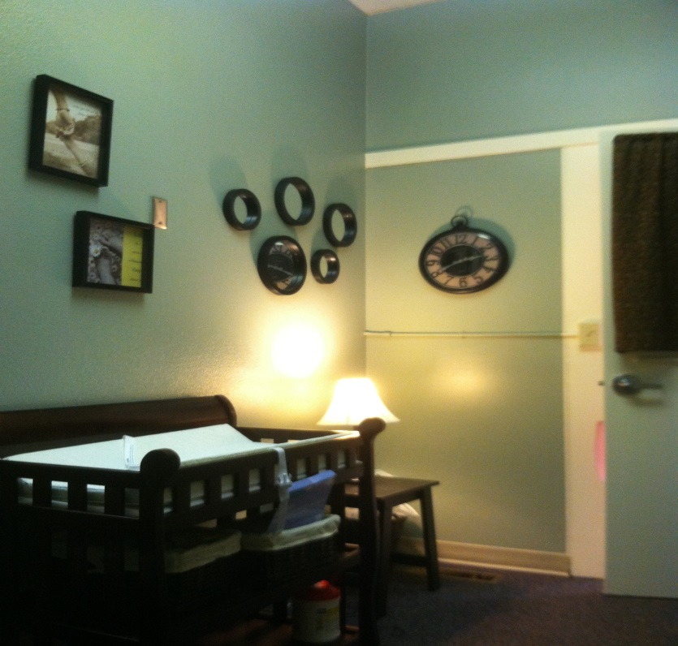
New Warm and Inviting Space!

Slide 28
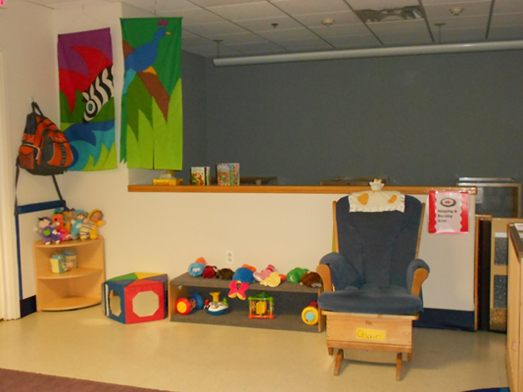
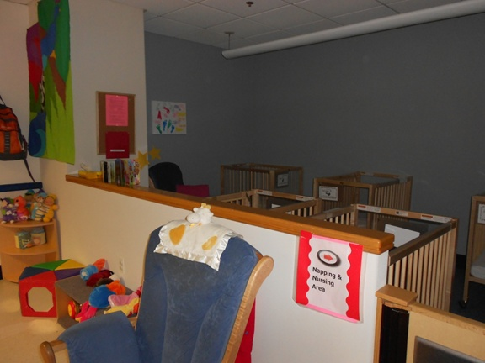
GSA – HHS/ED Children’s Center
Young Infant Classroom
Nursing Area
Notes:
Notes for trainers:
Share this story as an example of how you can create a private space.
Here’s what the Children’s Center told us about their efforts:
The U.S. General Services Administration Children’s Center is co-sponsored by the Department of Health and Human Services (HHS) and the Department of Education (ED).
At first, Let’s Move! Child Care best practices seemed a little overwhelming or daunting. However, once you start moving through the process, you find that you can accomplish it. We didn’t have a space that was private for breastfeeding or pumping. What we did have was a corner of the napping area that we could designate, define and promote for breastfeeding and pumping purposes.
From the entranceway of the infant suite, you really can’t see over the wall and what is taking place, so it really turned out to be close to private. The blue arrow you see in the slide indicates where the space is.
Signage is important, but be sensitive to your families. We put signage up indicating the napping and nursing area. One of our moms thought we weren’t being accepting by telling her where she had to breastfeed. The staff did a fine job of communicating their acceptance and letting her know that she was free to breastfeed anywhere but if she needed privacy, it was available also. We need to be accepting and supportive because of the service we provide.

Slide 29
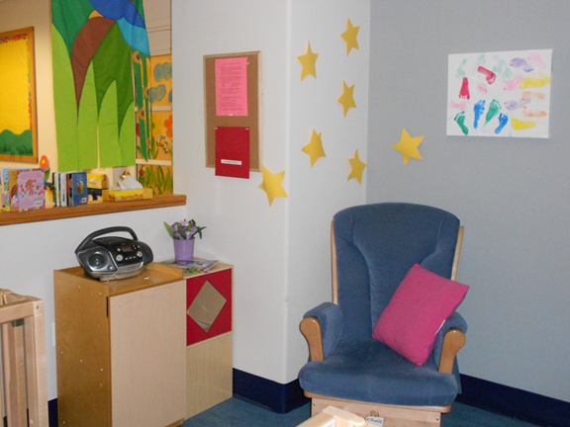
What did the program do?
Utilized a small corner in the nap area
Added cubes and board for breastfeeding information, books, magazines, and music
Outlet and changing area in close proximity
Repurposed existing equipment
Notes:
Notes for trainers:
More details from the Children’s Center:
It’s really helpful to walk through the process with someone else (your trainer/liaison, staff member(s), etc.). Having another set of eyes is a huge help in looking for ideas.
In our space, we used approximately 9 items in our little nook (which is really comfy and cozy): glider, pillow, two storage cubes, and small kid’s cupboard left over from an old kitchen set, radio, art work, bulletin board, and flowers. All the items were re-purposed from other areas of the center. Our child care liaison, Pam, was a huge help in selecting items. The electrical outlet was already there. Our cost was in time and creating the space didn’t take much time.
One of our moms who’s currently breastfeeding loves the area because it is so comfortable and convenient. She loves the sense of privacy but is still able to hear what’s going on in the room. This is her 2nd child who is in our program, and she says this time is even better because the space is so accommodating.

Slide 30
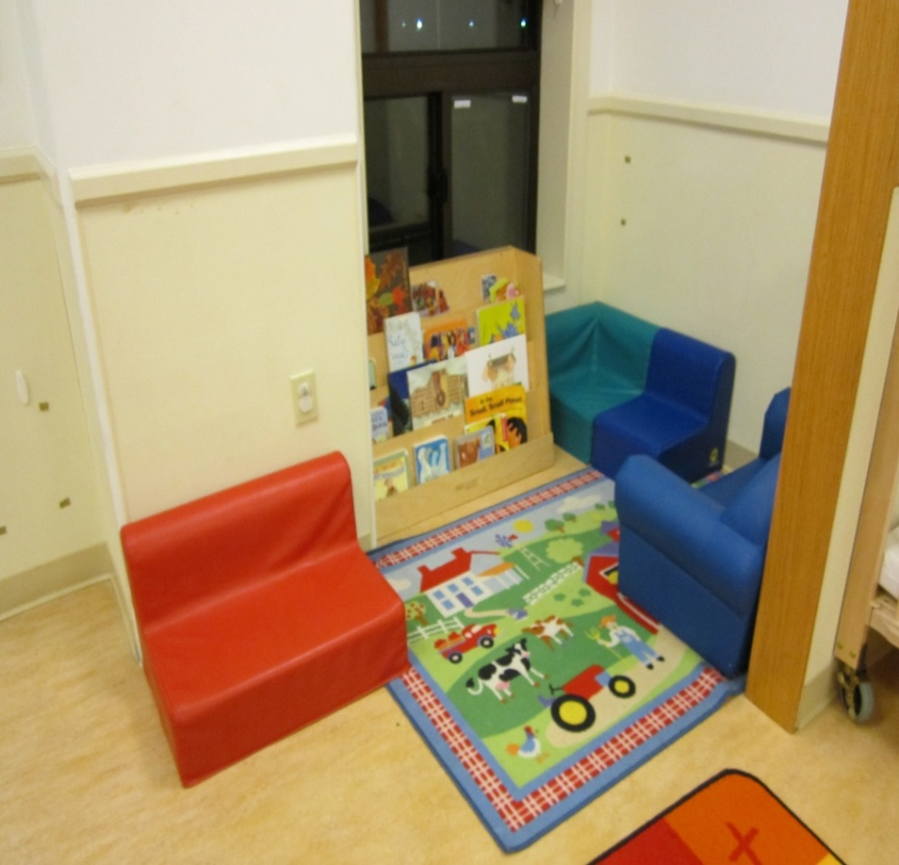
GSA – Suitland Federal CDC: Before
A corner of the classroom
Notes:
Notes for trainers:
Share this story as an example of how you can create a private space.
Here’s what Pam, a U.S. General Services Administration trainer, told us about Suitland Federal CDC’s efforts:
The Suitland Federal CDC had a big challenge with trying to meet the Let’s Move! Child Care best practice for infant feeding. The program did not have a private space in their infant classroom. As a small facility, they had no extra space. The Director and Assistant already shared an office. And they have many staff members, making the staff lounge unavailable for mothers.
We did a center walk through and found a small corner in the Young Toddler classroom.

Slide 31
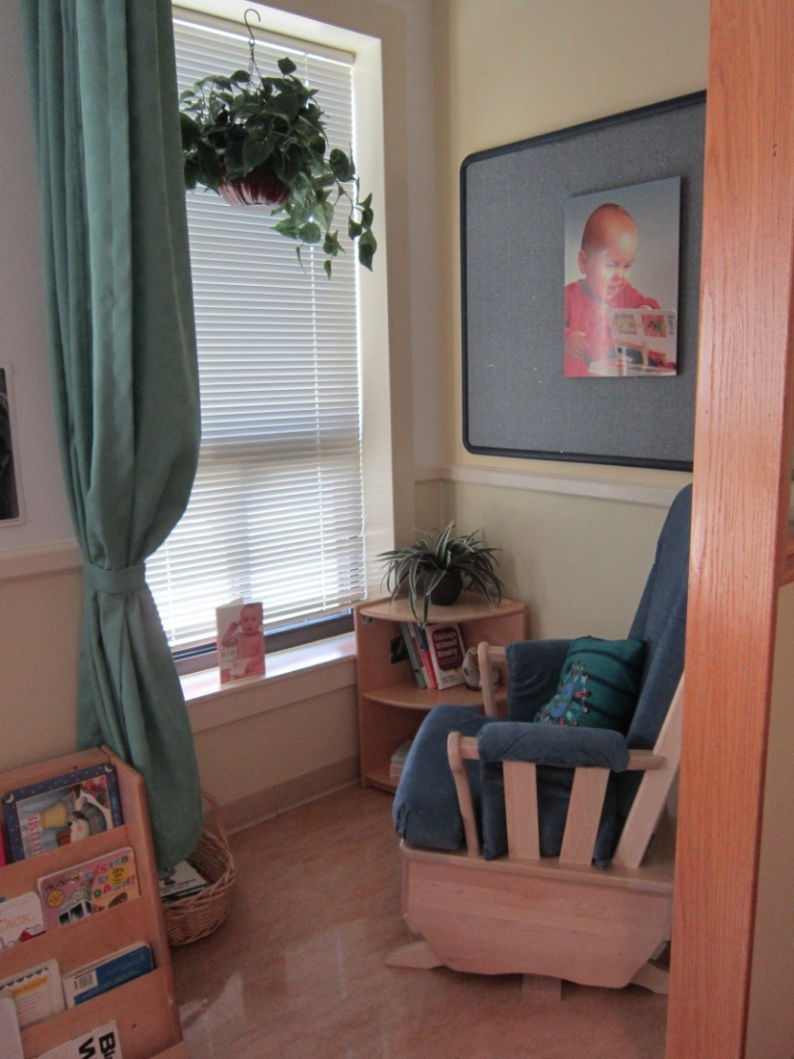
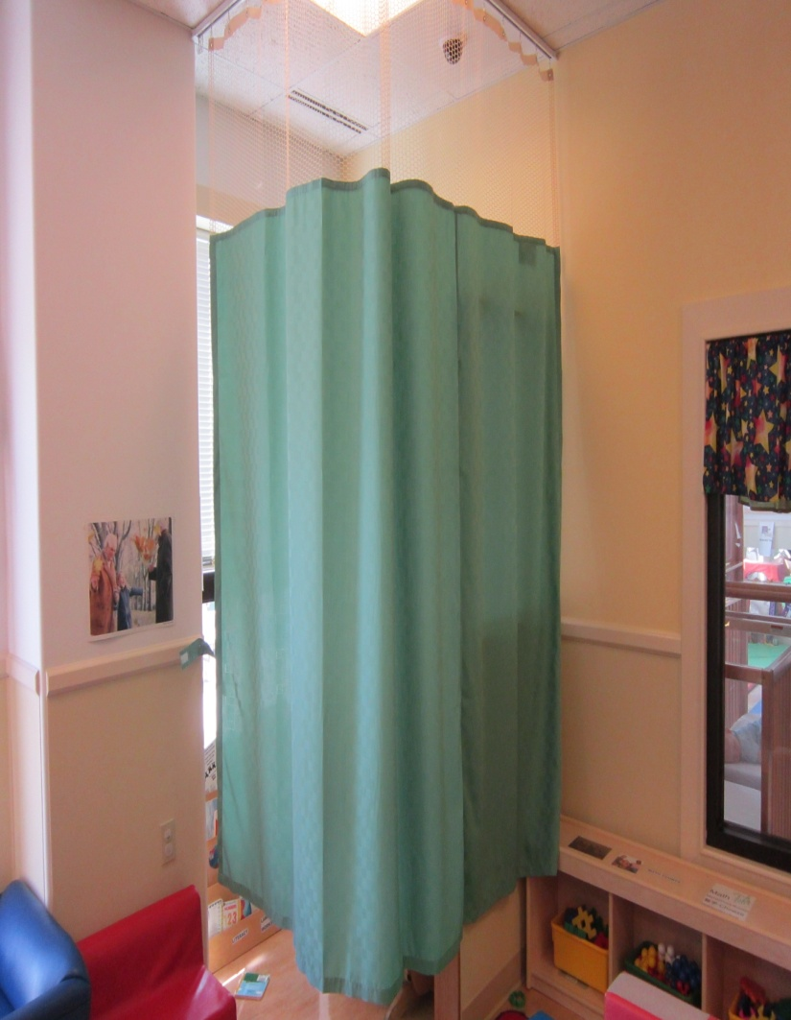
GSA – Suitland Federal CDC: After
Notes:
Notes for trainers:
More details from Pam:
We repurposed items from around the program to create this space.
We installed a curtain to create privacy for mothers.

Slide 32
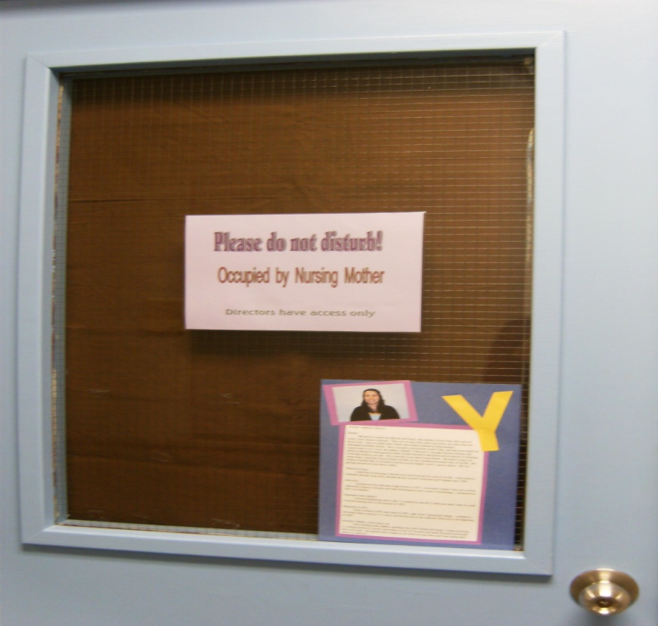
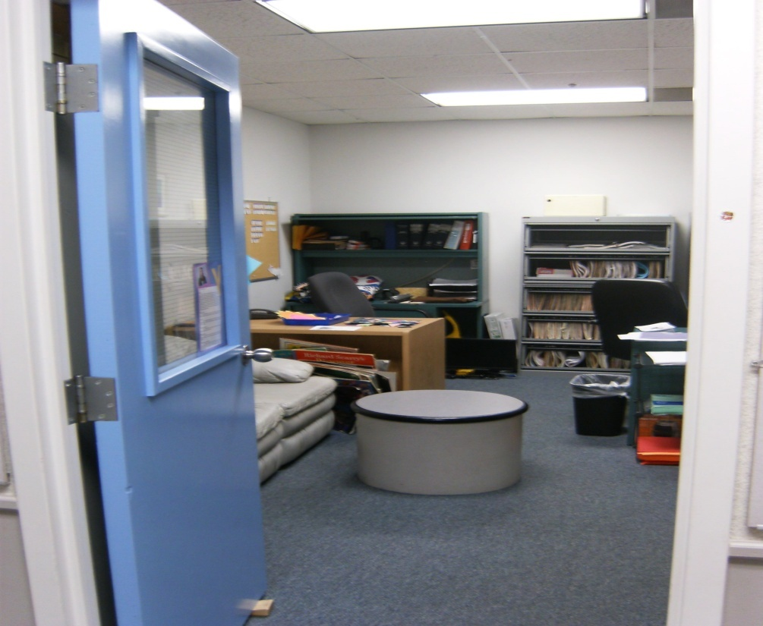
GSA – Federal Children’s Center of Northern VA
Used existing program area (Assistant Director Office)
Added a curtain hung by Velcro with a sign to provide and support privacy for nursing mothers
Notes:
Notes for trainers:
Share this story as an example of how you can create a private space.
Here’s what Pam, a U.S. General Services Administration trainer, told us about Federal Children’s Center of Northern VA:
This program used the Asst. Director’s Office, which had a sofa. They used a curtain for the door that is attachable with Velcro. And they have a ‘Please do not disturb’ sign for parents to put up when the area is in use.
This is a low-cost way to create a private space.

Slide 33
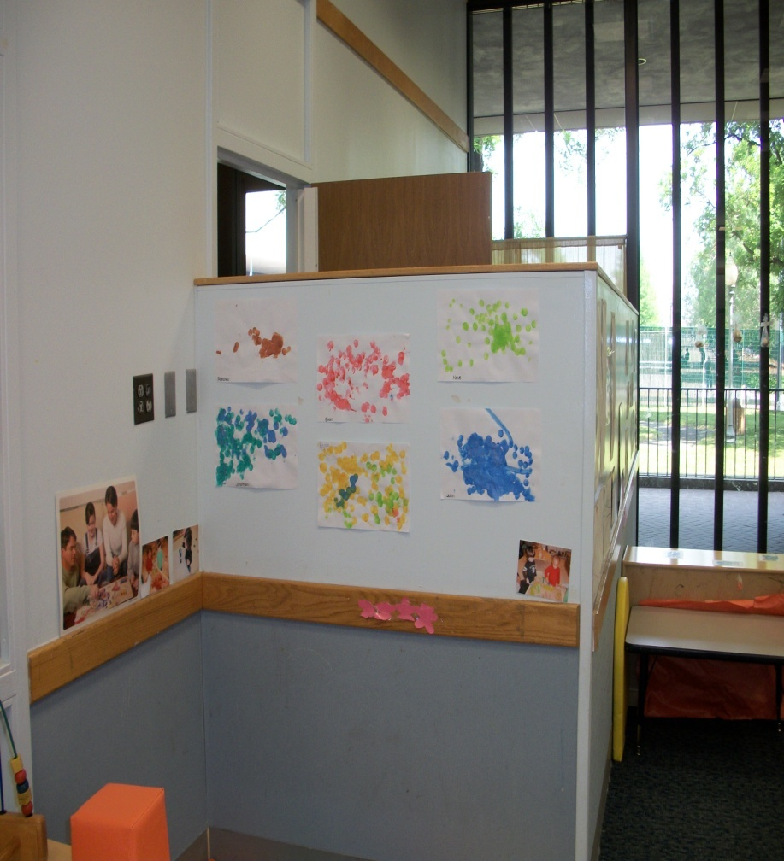
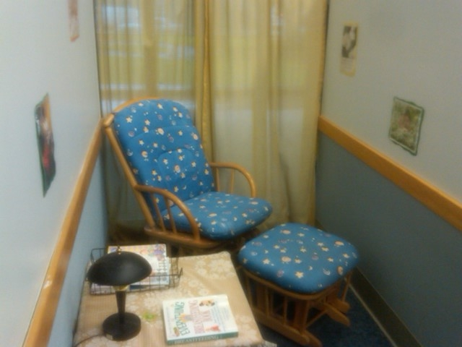
GSA – Department of Labor CDC
Renovated a small section of a larger classroom
Notes:
Notes for trainers:
Share this story as an example of how you can create a private space.
Here’s what Pam, a U.S. General Services Administration trainer, told us about the Department of Labor CDC’s efforts:
This program had a large Toddler classroom. They built a partition wall and installed a door to create a small private “Mommy Baby Room”.

Slide 34
What could a private space for breastfeeding mothers look like in your program?
Draw it!
Notes:
Suggested talking points:
What could a private space for breastfeeding mothers look like in your program? Think about where you might create a private space and how you would create the space. Draw what your space could look like?
Notes for trainers:
Pass out pieces of paper and pens, pencils, crayons, or markers.
Encourage providers to think about this question and draw what their space could look like.
Ask providers to share their drawings with the group and talk about their space.

Slide 35
Time to Practice!
Pair up
Choose your role – parent or provider?
Role play a discussion about breastfeeding
Notes:
Suggested talking points:
Let’s role play to practice what it will be like talking with families about your new space and your efforts to support breastfeeding.
Pair up.
Choose which role you want to play – Do you want to be the parent? Or do you want to be the provider?
Role play a discussion about breastfeeding (e.g. parent is “interviewing” provider about breastfeeding in the program, provider is interviewing parent about what she needs to breastfeed comfortably on-site)
For example, a parent might ask:
How does your program support breastfeeding?
For example, a provider might ask:
What do you need to breastfeed comfortably on-site?

Slide 36
Finding resources and tips
Notes:
Suggested talking points:
Now, I’m going to tell you about how you can find resources and tips on the Let’s Move! Child Care website.

Slide 37
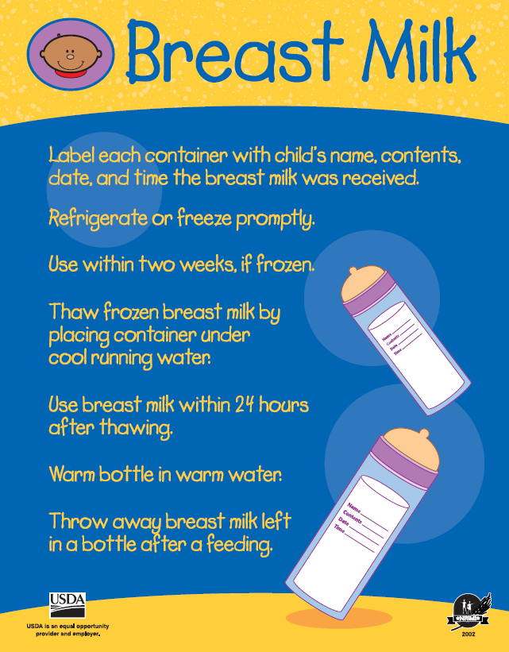
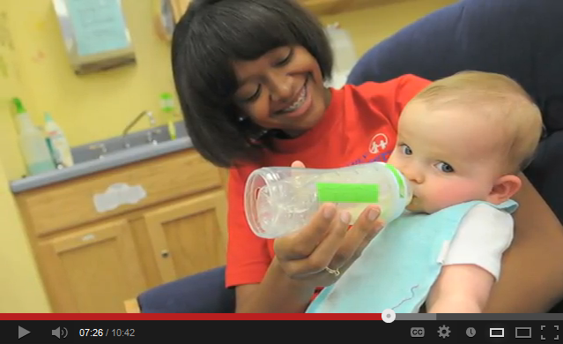
Sample Resources
Video: How to Support a Breastfeeding Mother
Posters
Notes:
Suggested talking points:
You can watch videos to learn more about supporting breastfeeding mothers in your program.
You can find this poster on breast milk handling tips. Display this poster in your program as a reminder for how to handle breast milk.

Slide 38
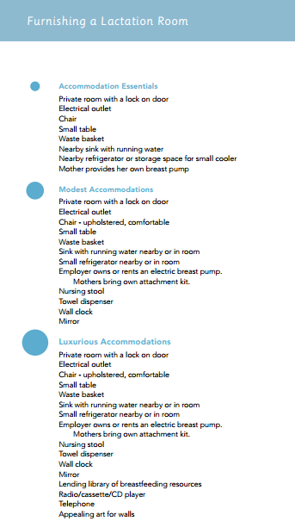

Notes:
Suggested talking points:
Another example is this resource kit from the Wisconsin Department of Health Services. It focuses on 10 Steps to Breastfeeding Friendly Child Care Centers and provides guidance and resources for providers. One of the steps focuses on providing a comfortable place for mothers to breastfeed or pump their milk in privacy.
As you can see on the right side, the kit includes a useful list of items for furnishing a lactation room – from the essentials to luxurious accommodations.

Slide 39

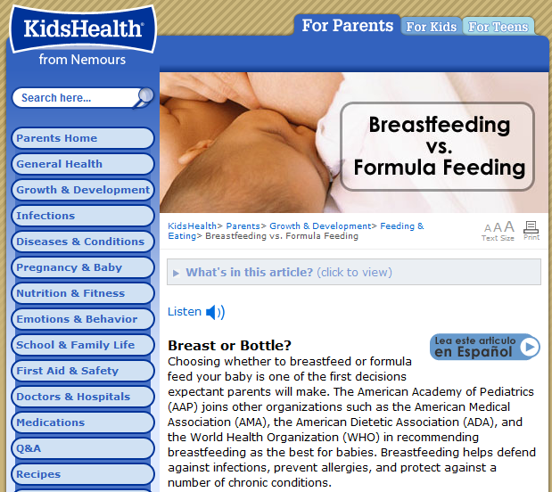

Resources for Mothers
English & Spanish
Notes:
Suggested talking points:
There are resources that you can share with mothers. Many of these resources are in English and Spanish, like the articles from KidsHealth that you can see here on the right.

Slide 40

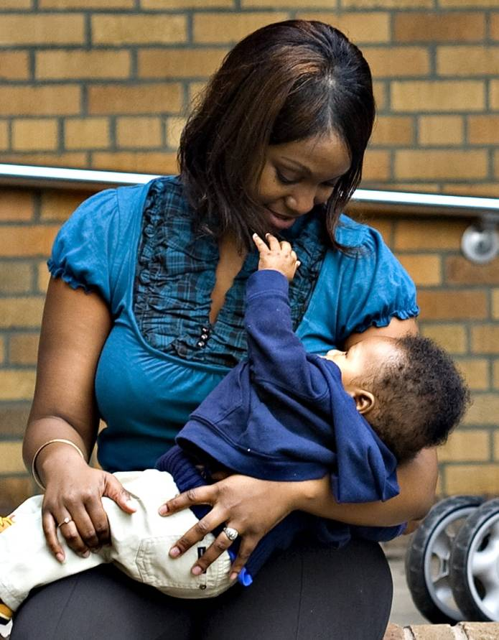
What’s your next step?
Write down action steps you can
take to support breastfeeding!
Notes:
Notes for trainer:
At the end of the session, pass out pieces of paper or note cards and pens.
Encourage providers to write down 1 to 3 action steps they will take when they go back to their programs.
Ask for volunteers to share what they wrote with the larger group.
By identifying clear action steps, providers will be ready to make changes when they return to their programs.

Slide 41
Join LMCC & Stay Connected
For more information and to sign up, visit: www.HealthyKidsHealthyFuture.org
Contact the Let’s Move! Child Care Help Desk
LMCCHelp@cdc.gov
Share your success stories!
www.healthykidshealthyfuture.org/home/resources/success.html
Notes:
Suggested talking points:
By signing up, you will get LMCC newsletters with new resources, tips, and the latest updates.
If you have any questions about LMCC, email LMCC at LMCCHelp@cdc.gov.
Notes for trainers:
We’d love to hear your success story too! To share your story, go to www.healthykidshealthyfuture.org/home/resources/success.html and fill out the online form.

