Slide 1
Limit screen time
Notes:
Notes for trainer:
This slide set offers child care and early education providers an in-depth look at LMCC Goal 2: Limit Screen Time.
You can use these slides to train providers. Hold a training on LMCC or integrate LMCC content into existing or new trainings, including in-person and online trainings.
Please feel free to adapt the slides for specific needs and audiences, including adding slides from other LMCC slide sets. For example, use the slides from the ‘Introduction to Let’s Move! Child Care’ slide set to show providers how to participate in LMCC.
We have included some interactive activities in this module to keep providers engaged and promote learning. Consider including more!
Consider adding additional slides that give information on local resources, training opportunities, and contacts for technical assistance.
For questions, please email LMCCHelp@cdc.gov.

Slide 2
Learning Objectives
Understand Let’s Move! Child Care Goals and best practices for screen time
Know the benefits of limiting or eliminating screen time
Get strategies and ideas to limit or eliminate screen time
Learn about the resources and tips available on the Let’s Move! Child Care website: www.HealthyKidsHealthyFuture.org

Slide 3
Knowledge Check
How much screen time should children under 2 years be allowed?
None
20 minutes
30 minutes
40 minutes

Slide 4
Knowledge Check
How much screen time should children under 2 years be allowed?
None
20 minutes
30 minutes
40 minutes

Slide 5
Screen Time Best Practices
Infants: No screen time
Toddlers: No more than 3 – 4 times per year, or never
Preschoolers:
Only for educational or physical activity purposes
No more than 30 minutes per week or never, while in your care
Work with families to ensure no more than 1 – 2 hours per day
Provide screen time reduction and/or media literacy education to parents at least twice a year
For example, special programs, newsletters, or information sheets
Notes:
Notes for trainer:
Point out that the best practice for preschoolers is 30 min. per week or never while they’re in care, and 1 – 2 TOTAL hours for the entire day.
The screen time best practices are consistent with American Academy of Pediatrics recommendations.

Slide 6
Reasons for Limiting Screen Time
Gets in the way of exploring, playing, and social interaction.
As kids get older, screen time can get in the way of being active, reading, doing homework, playing with friends, and spending time with family.
Kids who spend more time watching TV are more likely to be overweight or obese.
Notes:
Suggested talking points:
The first 2 years of life are a critical time for brain development. Spending time in front of a screen can get in the way of exploring, playing, and interacting with grown-ups and their tiny peers — all of which encourage learning and healthy physical and social development.

Slide 7
Ways to Limit Screen Time
Keep the TV/computer out of sight
Put it in rooms not used by children
Hide it with a blanket or sheet
Get rid of it
Replace screen time with fun, interactive activities
Play outside
Turn on music and dance
Bring kids into the kitchen and let them help you set the table, cook, and clean up

Slide 8
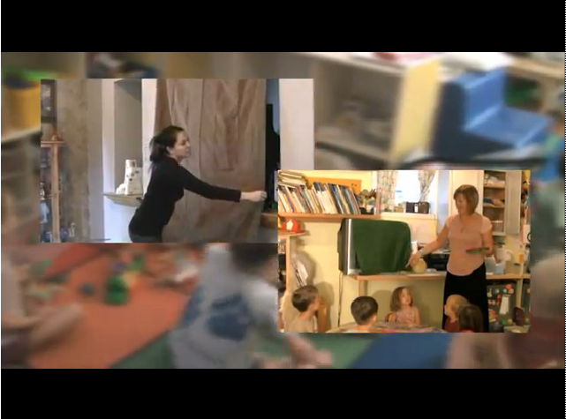
Screen Free Moments: Promoting Healthy Habits
Notes:
Suggested Talking Points
This vides shows you simple ways to limit or even eliminate screen time in your program. It’s available in English and Spanish.
You can find a link to this video on the LMCC website.
Notes for trainer:
Play this video during your training session. The video is ~8 min.
NOTE: The image on the slide is ONLY an image, not a video.
If you will have internet during your training session, click on the title to show the video.
If you will not have internet during your training session, try embedding the video in your presentation. You can find the video at: http://www.youtube.com/watch?v=cogJkMgIjs0
The video is available in Spanish at: http://www.youtube.com/watch?v=CwPNg57myRo

Slide 9
When screen time is allowed:
Make it “quality programming” by choosing shows or computer games that are educational or get kids moving.
Track screen time with a simple scheduling sheet so you know how much screen time a child has and when they’ve reached their limit for the week.
Avoid watching while eating.
Touch screen technology does NOT count as ‘active’ screen time. Watch the quality of children’s movement with active video games.
Notes:
Suggested talking points:
Whenever the young kids in your care do get screen time, just make sure it’s for educational purposes only. A lot of the learning shows and DVDs on the market today weave the developmentally appropriate academic messages in so seamlessly that kids don’t even realize they’re getting some knowledge along with the entertainment.
With active games, often children learn they can get better scores be doing very minimal movements. Watch out for this.

Slide 10
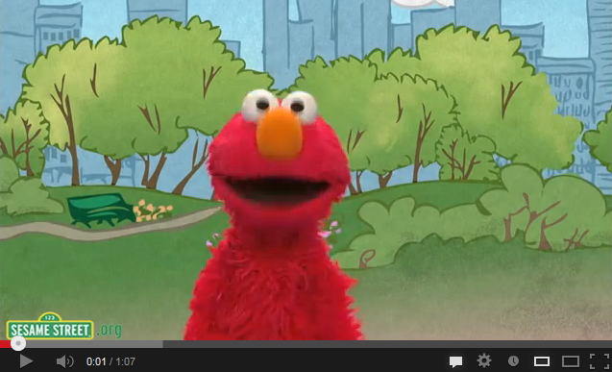
Elmo’s Got the Moves Music Video
Notes:
Suggested talking points:
This video is an example of “quality programming” because it gets kids moving. A link to this video is available on the LMCC website.
Notes for trainer:
Play this video during your training session. The video is ~1 min.
NOTE: The image on the slide is ONLY an image, not a video.
If you will have internet during your training session, click on the title to show the video.
If you will not have internet during your training session, try embedding the video in your presentation. You can find the video on YouTube at: www.youtube.com/watch?v=mtDW8hxOrYk

Slide 11
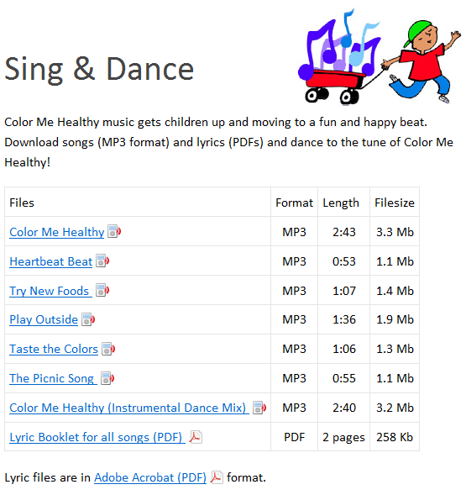
Turn on Music Instead of the TV!
Color Me Healthy music gets kids up and moving to a fun and happy beat!
Notes:
Notes for trainer:
These songs are in the ‘Music’ section on the LMCC Resource Center: www.healthykidshealthyfuture.org/home/resources.html

Slide 12
Get Moving Time!
Move like an animal
Swing your trunk like an elephant
Hop like a bunny
Walk like a flamingo
Tip toe like a mouse
Notes:
Suggested talking points:
Try replacing screen time with physical activities!
Notes for trainer:
Try this activity with providers to get them moving. This is an example of an activity that they can take back to their programs and do with their children.

Slide 13
Screen Time Best Practices in Review
Pop Quiz!
Can you recite all of the screen time best practices without looking at your notes?
Notes:
Suggested talking points:
Ask providers to volunteer to recite the screen time best practices. You can ask one or more volunteers to come to the front of the room. Try giving providers an incentive for volunteering, such as a screen time or physical activity resource.

Slide 14
Screen Time Best Practices in Review
Infants: No screen time
Toddlers: No more than 3 – 4 times per year, or never
Preschoolers:
Only for educational or physical activity purposes
No more than 30 minutes per week or never, while in your care
Work with families to ensure no more than 1 - 2 hours per day
Provide screen time reduction and/or media literacy education to parents at least twice a year,
e.g. special programs, newsletters, or information sheets

Slide 15
Finding resources and tips

Slide 16
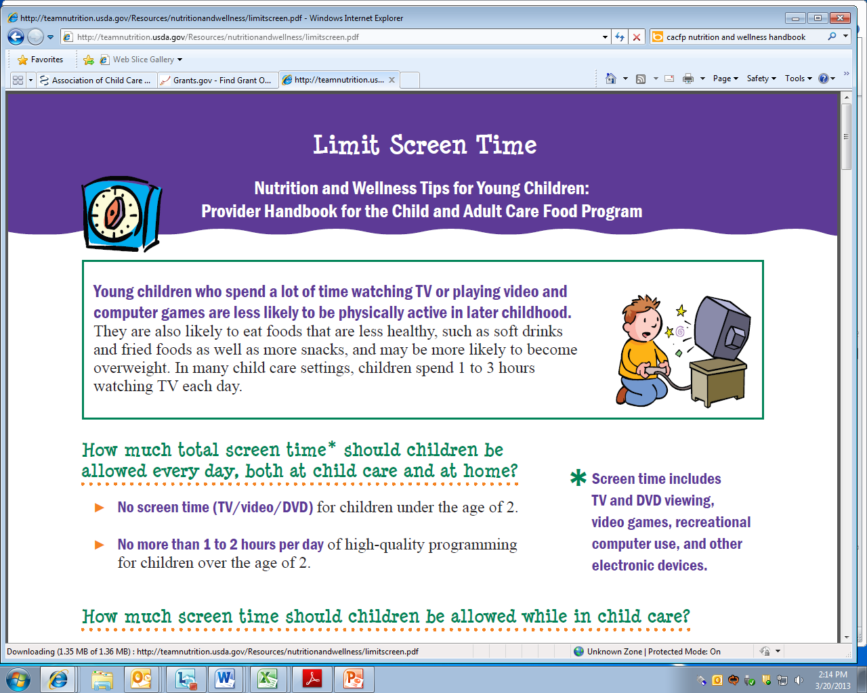
Child & Adult Care Food Program Screen Time Resources
Download the Handbook at: www.teamnutrition.usda.gov
Notes:
Suggested talking points:
This resource is valuable for all providers to use, regardless of participation in CACFP. It’s full of ideas and tips that can help you make changes and meet the Let’s Move! Child Care goals to help kids grow up healthy.
The Handbook makes it easy!
In the Provider Handbook, you will find resources on limiting screen time (as shown on the right).
You will also find:
Suggestions for active play
Ideas for meal planning, shopping, and food preparation
Success stories from providers. Learn from others – success stories will show you new and exciting ways child care programs have met the wellness challenge.
Links to additional resources
Download the Handbook from the USDA Resource Library at:
www.teamnutrition.usda.gov (The direct link is: http://teamnutrition.usda.gov/Resources/nutritionandwellness.html)

Slide 17
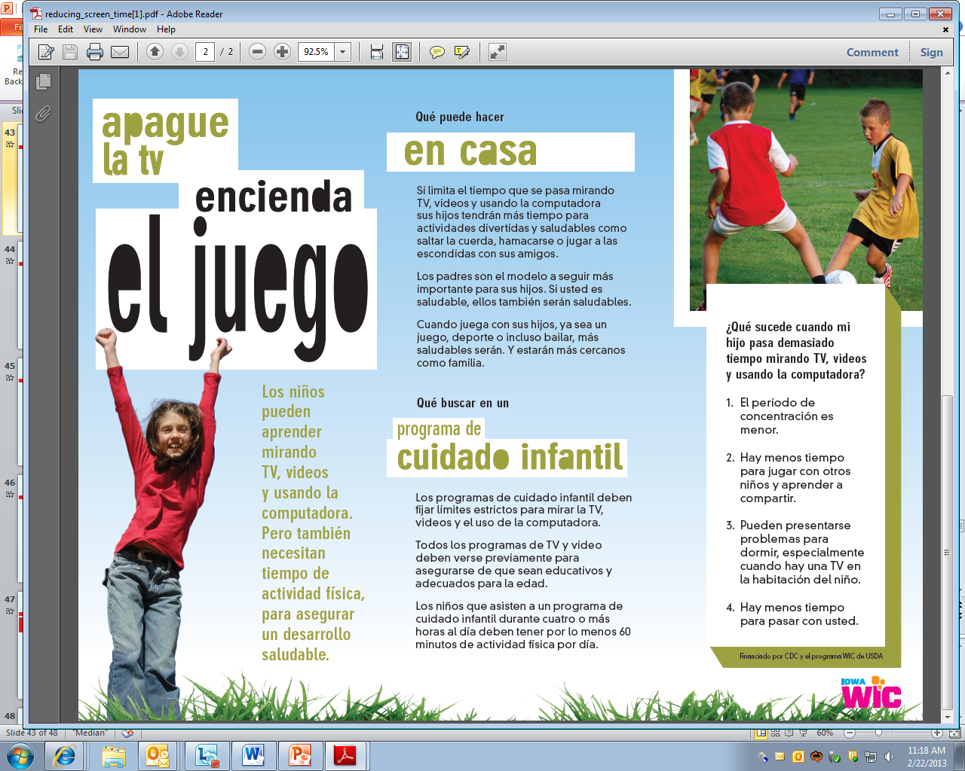
Tip Sheets & Handouts
Notes:
Suggested talking points:
You can find tip sheets and handouts available in English and Spanish.
The resources shown here are from Iowa WIC.

Slide 18
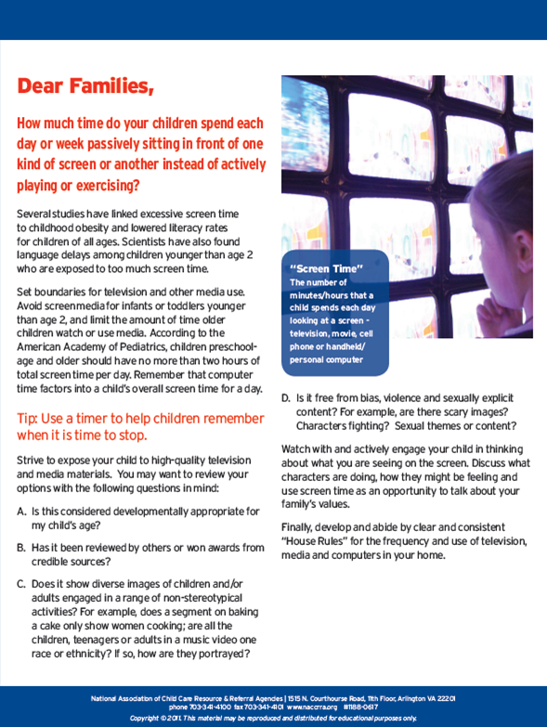
Resources for
Families
Letter about the importance of limiting screen time and tips for limiting screen time at home.
Send the letter home in backpacks or with your newsletter.
Notes:
Suggested talking points:
You can find resources that you can share with families, such as this letter that gives ideas on how to limit screen time at home (as shown on the right).

Slide 19
What’s your next step?
Write down action steps you can
take to limit or eliminate screen time!
Notes:
Notes for trainer:
At the end of the session, pass out pieces of paper or note cards and pens.
Encourage providers to write down 1 to 3 action steps they will take when they go back to their programs.
Ask for volunteers to share what they wrote with the larger group.
By identifying clear action steps, providers will be ready to make changes when they return to their programs.

Slide 20
Join LMCC & Stay Connected
For more information and to sign up, visit: www.HealthyKidsHealthyFuture.org
Contact the Let’s Move! Child Care Help Desk
LMCCHelp@cdc.gov
Share your success stories!
www.healthykidshealthyfuture.org/home/resources/success.html
Notes:
Suggested talking points:
By signing up, you will get LMCC newsletters with new resources, tips, and the latest updates.
If you have any questions about LMCC, email LMCC at LMCCHelp@cdc.gov.
Notes for trainers:
We’d love to hear your success story too! To share your story, go to www.healthykidshealthyfuture.org/home/resources/success.html and fill out the online form.

