Slide 1
Increase Physical Activity
Notes:
Notes for trainer:
This slide set offers child care and early education providers an in-depth look at LMCC Goal 1: Increase Physical Activity.
You can use these slides to train providers. Hold a training on LMCC or integrate LMCC content into existing or new trainings, including in-person and online trainings.
Please feel free to adapt the slides for specific needs and audiences, including adding slides from other LMCC slide sets. For example, use the slides from the ‘Introduction to Let’s Move! Child Care’ slide set to show providers how to participate in LMCC.
We have included some interactive activities in this module to keep providers engaged and promote learning. Consider including more!
Consider adding additional slides that give information on local resources, training opportunities, and contacts for technical assistance.
For questions, please email LMCCHelp@cdc.gov.

Slide 2
Learning Objectives
Understand Let’s Move! Child Care Goals and best practices for physical activity
Know the benefits of physical activity
Get strategies and ideas to keep kids active
Learn about the resources and tips available on the Let’s Move! Child Care website: www.HealthyKidsHealthyFuture.org

Slide 3
Rainbow Run
When I call out one of the colors of the rainbow,
run and touch 3 things that are that color.
Notes:
Notes for trainer:
To start off, try this activity with providers to get them moving. This is an example of an activity that they can take back to their programs and do with their children.

Slide 4
Knowledge Check
What is the recommended amount of physical activity for toddlers in full day care?
15 - 30 min
30 - 45 min
60 - 90 min
90 - 120 min

Slide 5
Knowledge Check
What is the recommended amount of physical activity for toddlers in full day care?
15 - 30 min
30 - 45 min
60 - 90 min
90 - 120 min

Slide 6
Physical Activity Best Practices
Infants: Short supervised periods of tummy time several times each day
Toddlers & Preschoolers: Active play time every day, both indoor and outdoor
Toddlers: 60 – 90 minutes or more (for half-day programs, 30 minutes or more)
Preschoolers: 120 minutes or more (for half-day programs, 60 minutes or more)
Make sure that kids with special needs can
participate in activities too!

Slide 7
Benefits of Physical Activity
Helps children stay at a healthy weight
In childhood
In adulthood – physical activity habits learned in early childhood can last a lifetime

Slide 8
Benefits of Physical Activity (2)
Helps children:
Develop motor skills and build their strength, flexibility, and endurance
Develop and maintain strong bones

Slide 9
Benefits of Physical Activity (3)
Improves social skills and brain development
Helps children feel confident about themselves and their bodies
Reduces children’s risk of feeling stressed or depressed
Helps children sleep better

Slide 10
Benefits of Physical Activity (4)
Children who are active tend to have fewer behavioral and disciplinary problems, do better in school, and have longer attention spans in class.

Slide 11
My Bonnie Lies Over the Ocean
My Bonnie lies over the ocean, My Bonnie lies over the sea, My Bonnie lies over the ocean, O bring back my Bonnie to me.
Bring back, bring back, O bring back my Bonnie to me, to me. Bring back, bring back, O bring back my Bonnie to me.
Notes:
Notes for trainer:
Sing ‘my bonnie lies over the ocean’. Have providers start the song standing up and sit down when a word starts with the letter ‘b’. Then, stand up when a word starts with the letter ‘b’, and so on. Sing the song 3 times, singing faster each time. Try asking volunteers to come to the front to lead the song with you.

Slide 12
2 Kinds of Physical Activity
STRUCTURED: Organized, quick, and intense activities led by adults
UNSTRUCTURED: Free play to stimulate creativity and use the imagination
Notes:
Suggested talking points:
Structured physical activity basically means any daily activity led by the teacher, developmentally appropriate, fun, planned and:
supports age-appropriate motor skill development — it should be engaging and involve all children with very little or no waiting
vigorous (in other words, it gets children breathing deeper and faster than during typical activities) for short doses of time (say, 10 minutes)
Unstructured activity is free play that’s led by the child — in other words, when kids are able to play whatever they’d like (dress-up, dolls, cars, and other activities) in a safe environment. Unstructured activity should include:
activities that respect and encourage children’s individual abilities and interests
teacher engagement with children during play, as well as gentle prompts and encouragement by teachers to stay physically active

Slide 13
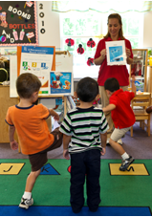
Ways to Get Kids Moving
Add physical activity to your daily routine
Have children act out a story as you read it.
Encourage kids to move like different animals during transitions from one activity or room to another.
Use props to help kids move and identify shapes, colors, and numbers.

Slide 14
Ways to Get Kids Moving (2)
Mix up the usual ‘hokey pokey’ and ‘head, shoulders, knees and toes’ with a dance party or obstacle course.
Encourage working together to come up with games and activities.
Notes:
Suggested talking points:
It’s best to choose games where kids do not get ‘out’ or are eliminated from the activity and side lined.

Slide 15
Get Moving Time!
Move around the room like the motions of weather:
Rain
Wind
Thunder
Snow
Sunshine
Notes:
Notes for trainer:
Try this activity with providers to get them moving. This is an example of an activity that they can take back to their programs and do with their children.

Slide 16
Where to Play
Opt for outdoors as much as possible!
Be warm-weather-ready.
Play outside even when it’s chilly, rainy, or snowing.
Find indoor options like a school gym, part of your classroom, or a room in your home.
Make sure the play space is safe!
Notes:
Suggested talking points:
Opt for outdoors as much as possible.
Be warm weather-ready.
When it’s hot out, ask parents to bring in sunscreen — they should apply it at home before drop-off and you’ll need to reapply during the day.
Also, keep kids hydrated. Have each toddler and preschooler bring their own personal labeled water bottles outside so they can keep drinking up while playing and avoid getting overheated. And be sure to watch for any signs of heat illness. [Learn more about how to look for the signs of heat illness at: http://kidshealth.org/parent/firstaid_safe/sheets/heat_exhaustion_heatstroke_sheet.html#cat32].
Play outside even when it’s chilly, rainy, or snowing
When it’s chilly, rainy, or snowing, it can make getting outside seem daunting — and, OK, downright messy. But when you ask parents to stock their kids’ cubbies with weather-appropriate attire (and, of course, an extra change of clothes just in case), it makes it that much easier to make sure they have some fresh air and outdoor play time every day, no matter what the weather.
Even rainy days can be a riot when kids bring in rain boots and a raincoat (with a hood or rain hat). As long as there’s no thunder or lightning, let ’em splash in the puddles. And snow days can be a blast if they have snow-proof pants, coats, mittens, hats, and scarves to keep them cozy.
Sure, they could (and probably will) get a little wet or muddy — and that’s a lot of extra garb and accessories to worry about putting on and taking off. And, of course, you’ll have some kids who get too wet, too cold, etc. But when you plan ahead for all of that, you’ll be surprised at how much better both you and the kids feel when you’re able to get out and enjoy some fresh air, instead of being cramped up inside. Just be prepared with your own weather-appropriate wear.
Find indoor options
Whether they’re inside frolicking around a gym or the classroom, or enjoying the great outdoors, just make sure the kids in your care have a variety of activity options and a safe play space at every single age and stage.
Check your childproofing.
It’s always good to go the extra mile to look around and make sure everything’s OK where the kids are playing.
For outside play areas, check to see that:
sidewalks and stairways are clear of concrete cracks or missing pieces
garbage cans are securely covered
swing set/playground parts are free of rust, splinters, and sharp edges
parts on swing sets or other outdoor equipment are securely fastened
the surface beneath the swing set/playground is soft enough to absorb the shock of a fall (cushioned with material like sand, mulch, wood chips, or approved rubber surfacing mats)
Get down to their level.
For babies and toddlers, you need to take childproofing one step further by getting down on your hands and knees to see the surroundings from their position.
Look for tempting things that could harm them:
electrical cords they could pull on (that could make things like hot glue guns or phones fall on their heads)
electrical outlets they could stick their tiny digits into
things they could pop in their mouths (buttons, coins)
blind or curtain cords they could strangle on
cabinets they could get into

Slide 17
Keep infants active too!
Tummy Time:
Is allowing babies to interact and play while awake and on their tummies
Prepares babies for sliding on their bellies and crawling
Should be done 2 or 3 times a day. Begin with 3-5 minutes at one time. When you see the infant enjoying the activity, gradually increase the time.

Slide 18
What to do during tummy time
Encourage infants to see, touch, and feel what’s around them.
Place different toys in a circle around the baby and let the baby reach for them. Reaching helps the baby develop muscles to roll over, crawl, and scoot.
Always make sure infants have tummy time when they’re awake and alert. Place infants on a solid surface on the floor (never on a surface that’s soft or up high like a mattress or sofa).

Slide 19
Tummy Time Tips
Some babies will not like tummy time at first so try putting their favorite toys just out of reach.
A great time to do tummy time is following a diaper change or when the baby wakes up from a nap.
Notes:
Notes for trainer:
The resource on the right is available at: www.healthychildcare.org/pdf/SIDStummytime.pdf

Slide 20
Know the Developmental Milestones
Kids should do specific things at every age and stage.
Know the milestones to help them work on the appropriate physical and motor skills.
Notes:
Suggested talking points:
When you know what kids should be — and will be — doing at every age and stage, you can help them work on their physical and motor skills as they grow.

Slide 21
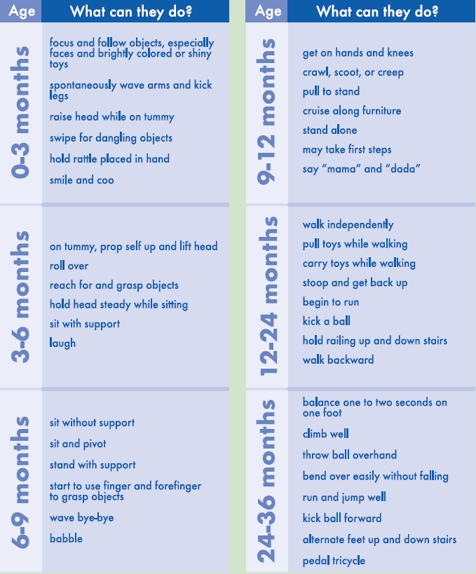
Chart of Developmental Milestones
Notes:
Suggested talking points:
You can find a link to this resource on the LMCC website.
Notes for trainer:
The link is: http://healthykidshealthyfuture.org/content/dam/hkhf/filebox/kidshealthsheets/2011devchart.pdf

Slide 22
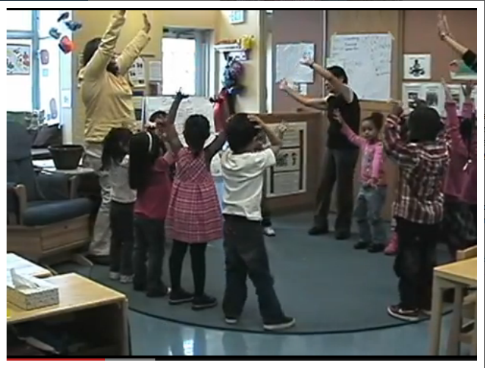
Physical Activity Video: Motion Moments
Notes:
Suggested talking points:
The Motion Moments videos offer ideas for incorporating physical activity for babies, toddlers, and preschoolers into your program. They’re available in English and Spanish. You can find links to the videos on the LMCC website.
Notes for trainer:
Show one or more of the Motion Moments videos during your training session. The videos are 7 – 9 minutes each.
NOTE: The image on the slide is ONLY an image, not a video.
If you will have internet during your training session, click on the title to show the Motion Moments video for preschoolers. You can find the videos for infants and toddlers at: http://nrckids.org/Motion_Moments/index.htm
If you will not have internet during your training session, try embedding one or more of the videos in your presentation. You can find the videos at: http://nrckids.org/Motion_Moments/index.htm or on youtube.com
The video is available in Spanish at: http://nrckids.org/Motion_Moments/index.htm

Slide 23
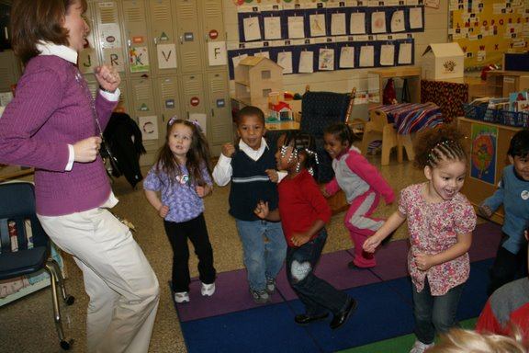
Be a Get Moving Role Model
Participate in and enjoy physical activity.
If you have limitations, be a cheerleader!
Wear comfortable clothing and shoes.
Notes:
Suggested talking points:
Adults who participate in and seem to enjoy physical activity show kids that being active isn’t something you just have to do — it’s fun.

Slide 24
Break Time!
March to your break and pretend to play your favorite instrument. Have someone guess which instrument you are playing!
Notes:
Notes for trainer:
Try this activity with providers to get them moving. This is an example of an activity that they can take back to their programs and do with their children.

Slide 25
Physical Activity Best Practices in Review
Pop Quiz!
Can you recite all of the physical activity best practices without looking at your notes?
Notes:
Notes for trainer:
Ask providers to volunteer to recite the physical activity best practices. You can ask one or more volunteers to come to the front of the room. Try giving providers an incentive for volunteering, such as a physical activity resource.

Slide 26
Physical Activity Best Practices in Review
Infants: Short supervised periods of tummy time several times each day
Toddlers & Preschoolers: Active play time every day, both indoor and outdoor
Toddlers: 60 – 90 minutes or more (for half-day programs, 30 minutes or more)
Preschoolers: 120 minutes or more (for half-day programs, 60 minutes or more)
Make sure that kids with special needs can
participate in activities too!

Slide 27
Finding resources and tips

Slide 28
Visit www.HealthyKidsHealthyFuture.org
Notes:
Suggested talking points:
The LMCC website is www.healthykidshealthyfuture.org.
On the website, you can find lots of resources and tips.
For physical activity resources and tips, click on the ‘Get Kids Moving – Physical Activities’ tab.
Notes for trainer:
If you have internet access during your training, we encourage you to pull up the LMCC website and walk through some of the pages that would be of greatest interest to your audience. The titles in orange on this slide and the subsequent slides are linked to the associated pages.

Slide 29
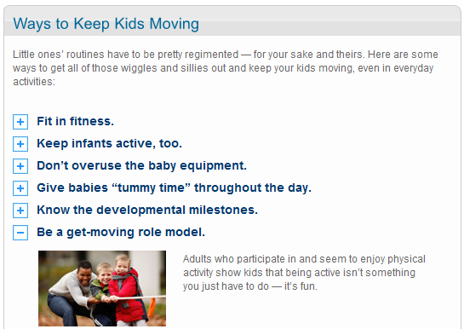
Physical Activities
Fun ideas, tips, activity sheets, and more!
Notes:
Suggested talking points:
When you click on the the ‘Get Kids Moving – Physical Activities’ tab, you can find fun activity ideas, tips for incorporating physical activity into your daily routine, activity sheets, and more!

Slide 30
Visit www.HealthyKidsHealthyFuture.org
Notes:
Suggested talking points:
This is the homepage again. For a library of nutrition and physical activity resources all in one place, click on the ‘Be Inspired – Ideas and Resources’ tab.

Slide 31
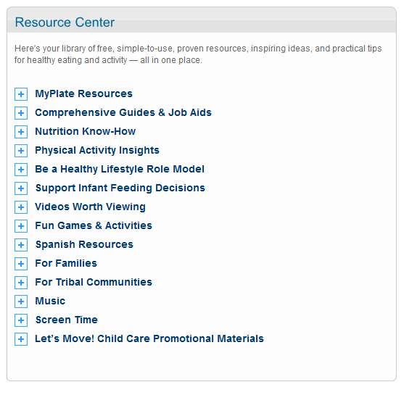
Ideas and Resources
One stop shop for nutrition and physical activity resources for all providers
Resources in Spanish
Notes:
Suggested talking points:
Under the ‘Be Inspired – Ideas and Resources’ tab, you will find the Resource Center: a one stop shop for nutrition and physical activity resources.
There are lots of resources available! Explore the website to find the resources that fit your needs!
When you click on the ‘plus sign’ next to a topic, you will see resources on that topic.
These resources are useful for all types of programs, including early education and child care centers, Head Start programs, family child care homes, pre-K programs, etc.
There are resources available in Spanish.
There are resources that are particularly helpful for providers serving tribal communities.
The next few slides show examples of the types of resources you will find on the LMCC website, though there are many more.

Slide 32
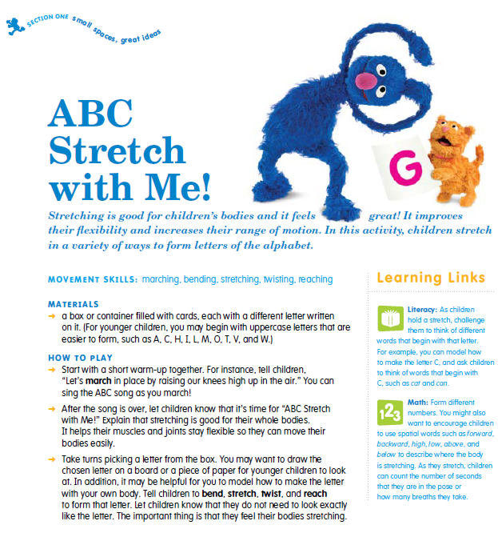
Notes:
Suggested talking points:
You can find Sesame Workshop’s We Have the Moves! Physical Activity Resource.
Here you can see an example of a structured activity.

Slide 33
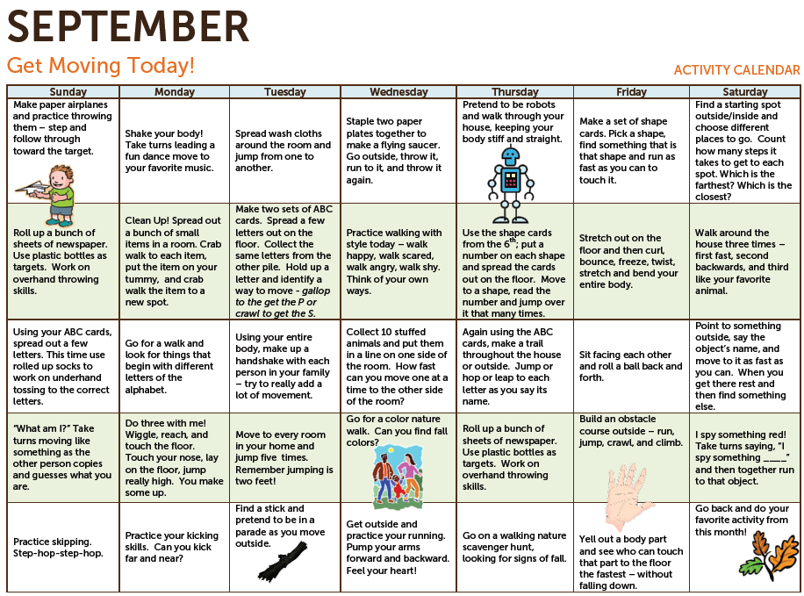
Available in English and Spanish
Notes:
Suggested talking points:
This is the Head Start Body Start Activity Calendar. In this calendar, you will find a new activity for each day. You can use this in your program for physical activity ideas or give it to parents to encourage them to be active with their children at home.

Slide 34
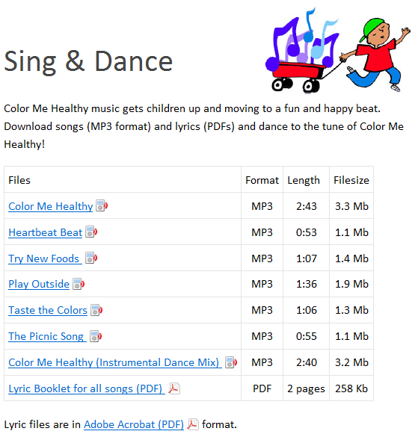
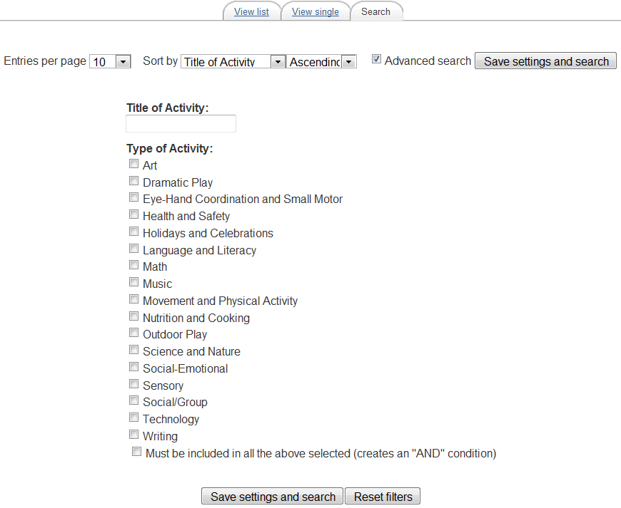
Activity sheets
eXtension Alliance for Better Child Care Hands-on Activities Database
Songs to get kids dancing
Notes:
Suggested talking points:
You can find songs that you can download for free. You can turn on these songs and dance with kids to get them moving.
Also, you can find a link to the eXtension Alliance for Better Child Care Hands-on Activities Database, which allows you to search for different types of nutrition and movement activities.

Slide 35
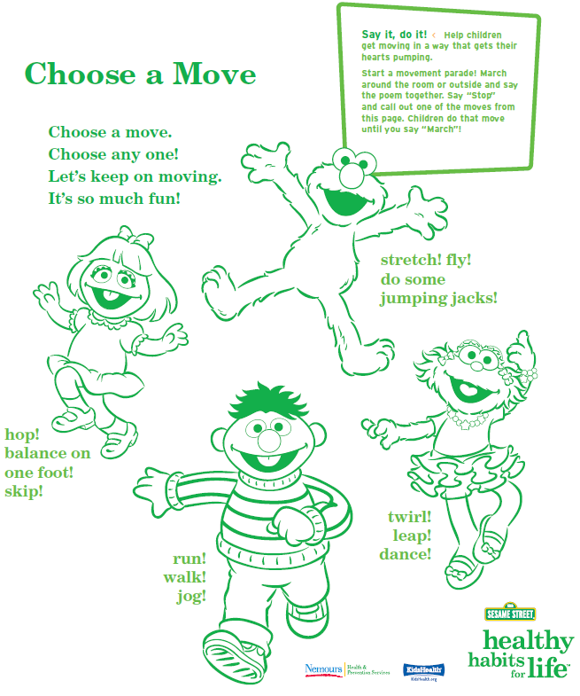
Nutrition & Physical Activity Curriculum (with DVD)
Available in English and Spanish
Notes:
Suggested talking points:
In this nutrition and physical activity curriculum, you will find:
easy-to-use, fun lessons and activities that will fit in with your existing routines;
ways to establish a connection with children’s families so that children continue to practice healthy habits at home.
This curriculum is available in English and Spanish.
Notes for trainer:
If you would like to talk more about the curriculum, please find background info on the curriculum below. Please note that this language was lifted from the curriculum.
What providers will learn
In order to teach the basic concepts of nutrition and physical fitness to the children in your care, this kit will:
offer information about nutrition and physical activity for young children,
help you to use this knowledge in your group setting, and
present you with exciting options for improving nutrition and increasing physical activity during the course of your day.
What children will learn
Because the greatest learning takes place in an atmosphere of fun, this kit, featuring the Sesame Street friends, is designed to provide an entertaining environment in which children will:
understand the health benefits of eating well and playing actively,
be able to name some healthy foods,
be more likely to try new foods, especially fruits and vegetables,
take part in a variety of physical activities, and
be able to explore at home the lessons they learned in your program.
It’s easy to use. This kit is designed to be used throughout the day and to easily fit into your daily routine. The activities don’t require a lot of time or preparation, and they’re versatile. You’ll find activities for large and small groups, indoor and outdoor learning, and
active and quiet play. Choose the activities that work best for your group.
Section 1, Get Moving! focuses on physical activity and how it builds strong, healthy bodies.
Section 2, Food and Drink to Grow On, highlights ways we can make healthy food choices.
Section 3, Every Day Is a Healthy Day builds upon the first two sections to help children remember what they’ve learned – and celebrate their new knowledge.

Slide 36
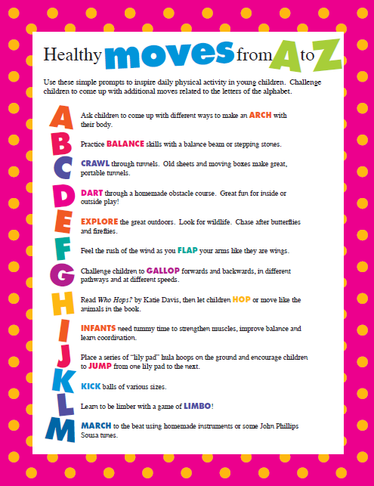
Tip Sheets & Handouts
Notes:
Suggested talking points:
You can find a number of simple tip sheets and handouts like Healthy Moves from A to Z (as shown here on the left) and Non-Competitive & Active Games for Preschoolers (as shown on the right).

Slide 37
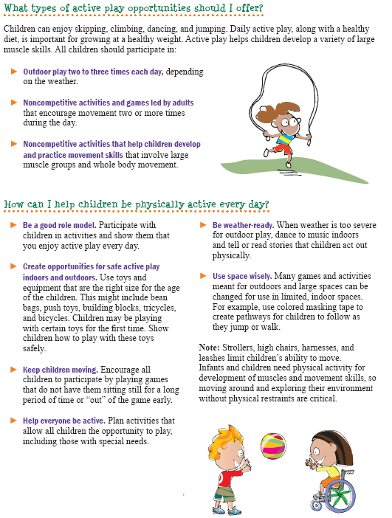
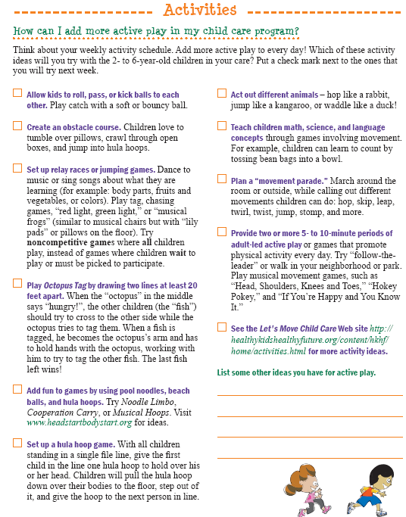
Download the Handbook at: www.teamnutrition.usda.gov
Notes:
Suggested talking points:
This resource is valuable for all providers to use when planning meals and activities for preschool-age children 2 through 5 years old, regardless of participation in CACFP. It’s full of ideas and tips that can help you make changes and meet the Let’s Move! Child Care goals to help kids grow up healthy.
The Handbook makes it easy!
In the Provider Handbook, you will find:
Activities for hands-on learning
Suggestions for active play
Success stories from providers. Learn from others – success stories will show you new and exciting ways child care programs have met the wellness challenge.
Links to additional resources
Structure of Active Play Tip Sheets.
Answers the questions:
Why is this important?
What does this mean?
What should I do?
How can I encourage physical activity?
How do I put this information into practice in my child care program?
The Handbook also includes:
Ideas for meal planning, shopping, and food preparation
Tips for creative menus
Hints for meeting meal pattern requirements (if you participate in the CACFP, also known as the ‘Food Program’)
Ways to serve foods safely
Download the Handbook from the USDA Resource Library at:
www.teamnutrition.usda.gov (The direct link is: http://teamnutrition.usda.gov/Resources/nutritionandwellness.html)

Slide 38
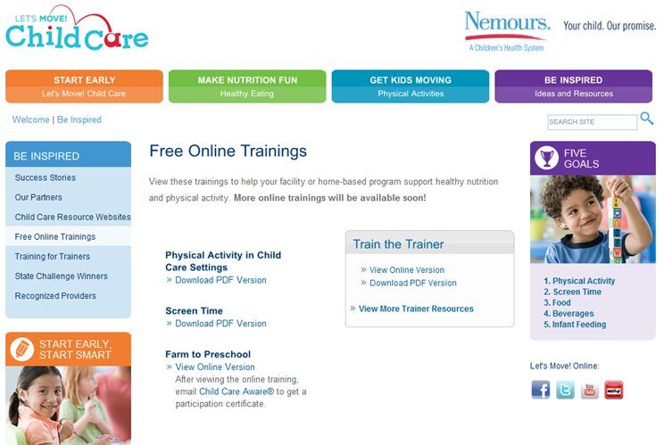
View Free Online Trainings
More trainings coming soon!
Notes:
Suggested talking points:
Webinars/online trainings are archived on the ‘Free Online Trainings’ page.

Slide 39
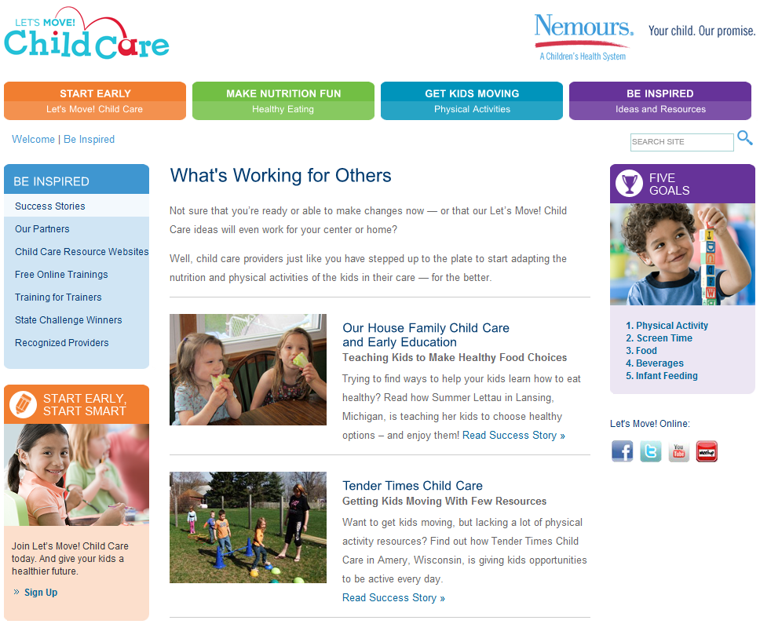
See What’s Working for Others!
Notes:
Suggested talking points:
LMCC highlights success stories of providers who are promoting nutrition and physical activity in their programs. By reading these stories, you can find out what’s working for others and get tips and ideas.
You can send LMCC your success stories by using the online form on this page. LMCC reads every story and contacts providers who are selected to be featured. This is a great way for you to be recognized for outstanding efforts and inspire others to make healthy changes in their programs! Note: You don’t need to be meeting all of the goals to be showcased for making improvements.

Slide 40
Activity Break
Get on your feet for a fun activity!
(that can be used with kids too!)
Notes:
Notes for trainer:
Use this slide to introduce the activity story in the next slide or another activity that you plan. Emphasize that the activity is an example of how to fit physical activity into daily lessons.

Slide 41
Action Story New Fruits and Veggies at the Market
Notes:
Notes for trainer:
Read this story. When you read the actions highlighted in red, have providers act out those actions.

Slide 42
What’s your next step?
Write down action steps you can
take to give kids opportunities to be active every day!
Notes:
Notes for trainer:
At the end of the session, pass out pieces of paper or note cards and pens.
Encourage providers to write down 1 to 3 action steps they will take when they go back to their programs.
Ask for volunteers to share what they wrote with the larger group.
By identifying clear action steps, providers will be ready to make changes when they return to their programs.

Slide 43
Join LMCC & Stay Connected
For more information and to sign up, visit: www.HealthyKidsHealthyFuture.org
Contact the Let’s Move! Child Care Help Desk
LMCCHelp@cdc.gov
Share your success stories!
www.healthykidshealthyfuture.org/home/resources/success.html
Notes:
Suggested talking points:
By signing up, you will get LMCC newsletters with new resources, tips, and the latest updates.
If you have any questions about LMCC, email LMCC at LMCCHelp@cdc.gov.
Notes for trainers:
We’d love to hear your success story too! To share your story, go to www.healthykidshealthyfuture.org/home/resources/success.html and fill out the online form.

