Slide 1
serve healthy food
Notes:
Notes for trainer:
This slide set offers child care and early education providers an in-depth look at LMCC Goal 3: Serve Healthy Food.
You can use these slides to train providers. Hold a training on LMCC or integrate LMCC content into existing or new trainings, including in-person and online trainings.
Please feel free to adapt the slides for specific needs and audiences, including adding slides from other LMCC slide sets. For example, use the slides from the ‘Introduction to Let’s Move! Child Care’ slide set to show providers how to participate in LMCC.
We have included some interactive activities in this module to keep providers engaged and promote learning. Consider including more!
Consider adding additional slides that give information on local resources, training opportunities, and contacts for technical assistance.
For questions, please email LMCCHelp@cdc.gov.

Slide 2
Learning Objectives
Understand Let’s Move! Child Care Goals and best practices for food
Know the benefits of offering healthy food
Get strategies and ideas to encourage healthy eating
Learn about the resources and tips available on the Let’s Move! Child Care website: www.HealthyKidsHealthyFuture.org

Slide 3
Benefits of Healthy Food
Helps children stay at a healthy weight
Opportunity to teach kids’ taste buds to appreciate healthy foods. Food preferences develop at an early age, even in infancy.
Notes:
Suggested talking points:
Infants should not be introduced to complimentary foods until about 6 months of age.

Slide 4
Food Best Practice #1
Serve toddlers and preschoolers a fruit and/or a vegetable at every meal
Remember, juice doesn’t count as fruit, and French fries, tater tots, and hash browns don’t count as vegetables!

Slide 5
Ideas for Serving Fruits & Vegetables
Serve vegetables with yogurt, hummus, or low-fat dressing.
Incorporate veggies into other things, like pasta sauce.
Take turns choosing a recipe with fruits or vegetables and prepare that dish.
Serve fruit as a naturally sweet dessert.

Slide 6
Get Kids Interested in Fruits & Vegetables
Highlight a fruit/vegetable of the month
Add it to the menu.
Read books about it.
Incorporate it into learning, art projects, and physical activities.

Slide 7
Do Taste Tests
As an activity, let kids taste fruits and veggies.
Try some that might be new to kids like squash, kale, or kiwi.

Slide 8
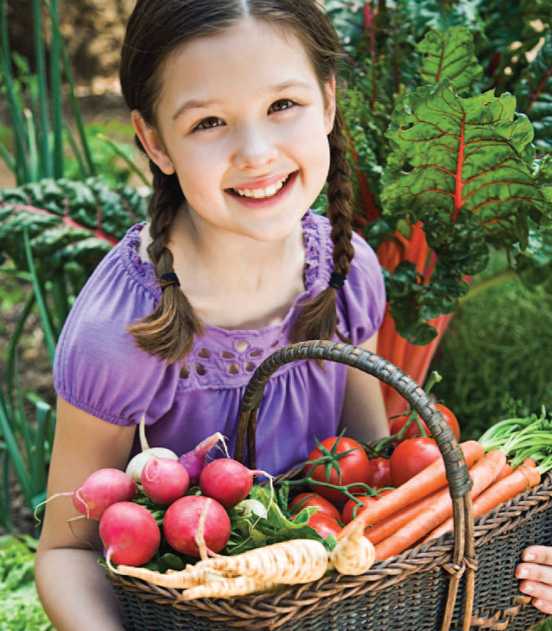
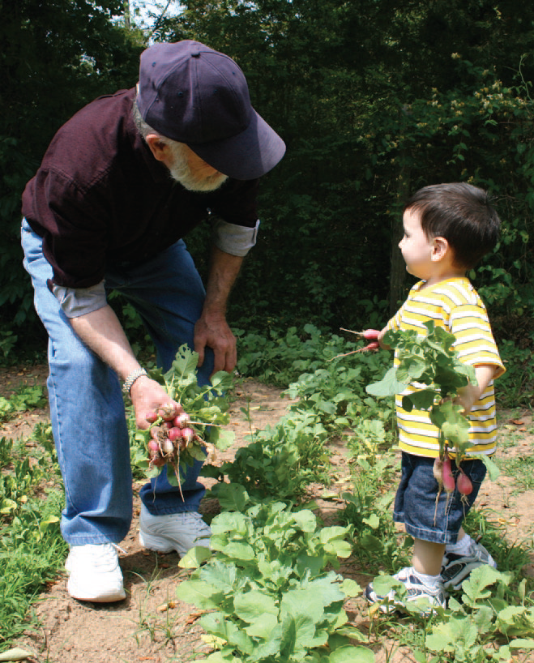
Learn about How Food Grows
Take field trips to local farms and farmers markets.
Plant your own garden and let kids help.

Slide 9
Food Best Practices #2 - 3
Offer toddlers and preschoolers French fries, tater tots, hash browns, potato chips, or other fried or pre-fried potatoes no more than once a month
Offer toddlers and preschoolers chicken nuggets, fish sticks, and other fried or pre-fried forms of frozen and breaded meats or fish no more than once a month

Slide 10
What do we mean by “fried” or “pre-fried”?
Fried: any meat, fish, poultry, potato or other vegetables that you or your vendor cooks by covering or submerging in oil, shortening, lard, or other animal fat.
Pre-fried: any meat, fish, poultry, potato or other vegetable that you or your vendor buys already fried—even if you prepare it in the microwave or oven.

Slide 11
What are some examples of “fried” or “pre-fried” foods?
Pre-fried meats:
Chicken nuggets
Chicken patties
Fried fish fillets
Fish sticks
Popcorn shrimp
Fried or pre-fried vegetables:
French fries and Crinkle-cut fries
Tater tots
Hash browns
Onion rings and onion straws
Fried okra

Slide 12
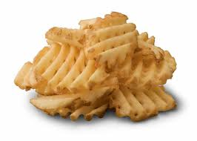
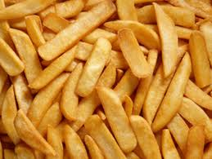
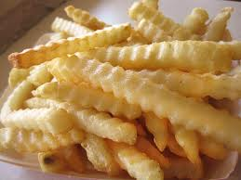
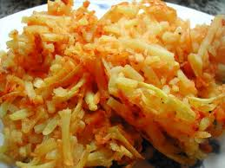
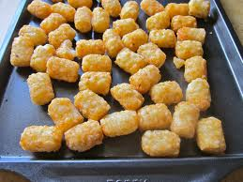
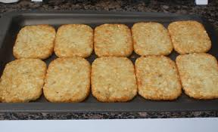
Watch out for pre-fried potatoes!
Some frozen potatoes are pre-fried (like French fries, hash browns, and tater tots). Even when you bake these foods to finish cooking or reheat them, they are still fried.

Slide 13
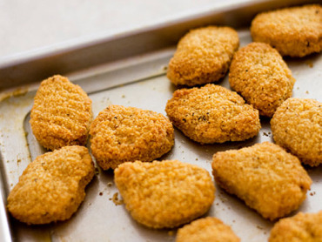
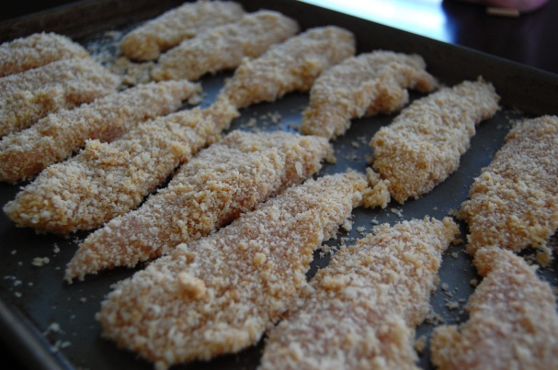
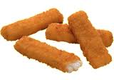
Watch out for pre-fried meats and fish!
Some frozen meats and fish (like chicken nuggets and fish sticks) are pre-fried too.
If a package says that the food is “crunchy”, “crispy”, “battered”, or “breaded”, it might be fried or pre-fried!

Slide 14
Check the Nutrition Facts to figure out if foods are pre-fried
Common ingredients in pre-fried foods:
Oil (partially hydrogenated soybean oil, vegetable oil, canola oil, soybean oil, cottonseed oil, sunflower oil, corn oil)
Corn starch or wheat starch
Bread crumbs
Bleached wheat flour or yellow corn flour

Slide 15
Ways to Reduce or Eliminate Fried Foods
Offer healthier alternatives
Instead of | Try
fries | potatoes sliced and baked
potato chips | baked vegetable chips
chicken nuggets | baked chicken

Slide 16
Ways to Reduce or Eliminate Fried Foods (2)
Work with your food vendor to find healthier alternatives.
Work with parents to help them pack healthy lunches that do not include fried or pre-fried foods.

Slide 17
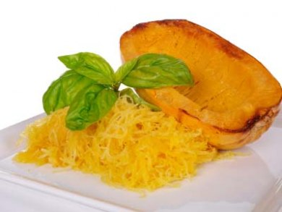
Activity: Food Moves!
Move like different foods
Melt like a popsicle
Pop like popcorn
Wiggle like spaghetti
Notes:
Notes for trainer:
Try this ‘Food Moves!’ activity with providers. Get them to stand up and move like different foods! This is an activity that they can take back to their programs and do with their children.

Slide 18
Food Best Practice #4
Serve all meals to preschoolers family style so that children are encouraged to serve themselves with limited help.

Slide 19
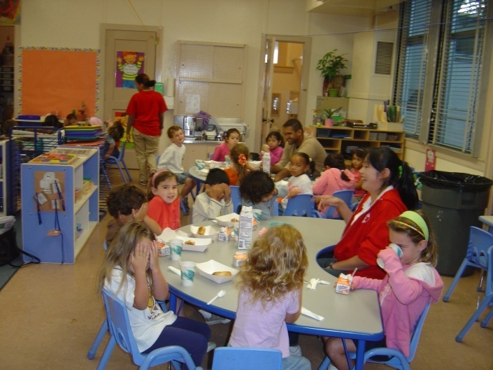
Basics about Family Style Dining
Children serve themselves with limited help.
Adults talk with children about the foods they’re eating.
Adults sit at the table and eat the same foods.
Role model healthy eating.
Prevent fighting, feeding each other, choking, etc.

Slide 20
Benefits of Family Style Dining
Improves self-feeding skills and recognition of hunger cues
Supports social, emotional, and motor skill development
Children learn about the foods they’re eating and are more likely to enjoy and eat healthy food.
Language skills improve as adults and children talk with each other.
Creates an opportunity for positive role modeling

Slide 21
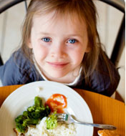
Ways to Make Family Style Dining Work
Let kids practice serving themselves first.
Use play food, like plastic fruits and veggies.
Use the right equipment.
Use child size pitchers, tongs, and serving bowls and plates.
Put dressings and dips in child size squeeze bottles.
Be prepared for spills!
Show kids you enjoy eating healthy foods. They will follow your example!
Notes:
Suggested talking points:
Be prepared for spills. Mistakes will happen so have paper towels within reach!

Slide 22
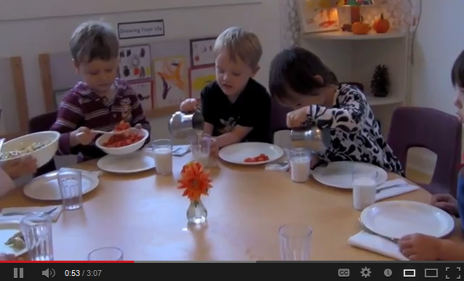
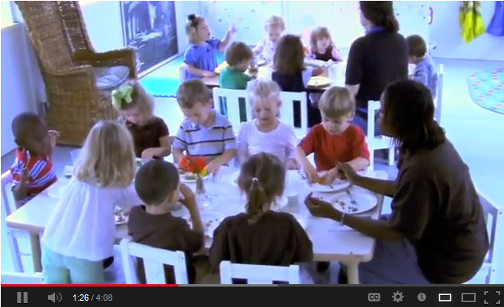
Video: Starting Family Style Dining
Part 1
Part 2
Notes:
Suggested talking points:
On the LMCC website, you can find two short videos on starting family style dining.
Starting Family Style Dining - Part 1: one program shares what it has learned about family style dining and how to make it a success
Starting Family Style Dining - Part 2: learn tips to help you switch to family style dining in your program
Notes for trainer:
Play these videos during your training session. Part 1 is ~3 min. Part 2 is ~4 min.
NOTE: The images on the slide are ONLY images, not videos.
If you will have internet during your training session, click on ‘Part 1’ and ‘Part 2’ to play the videos.
If you will not have internet during your training session, try embedding the videos in your presentation. You can find the videos at:
Part 1: www.youtube.com/watch?v=aRBzCMGzSvs
Part 2: www.youtube.com/watch?v=Fs0apIAsIpk&feature=relmfu

Slide 23
More Healthy Eating Tips
Mix it up—serve a variety of nutritious choices.
Don’t use food as a reward or punishment.
Avoid forcing children to finish the “healthy foods” to get to their dessert or sweets.
Talk about “sometime” vs. “anytime” foods or ‘Go’, ‘Slow’, and ‘Whoa’ foods.

Slide 24
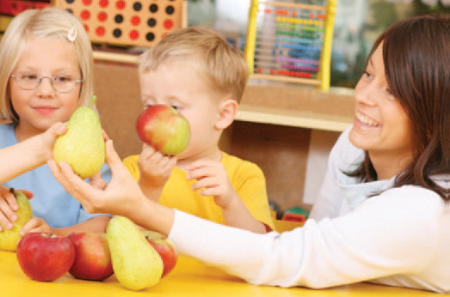
Reinforce nutrition messages with classroom activities
Teach kids about colors and textures by letting them see and touch fruits and veggies.
Read books about healthy foods.
Notes:
Suggested talking points:
The Two Bite Club is an educational storybook developed to introduce MyPlate to young children. Parents or caregivers read the book to children and encourage them to try foods from each food group by eating just two bites, just like the characters in the story. The back of the book contains a MyPlate coloring page, a blank certificate for the Two Bite Club, fun activity pages for kids, and Tips for Growing Healthy Eaters.
You can find a link to the book on the LMCC website.
Note for trainers:
The direct link is: http://teamnutrition.usda.gov/Resources/2biteclub.html. Providers can download a free pdf of the book.

Slide 25
Preplan meals
Add healthy dishes that children enjoy to the menu.
Try oatmeal with cinnamon and yogurt with granola and bananas.
Buy healthier alternatives.
Many healthy options cost the same as the not-so-healthy choices (like whole wheat bread vs. white bread).
Notes:
Suggested talking points:
If possible, try working with a nutritionist from a local health department or Cooperative Extension office.

Slide 26
Challenge: Unhealthy birthday & holiday treats
Focus on fun activities!
Make a special shirt or hat for the birthday child.
Let the birthday child choose a book or song for everyone to enjoy.
If including food as part of the party, give parents acceptable, healthy options to bring instead of cupcakes and candy. A policy helps!
Notes:
Suggested talking points:
Parties can be fun without unhealthy foods & beverages.
Although some parents might initially resist a change in what’s acceptable food/beverages for parties and celebrations, many will get on board if the idea is presented to them in a way that focuses on how the new policy can be helpful to them. For example, if you move to a fun activity, it can save parents time and money since they won’t have to bring in special treats.

Slide 27
Challenge: Picky Eaters
Include established favorites and some new foods on the menu.
Let children help prepare meals and snacks.
Stirring and adding ingredients make kids feel "big” and proud of what they created.
Kids like to try their food creations.
Kids do as you do. Set a good example!
Hang in there! It may take 10 to 15 tries before children accept a new food.

Slide 28
Challenge: Buying Healthy Foods from Vendors
Reach out to your vendor to see what healthier alternatives they have or might be willing to start offering.
Eliminate unhealthy foods from your regular order or try purchasing these foods less often.
Plan a menu and work with your vendor to get healthy options.

Slide 29
Challenge: Buying Healthy Foods from Vendors (2)
Consider partnering with other providers to have more influence over what vendors offer or to stretch your dollars for healthy foods (for example, procurement cooperative).
If options are limited, try purchasing some foods at local wholesale stores or grocery stores.
Find a new vendor that offers healthier food options.
See if there’s a central kitchen in your area.
Notes:
Suggested talking points:
Band together with other providers in your community who are using the same vendor. Combined you will have more influence.
Notes for trainer:
A centralized kitchen model is one in which all of the cooking activities of a particular location are concentrated within one large kitchen to achieve economies of scale.

Slide 30
Food Best Practices in Review
Toddlers and preschoolers
Serve a fruit and/or a vegetable at every meal (Juice doesn’t count as fruit, and French fries, tater tots, and hash browns don’t count as vegetables!)
Limit French fries, tater tots, hash browns, potato chips, or other fried or pre-fried potatoes to no more than once a month
Limit chicken nuggets, fish sticks, and other fried or pre-fried frozen and breaded meats or fish no more than once a month
Preschoolers: Serve all meals family style so that children are encouraged to serve themselves with limited help.
Notes:
Suggested talking points:
Offering healthy food is important, particularly because many children eat most of their daily meals and snacks while in care, especially children in full-time care.

Slide 31
Finding resources and tips

Slide 32
USDA’s Child and Adult Care Food Program (CACFP)
Save money and serve healthier meals with CACFP (commonly known as ‘the food program’)
This federal program provides aid to early education and child care centers and homes for serving nutritious meals and snacks to young children
To learn more about CACFP and contact your State agency to see if your program is eligible to participate, visit www.fns.usda.gov/cacfp/child-and-adult-care-food-program-cacfp
Notes:
Suggested talking points:
You can find information about CACFP.
You can save money and serve healthier meals with CACFP . Commonly known as ‘the food program’, CACFP provides aid to early education and child care programs for serving nutritious foods to young children. To learn more about CACFP and contact your State agency to see if your program is eligible to participate, visit www.fns.usda.gov/cacfp/child-and-adult-care-food-program-cacfp.
Notes for trainers:
CACFP provides aid to child and adult care institutions and family or group day care homes for the provision of nutritious foods that contribute to the wellness, healthy growth, and development of young children, and the health and wellness of older adults and chronically impaired disabled persons.
CACFP is a reimbursement program administered by State agencies or sponsoring organizations.
Through CACFP, more than 3.3 million children and 120,000 adults receive nutritious meals and snacks each day as part of the day care they receive.

Slide 33
Join LMCC & Stay Connected
For more information and to sign up, visit: www.HealthyKidsHealthyFuture.org
Contact the Let’s Move! Child Care Help Desk
LMCCHelp@cdc.gov
Share your success stories!
www.healthykidshealthyfuture.org/home/resources/success.html
Notes:
Suggested talking points:
By signing up, you will get LMCC newsletters with new resources, tips, and the latest updates.
If you have any questions about LMCC, email LMCC at LMCCHelp@cdc.gov.
Notes for trainers:
We’d love to hear your success story too! To share your story, go to www.healthykidshealthyfuture.org/home/resources/success.html and fill out the online form.

